Slide 1
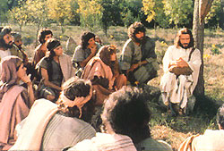
The Obedient Family of God
3rd Sunday of Messri 1728/2012

Slide 2
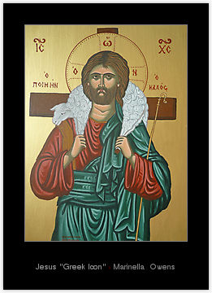
1. Obedience or divisions?
Now I urge you, brethren, note those who cause divisions and offenses, contrary to the doctrine which you learned, and avoid them. For those who are such do not serve our Lord Jesus Christ, but their own belly, and by smooth words and flattering speech deceive the hearts of the simple. For your obedience has become known to all. Therefore I am glad on your behalf; but I want you to be wise in what is good, and simple concerning evil. And the God of peace will crush Satan under your feet shortly. Rom 16:17-19

Slide 3
2. Obedience to the harsh
Servants, be submissive to your masters with all fear, not only to the good and gentle, but also to the harsh. For this is commendable, if because of conscience toward God one endures grief, suffering wrongfully. For what credit is it if, when you are beaten for your faults, you take it patiently? But when you do good and suffer, if you take it patiently, this is commendable before God. For to this you were called, because Christ also suffered for us, leaving us an example, that you should follow His steps: "Who committed no sin, Nor was deceit found in His mouth"; who, when He was reviled, did not revile in return; when He suffered, He did not threaten, but committed Himself to Him who judges righteously;

Slide 4
3. Obedience likewise..
Wives, likewise, be submissive to your own husbands, that even if some do not obey the word, they, without a word, may be won by the conduct of their wives, when they observe your chaste conduct accompanied by fear……
Husbands, likewise, dwell with them with understanding, giving honor to the wife, as to the weaker vessel, and as being heirs together of the grace of life, that your prayers may not be hindered.

Slide 5
4. Obedience to Death
Now when we heard these things, both we and those from that place pleaded with him not to go up to Jerusalem. Then Paul answered, "What do you mean by weeping and breaking my heart? For I am ready not only to be bound, but also to die at Jerusalem for the name of the Lord Jesus." So when he would not be persuaded, we ceased, saying, "The will of the Lord be done."

Slide 6
Saint John Climacus
”He who follows his own ideas in opposition to the direction of his superiors needs no devil to tempt him, for he is a devil to himself.”

Slide 7
5. The victory and joy of obedience
When the wicked came against me To eat up my flesh, My enemies and foes, They stumbled and fell. And now my head shall be lifted up above my enemies all around me; Therefore I will offer sacrifices of joy in His tabernacle; I will sing, yes, I will sing praises to the LORD.

Slide 8
6. The Obedient Family of God
Then His brothers and His mother came, and standing outside they sent to Him, calling Him. And a multitude was sitting around Him; and they said to Him, "Look, Your mother and Your brothers are outside seeking You." But He answered them, saying, "Who is My mother, or My brothers?" And He looked around in a circle at those who sat about Him, and said, "Here are My mother and My brothers! For whoever does the will of God is My brother and My sister and mother.”

