Slide 1
Setting Boundaries

Slide 2
Boundaries
are the realization of our own person apart from others

Slide 3
When we are over-responsible for others, we can’t take responsibility for our own life.

Slide 4
People who are unable to set boundaries allow themselves to be repeatedly controlled and even injured by others.

Slide 5
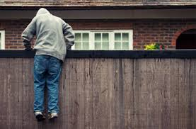
The essence of boundaries is where I end and
someone else begins

Slide 6
The HolyTrinity
Just as unity is the most basic quality God possesses, he has diversity within this unity

Slide 7
We are to master the art of “being me without losing you.”

Slide 8
Positive Affirmations of God’s identity
“I am compassionate.” (Ex. 22: 27)
“I am holy.” (Lev. 11: 44)
“I am the first and I am the last.” (Isa. 48: 12)
“I, the Lord, am your Savior.” (Isa. 60: 16)
“I am merciful.” (Jer. 3: 12)

Slide 9
Negative affirmations of God’s identity
“There are six things the Lord hates, seven that are detestable to him: haughty eyes, a lying tongue, hands that shed innocent blood, a heart that devises wicked schemes, feet that are quick to rush into evil, a false witness who pours out lies, and a man who stirs up dissension among brothers” Proverbs 6:16-19

Slide 10
What defines us…..
Our attitudes:
our opinions about or mental positions toward something

Slide 11
What Defines us….
Our Feelings:
Both our physical feelings of pleasure or pain and our emotional feelings are on our property and no one else’s. We are responsible for our own feelings

Slide 12
How do we develop boundaries?

Slide 13
There must be internal bonding for one to be able to establish boundaries.
Without bonding, boundaries as they were meant to be cannot exist.
They are limits without love

Slide 14
When setting boundaries….
Love cannot exist without freedom

Slide 15
Crossing over boundaries

Slide 16
When we take responsibility for others’ feelings we are crossing over their boundaries.

Slide 17
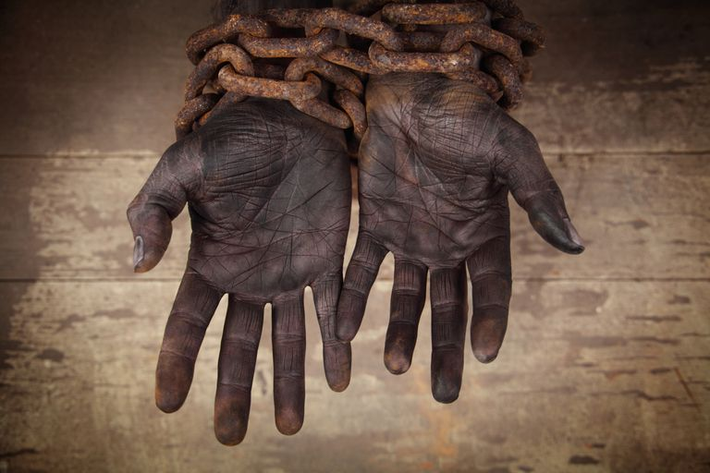
Guilty compliance is never love; it is slavery

Slide 18
Take responsibility of your own feelings
“If your brother sins against you, go and show him his fault, just between the two of you. If he listens to you, you have won your brother over” (Matt. 18: 15).

Slide 19
Causing Guilt to Others
One of the most common ways of taking away people’s choices is through guilt messages.
“ How could you do this to me?”

Slide 20
Manipulation
Intimacy does not thrive where someone is not free to choose separateness without guilt

Slide 21
SKILLS FOR SETTING BOUNDARIES
Gain Awareness
Define Who You Are
Define Who you are not
Develop the “No” muscle
Stop Playing Victim
Become Active, Not Reactive
Set Limits
Be Honest

