Slide 1
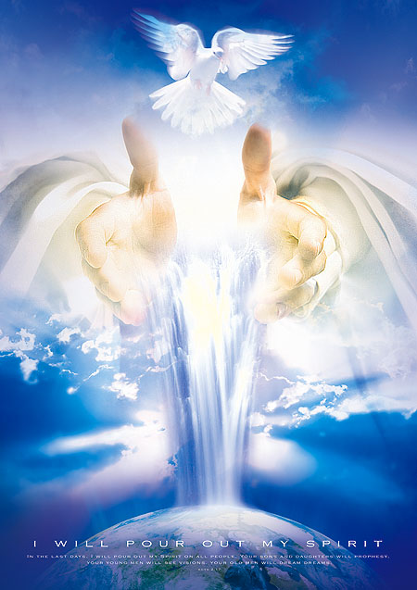
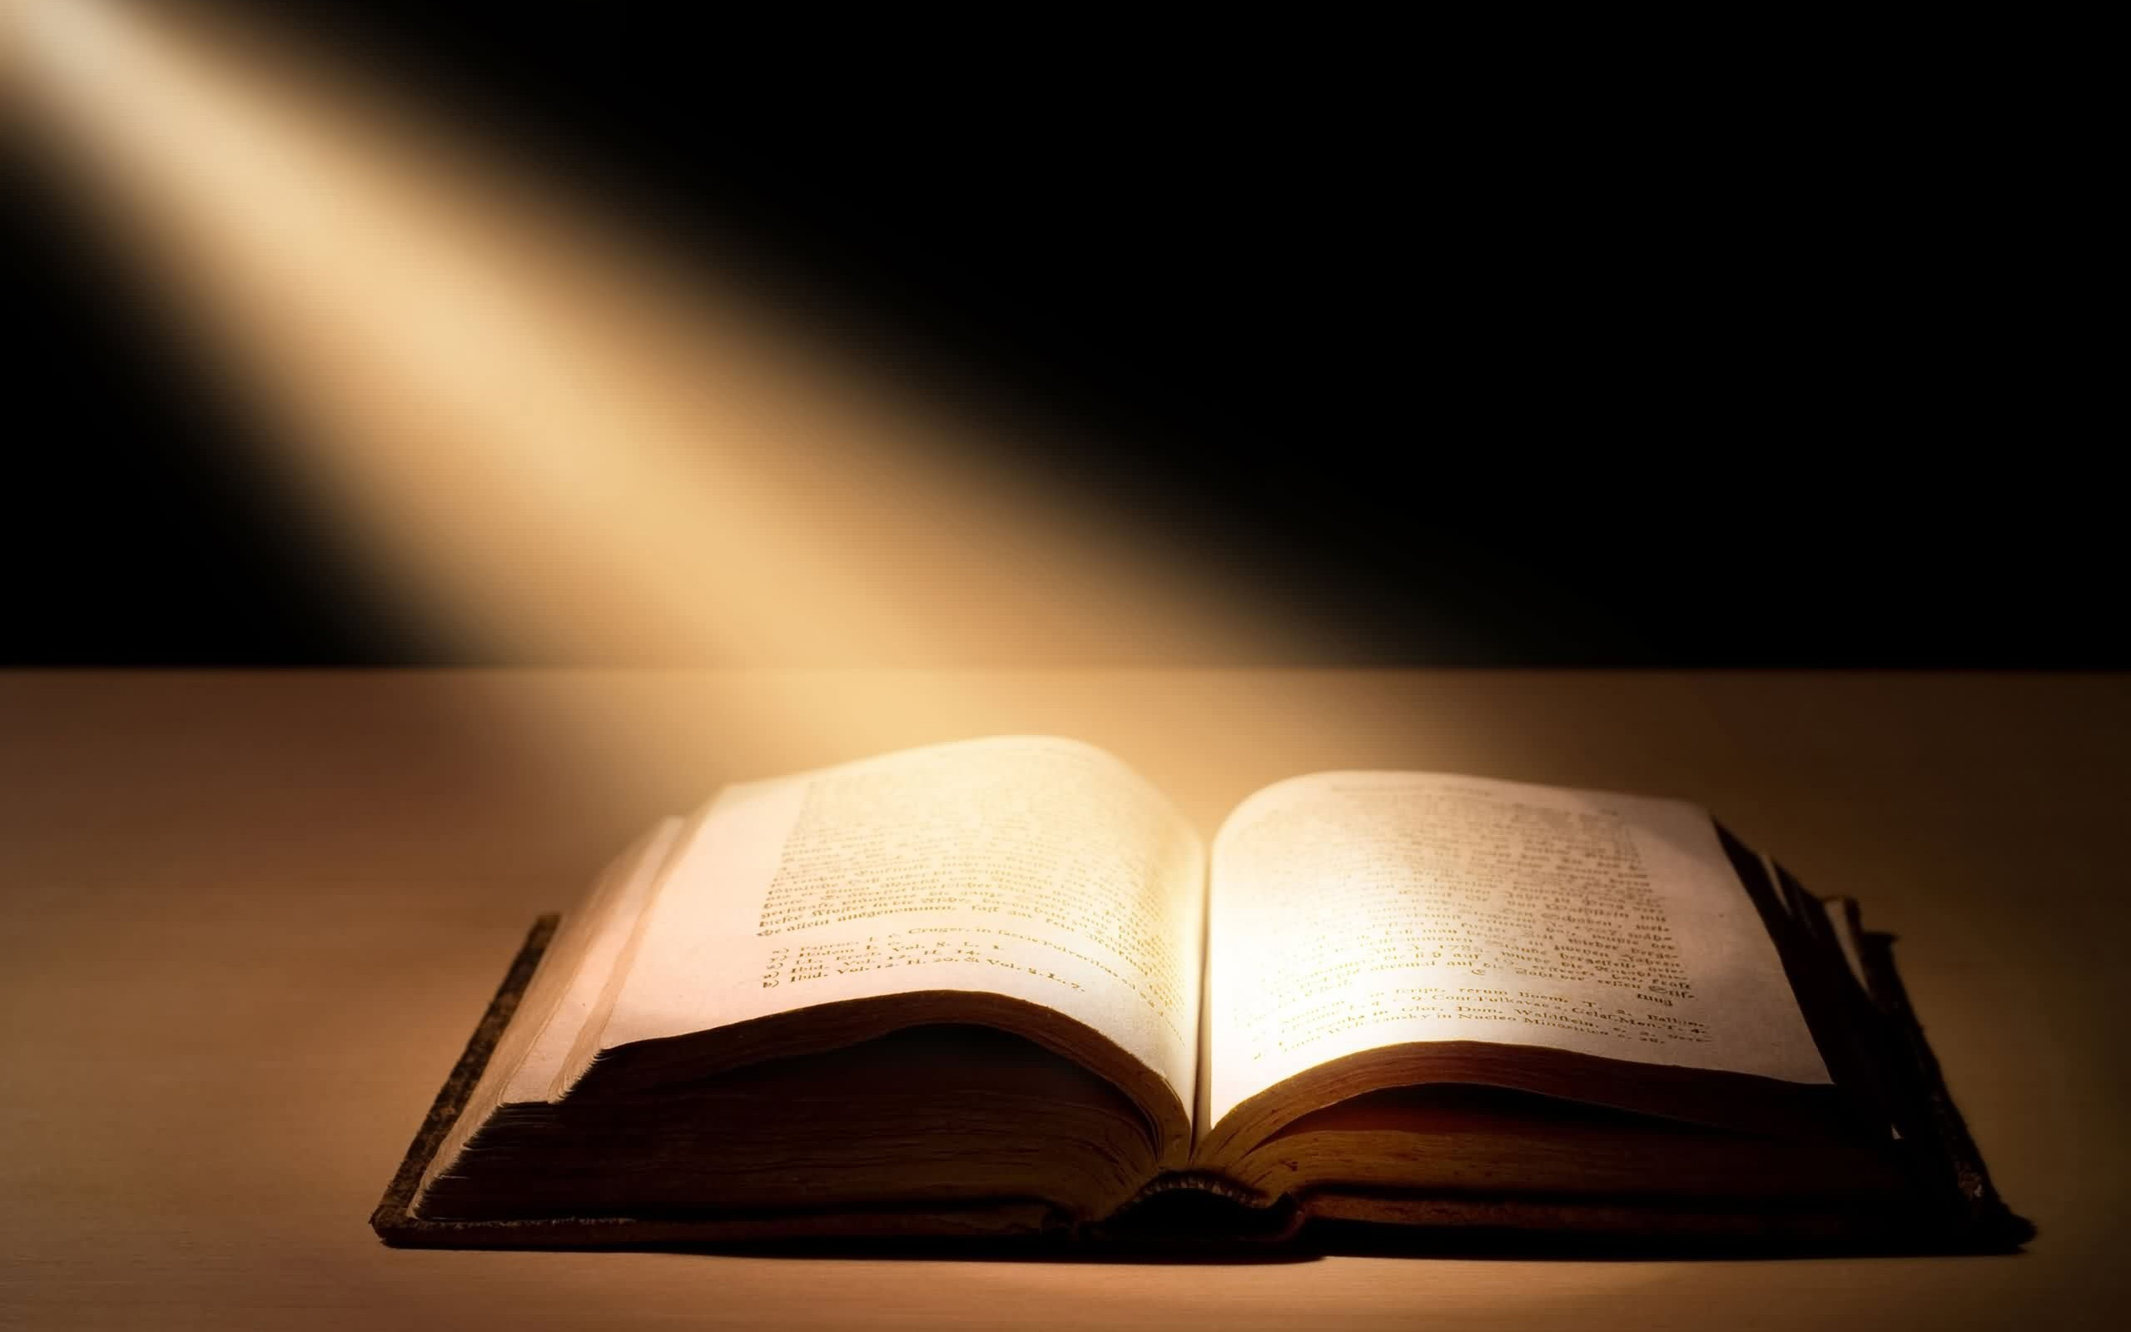
Scriptures and Mysticism
2nd Sunday of Hatour

Slide 2
Light or Darkness
To the law and to the testimony: if they speak not according to this word, it is because there is no light in them. Isa 8:20

Slide 3
Scripture as an aspect of Incarnation
Already in Scripture there is an aspect of incarnation, Scripture embodies the Word, and the incarnation of the Word completes the transformation into Eucharist of the hearing or reading the Word or reading of the Word. It is the Eucharist of the mind …
Olivier Clement, The Roots of Christian Mysticism

Slide 4
The Eucharist of the Mind
We are said to drink the blood of Christ not only when we receive it according to the rite of the mysteries, but also when we receive His Words, in which life dwells, as he said himself: the words that I have spoken to you are spirit and life.
Origen homilies on Numbers 16,9 ( Pg 12,701)

Slide 5
The Eucharist of the Mind
In truth, before Jesus, Scripture was like water, but since Jesus it has become for us the wine into which Jesus changed the water .
Origen Commentary on St John's Gospel 13,60 (CGS 4, 294-5

Slide 6
The revelation
No one has dared to give so pure revelation of the divinity of the Lord as John, we must make bold to say the Gospels are the fulfillment of the Whole Bible and John’s Gospel is the Fulfillment of the Gospels. No one can grasp their meaning unless he has rested on Christ’s breast, unless he has received Mary from Jesus so that she has become his mother too.
Origen Commentary on St John's Gospel 1,6 (CGS 8-9)

Slide 7
The secret dwelling
If you try to reduce the divine meaning to the purely external signification of the words, the Word will have no reason to come down to you. It will return to its secret dwelling. Which is contemplation that is worthy of it. For it has wings, this divine meaning, given to it by the Holy Spirit who is its guide.
Origen Commentary on Proverbs, 23 (PG17, 221-4)

Slide 8
The Fire of the Lord
When a saying of the Lord’s kindles the imagination of a hearer of the Word and makes him captivated of the Wisdom that bursts into flames at the sight of any beauty, then ‘the Fire of the Lord is cone down upon him.
Origen Commentary on Psalm 104,19 ( Pitra, Analecta sacra 3,207)

Slide 9
Humility
If you wish to attain to true knowledge of the Scriptures, hasten to acquire first an unshakable humility of heart. That alone will lead you , not to the true knowledge that puffs up, but to that which enlightens, by the perfection of love.
John Cassian Conferences, XIV, 10 (SC 54, p.194)

