Slide 1
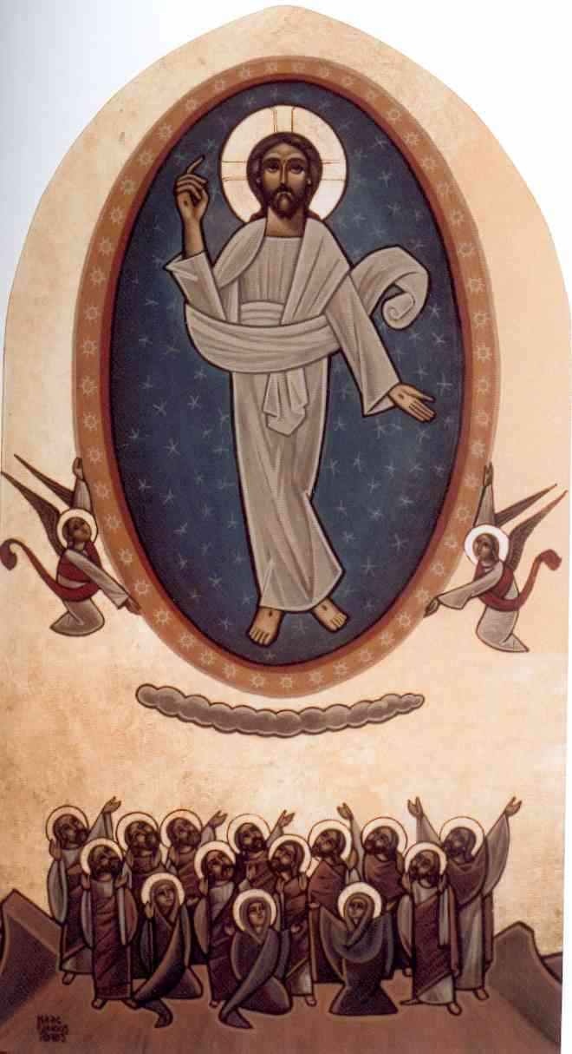
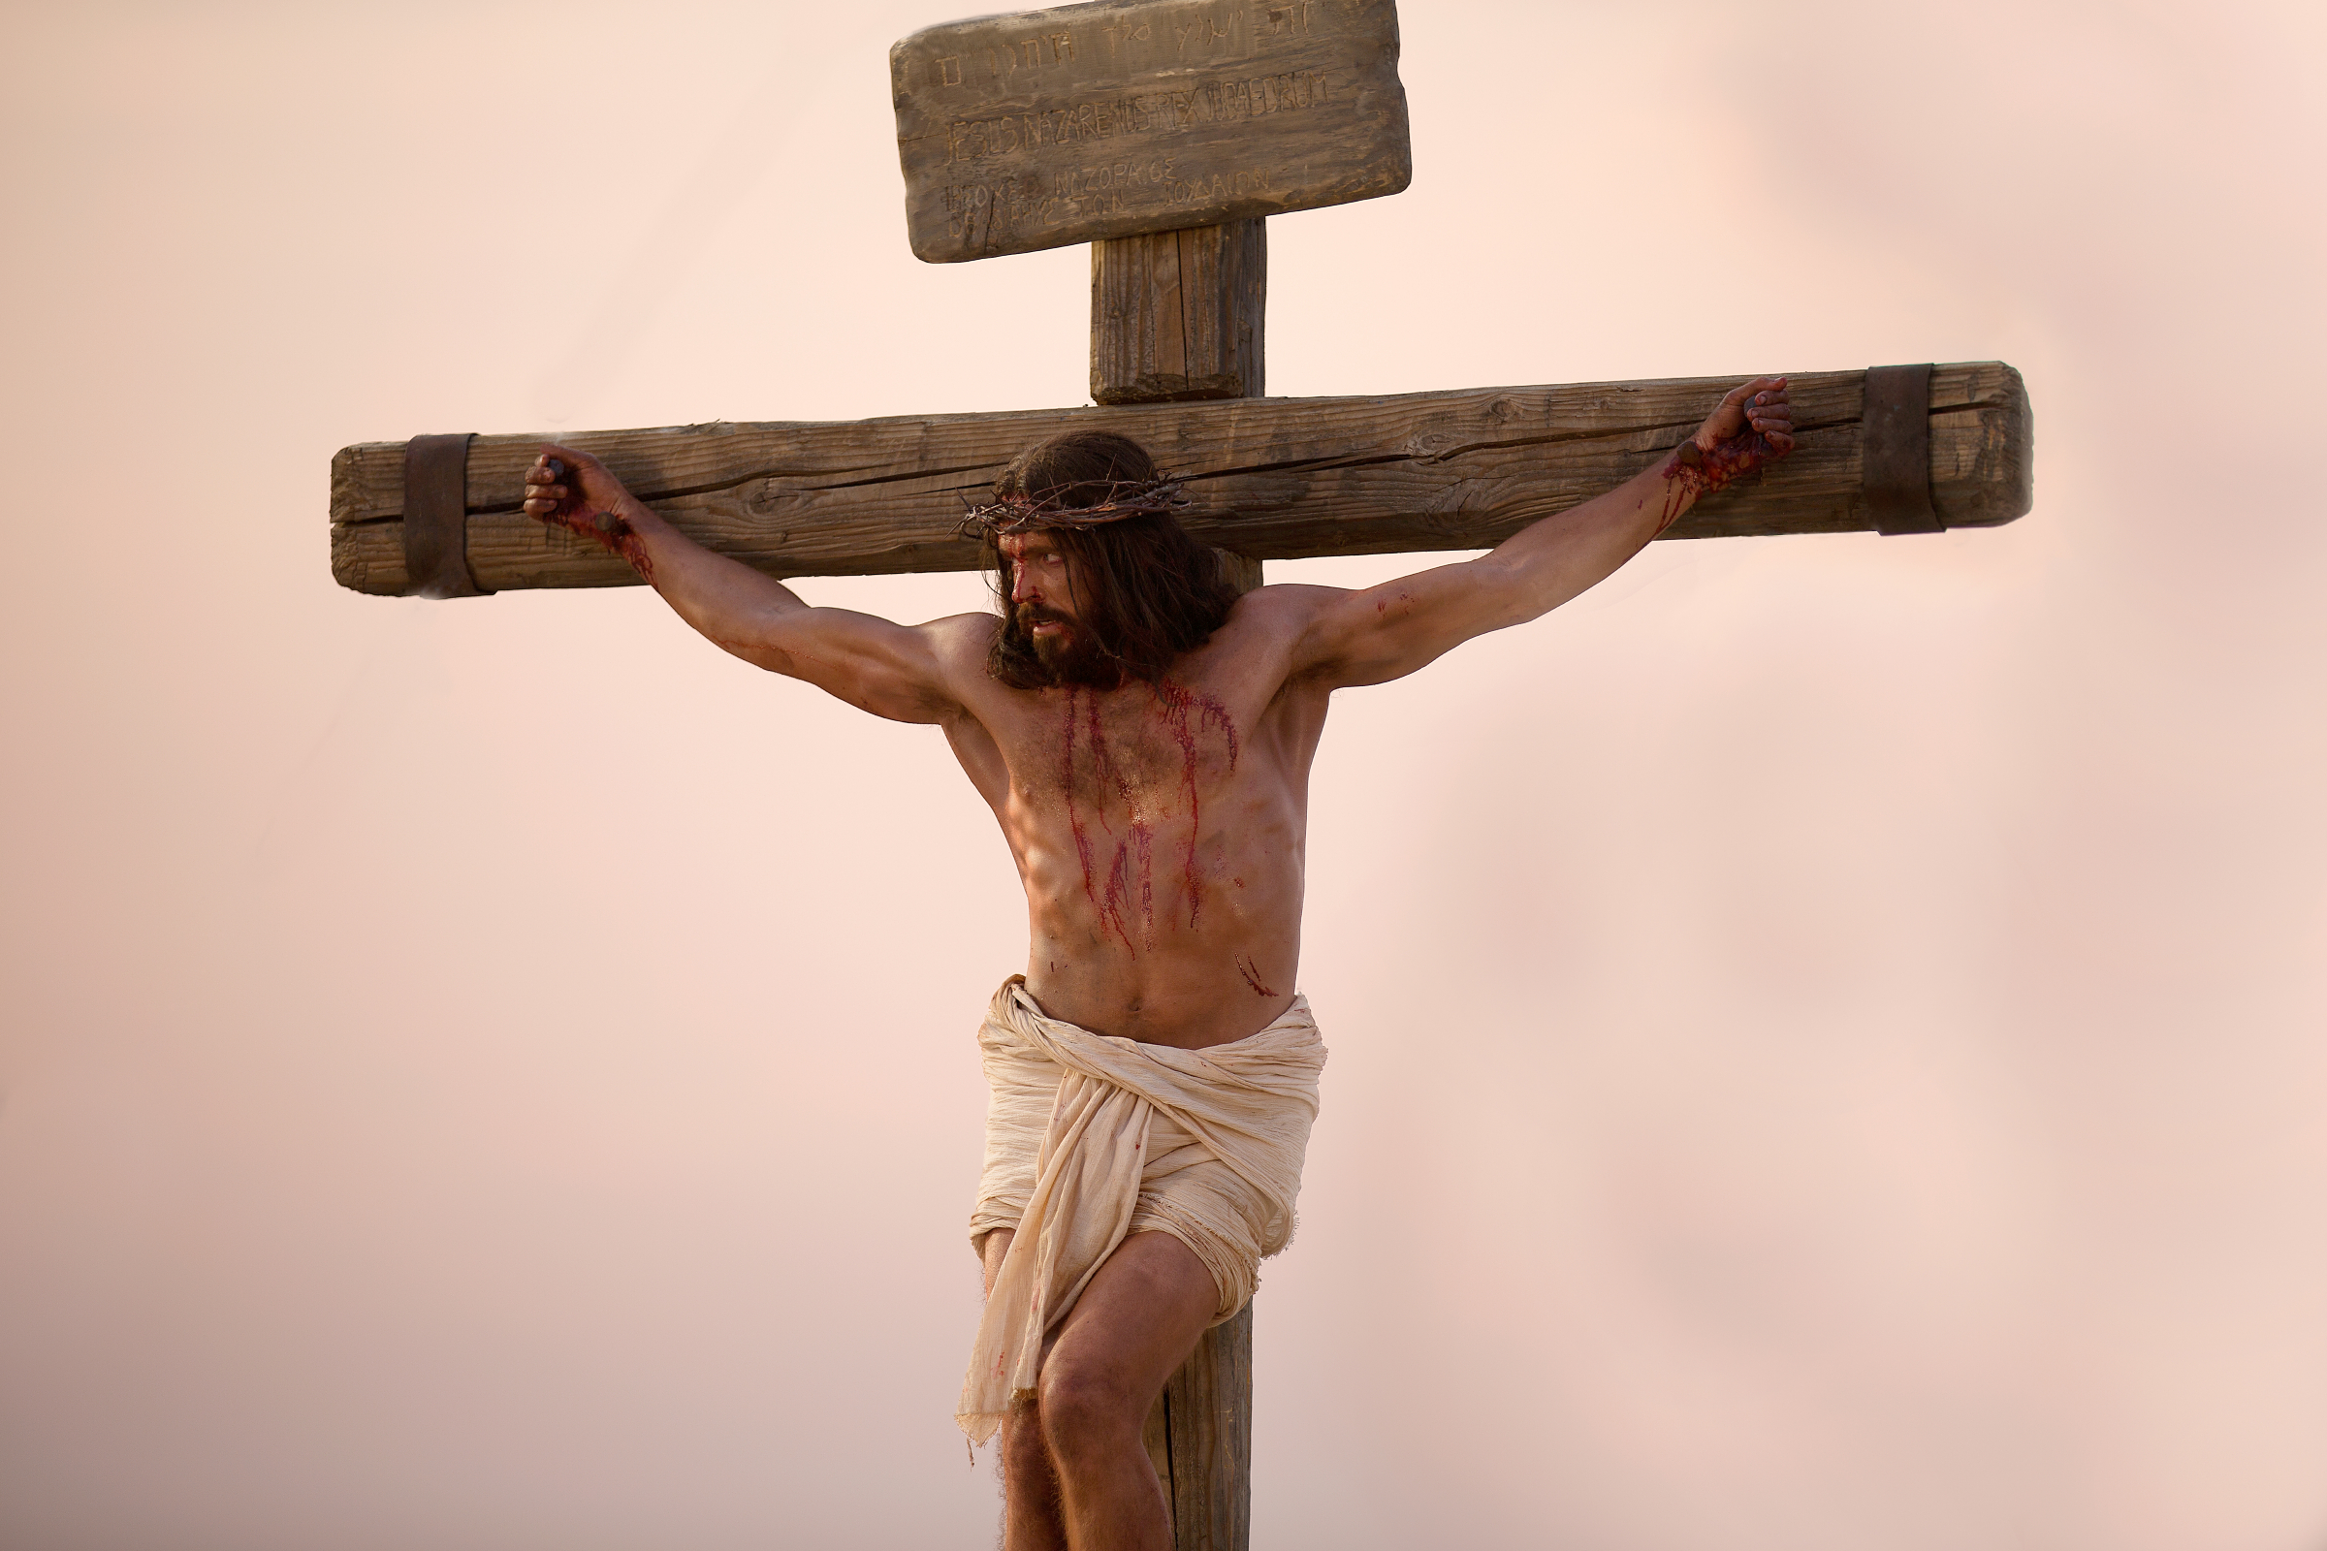
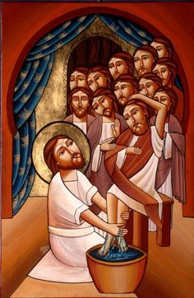
HUMBLE, OBEDIENT AND HIGHLY EXALTED
HIS LIFE IS MINE (1)

Slide 2
HIGHLY EXALTED
⁹ therefore God also has highly exalted Him and given Him the Name which is above every Name, ¹⁰ that at the name of Jesus every knee should bow, of those in heaven, and of those on earth, and of those under the earth, ¹¹ and that every tongue should confess that Jesus Christ is Lord, to the glory of God the Father. Phil 2:9-11

Slide 3
HUMBLE AND OBEDIENT
⁵ let this mind be in you which was also in Christ Jesus, ⁶ who, being in the form of God, did not consider it robbery to be equal with God, ⁷ but made Himself of no reputation, taking the form of a bondservant, and coming in the likeness of men. ⁸ and being found in appearance as a man, he humbled Himself and became obedient to the point of death, even the death of the Cross. Phil 2:2-8

Slide 4
I am exalting myself

Slide 5
He went down to lift us up

Slide 6
“O My Father, if it is possible, let this cup pass from me; nevertheless, not as I will, but as you will.” Matt 26:39

Slide 7
became obedient to the point of death, even the death of the cross.

Slide 8
POSTPONED obedience is a CURRENT disobedience
PARTIAL obedience is TOTAL DISOBEDIENCE

Slide 9
Second Adam
Humble and obedient
Restored Paradise
First Adam
Pride and disobedience
Out of the Paradise

Slide 10
HIGHLY EXALTED

Slide 11
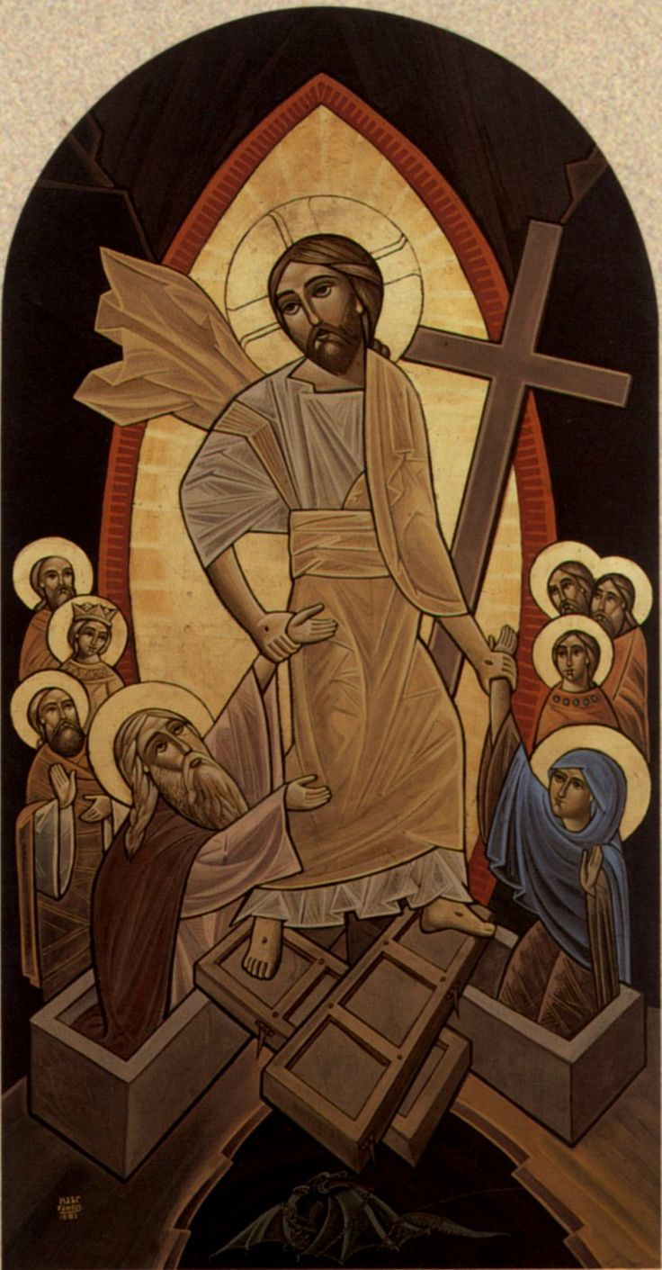
RAISED US WITH HIM

Slide 12
Seated us with Him in the heavenly places

Slide 13
ST. ATHANASIUS THE APOSTOLIC ADV. ARIAN. 1:11: 43.
If the Lord has not become man, we would not be redeemed of sin, we would not be resurrected from the dead, and we would not be raised up to heaven; but we would rather remain dead underneath the earth, and laid in hell.

