Slide 1
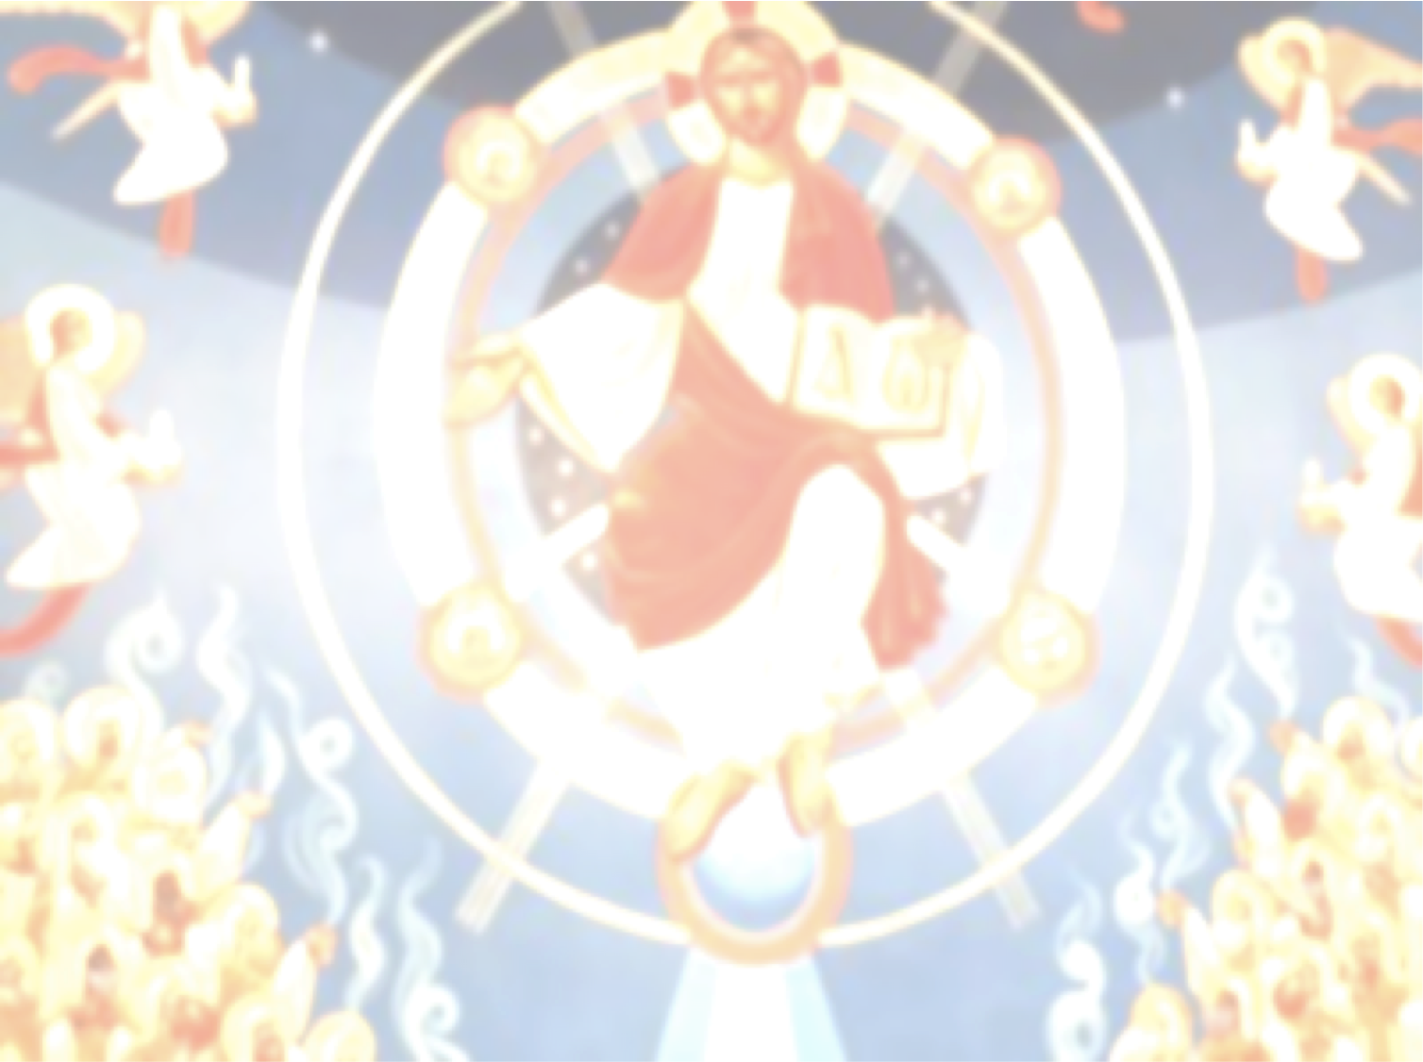
Cloud of Witnesses
Life of St Mina the Wonderworker

Slide 2
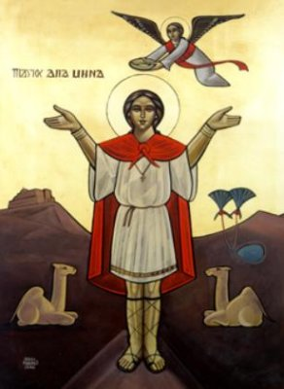
St Mina the Wonderworker

Slide 3
St Mina told the Governor
“I headed to the wilderness lest I mix and perish with you.”

Slide 4
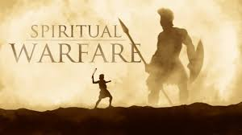
Preparing for the Battle

Slide 5
Luke 7:13-14
“Enter by the narrow gate; for wide is the gate and broad is the way that leads to destruction, and there are many who go in by it. 14 Because[a] narrow is the gate and difficult is the way which leads to life, and there are few who find it.

Slide 6
2 Timothy 1:12
“For this reason I also suffer these things; nevertheless I am not ashamed, for I know whom I have believed and am persuaded that He is able to keep what I have committed to Him until that Day.”

Slide 7
Romans 8:35
Who shall separate us from the love of Christ? Shall tribulation, or distress, or persecution, or famine, or nakedness, or peril, or sword?

Slide 8
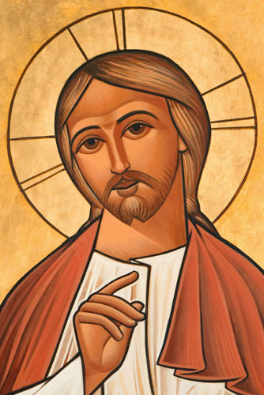
The Name of Jesus

Slide 9
Daniel 3:27
“And the satraps, administrators, governors, and the king’s counselors gathered together, and they saw these men on whose bodies the fire had no power; the hair of their head was not singed nor were their garments affected, and the smell of fire was not on them.”

