Slide 1
Comparative Theology
Roman Catholicism- Theological Differences

Slide 2
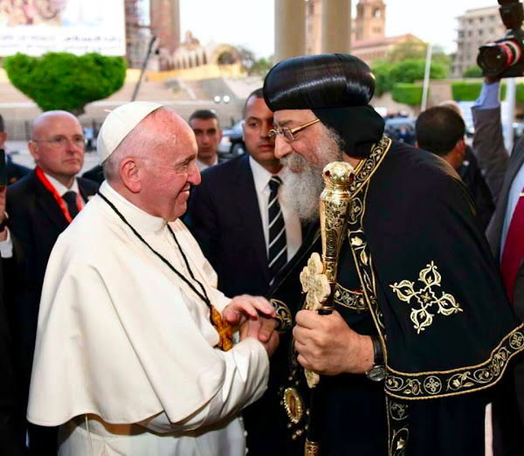
Common Declaration

Slide 3
Article 11 of the shared statement of HH Pope Tawadros and Pope Francis
In obedience to the work of the Holy Spirit, who sanctifies the church, keeps her throughout the ages, and leads her to full unity — that unity for which Jesus Christ prayed: Today we, Pope Francis and Pope Tawadros II, in order to please the heart of the Lord Jesus, as well as that of our sons and daughters in the faith, mutually declare that we, with one mind and heart, will seek sincerely not to repeat the baptism that has been administered in either of our churches for any person who wishes to join the other. This we confess in obedience to the Holy Scriptures and the faith of the three ecumenical councils assembled in Nicaea, Constantinople and Ephesus. We ask God our Father to guide us, in the times and by the means that the Holy Spirit will choose, to full unity in the mystical Body of Christ.

Slide 4
The Primacy of Rome and the Infallibility of the Pope
So, then, if anyone says that the Roman pontiff has merely an office of supervision and guidance, and not the full and supreme power of jurisdiction over the whole church, and this not only in matters of faith and morals, but also in those which concern the discipline and government of the church dispersed throughout the whole world; or that he has only the principal part, but not the absolute fullness, of this supreme power; or that this power of his is not ordinary and immediate both over all and each of the churches and over all and each of the pastors and faithful: let him be anathema. (Pastor Aeternus, Vatican 1, 1870)

Slide 5
Mathew 16:19
“And I will give you the keys of the kingdom of heaven, and whatever you bind on earth will be bound in heaven, and whatever you loose on earth will be loosed in heaven.”

Slide 6
Galatians 2:11
“Now when Peter[a] had come to Antioch, I withstood him to his face, because he was to be blamed;”

Slide 7
Papal Infallibility
This dogma was solemnly defined by the First Vatican Council in 1870: This see of St. Peter always remains unblemished by any error, in accordance with the divine promise of our Lord and Saviour to the prince of his disciples. . . .

Slide 8
. . . . We teach and define as a divinely revealed dogma that when the Roman
Pontiff speaks ex cathedra, that is, when, in the exercise of his office as shepherd and teacher of all Christians, in virtue of his supreme apostolic authority, he defines a doctrine concerning faith or morals to be held by the whole Church, he possesses, by the divine assistance promised to him in blessed Peter, that infallibility which the divine Redeemer willed his Church to enjoy in defining doctrine concerning faith or morals.

Slide 9
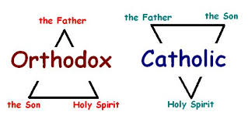
“Filioque”

Slide 10
The Filioque
(Latin, “and the Son”) is an addition to the Nicene-Constantinopolitan Creed that defines the eternal procession (origin) of the Holy Spirit as being not only from the Father (as is the wording of the original Creed and the Lord in John 15:26), but also “and the Son.”

Slide 11
John 15:26
“But when the Helper comes, whom I shall send to you from the Father, the Spirit of truth who proceeds from the Father, He will testify of Me”

Slide 12
Instead of any particular attribute belonging only either to the divine Nature or the Person, the Filioque grants an attribute to two Persons but not the other. For instance, unbegottenness belongs only to the Father, begottenness belongs to the Son, while procession belongs to the Spirit. Likewise, all divine characteristics (e.g., immortality, perfection, omniscience, etc.) belong to all three Persons.

Slide 13
But if being the eternal origin of the Spirit’s procession belongs to both the Father and the Son, that subordinates the Spirit in that He does not possess something that the other two Persons do

Slide 14

Original Sin

Slide 15
Romans 5:12
“Therefore, just as through one man sin entered the world, and death through sin, and thus death spread to all men, because all sinned.”

Slide 16
Romans 5:12 mistranslation
In Latin translations, the last phrase is in quo omnes peccaverunt, meaning “in whom all have sinned,” saying that in Adam (the “one man”) all sinned, making all guilty of Adam’s sin
In Greek, it is eph’ o pantes himarton, “because all sinned,” which is not only the actual wording of the Scripture but the faith of the Orthodox Church. That is, while we all suffer the effects of Adam’s sin (because we are human), we are not guilty of any sins but our own. We did not sin in Adam, but we sin because Adam’s sin made us capable of sin.

Slide 17
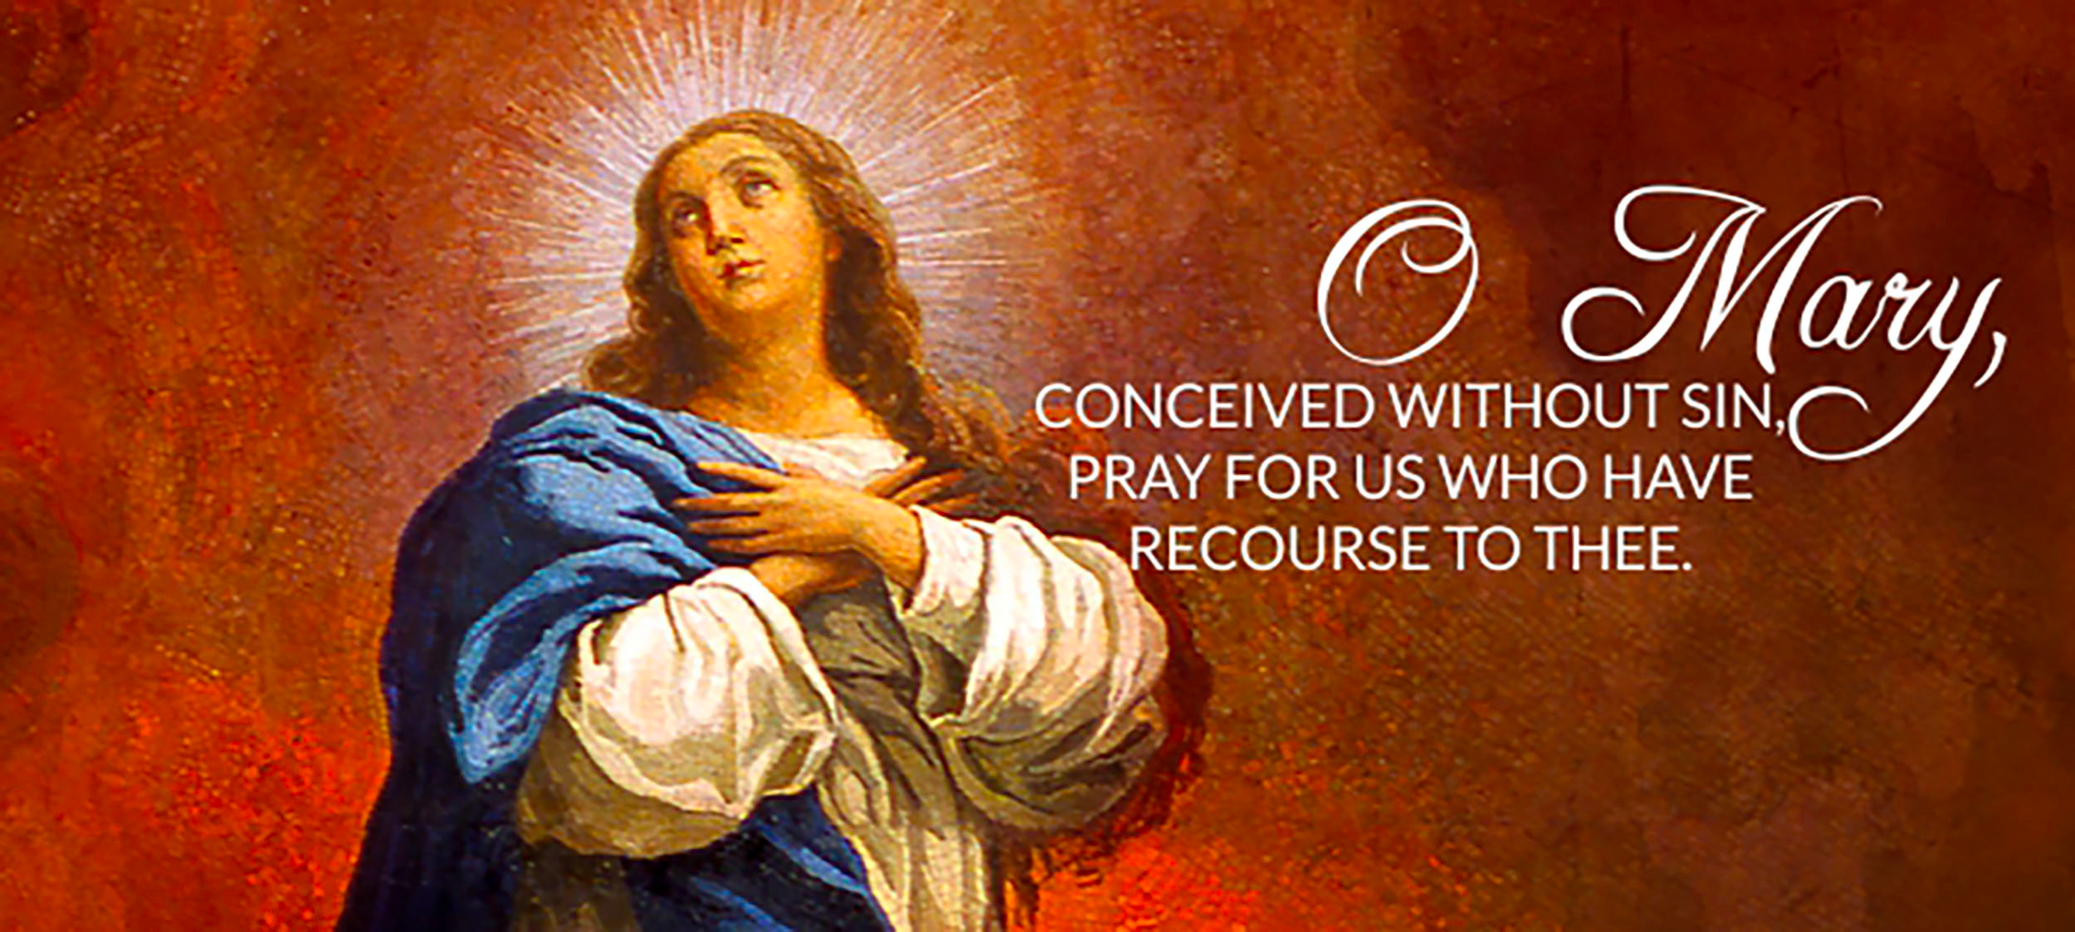
Immaculate Conception

Slide 18
The Immaculate Conception The original sin doctrine is also the origin of the immaculate conception teaching, which says that the Virgin Mary was preserved from all stain of original sin when she was conceived (declared as dogma in 1854, though rejected by Thomas Aquinas in the thirteenth century). Christ would therefore be born without it. Yet for the Orthodox, it is not guilt that Christ is born with, but rather mortality. He, like His mother, suffered the effects of fallen human nature (such as hunger, fatigue, etc.), but did not commit any personal sins.

Slide 19
Orthodox response
The original sin/immaculate conception combination puts Christ outside of human nature, making Him not truly human.
“What Christ did not assume, He did not heal.” St Gregory Nazianzen

Slide 20
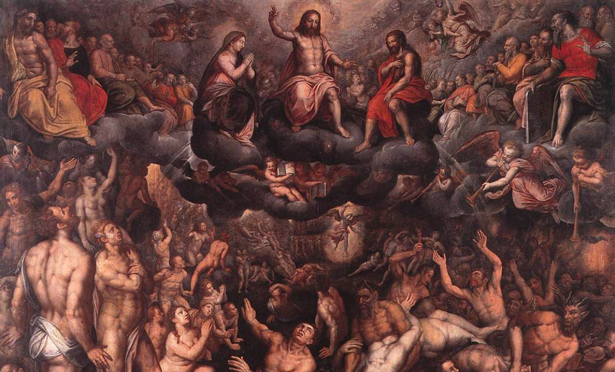
Purgatory and Indulgences

Slide 21
Doctrine of Purgatory
Purgatory is imagined as a place of temporal punishment where a saved believer pays God what he owes by suffering in torment for a certain number of years (while nonetheless somehow experiencing a joy not known on earth).

Slide 22
Indulgences
An indulgence is a remission before God of the temporal punishment due to sins whose guilt has already been forgiven, which the faithful Christian who is duly disposed gains under certain prescribed conditions through the action of the Church which, as the minister of redemption, dispenses and applies with authority the treasury of the satisfactions of Christ and the saints.

Slide 23
Orthodox response to Purgatory
it assumes a division of salvation into two parts: getting to heaven and being “purged” or paying off the debt of sin. The emphasis in spiritual life is then placed on externalized works in order to earn time out of purgatory rather than personal transformation in order to unite with God.

