Slide 1
When the Story becomes a Revelation !
05.06.2018

Slide 2
Luke 24
¹³ Now that same day two of them were going to a village called Emmaus, about seven miles from Jerusalem. ¹⁴ They were talking with each other about everything that had happened. ¹⁵ As they talked and discussed these things with each other, Jesus himself came up and walked along with them; ¹⁶ but they were kept from recognizing him.
¹⁷ He asked them, “What are you discussing together as you walk along?” They stood still, their faces downcast. ¹⁸ One of them, named Cleopas, asked him, “Are you the only one visiting Jerusalem who does not know the things that have happened there in these days?”

Slide 3
Luke 24
¹⁹ “What things?” he asked.
“About Jesus of Nazareth,” they replied. “He was a prophet, powerful in word and deed before God and all the people. ²⁰ The chief priests and our rulers handed him over to be sentenced to death, and they crucified him; ²¹ but we had hoped that he was the one who was going to redeem Israel. And what is more, it is the third day since all this took place. ²² In addition, some of our women amazed us. They went to the tomb early this morning ²³ but didn’t find his body. They came and told us that they had seen a vision of angels, who said he was alive.

Slide 4
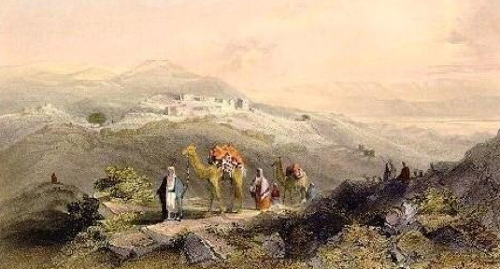
Are you leaving Jerusalem?
why ?!!!

Slide 5
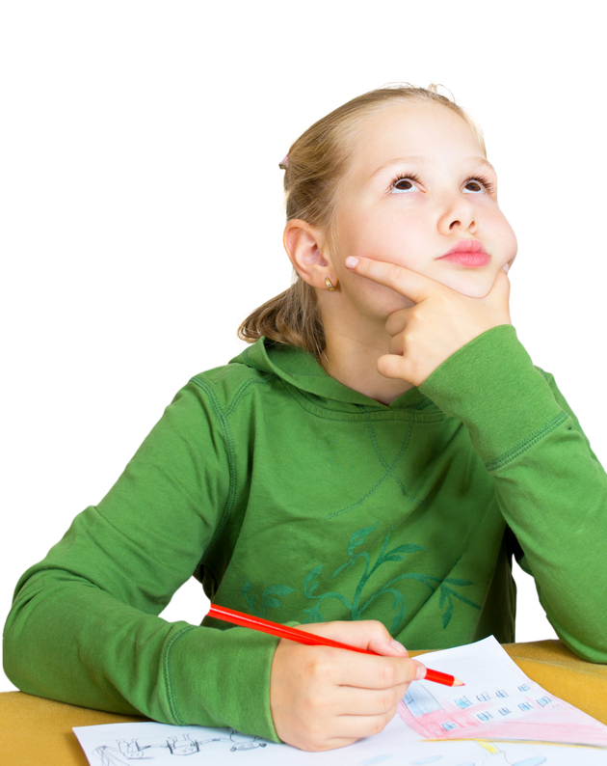
Do you know everything that had happened?
My expectation and the reality!!!

Slide 6
Are you an eye Witness?
When I started to be uncertain of what I have seen!!!

Slide 7
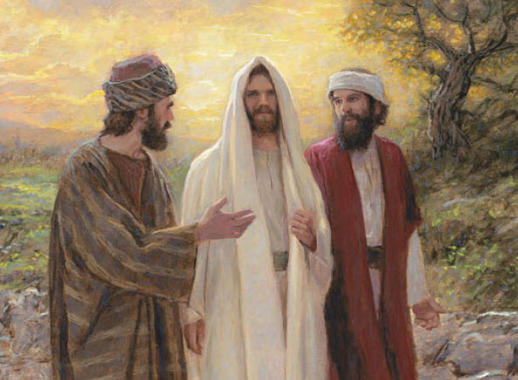
Are you mocking the truth?
When I say I know, do not you know ?!!!

Slide 8
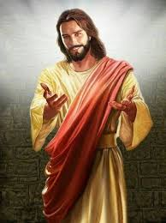
Do you belittle the Son of God to be just a mighty prophet who failed you?
When my false knowledge hinders me from seeing Him!!!

Slide 9
Even the demons are subject to us in Your name
¹After these things the Lord appointed seventy others also, and sent them two by two before His face into every city and place where He Himself was about to go. …¹⁷ Then the seventy returned with joy, saying, “Lord, even the demons are subject to us in Your name.” Luke 10:1,17

Slide 10
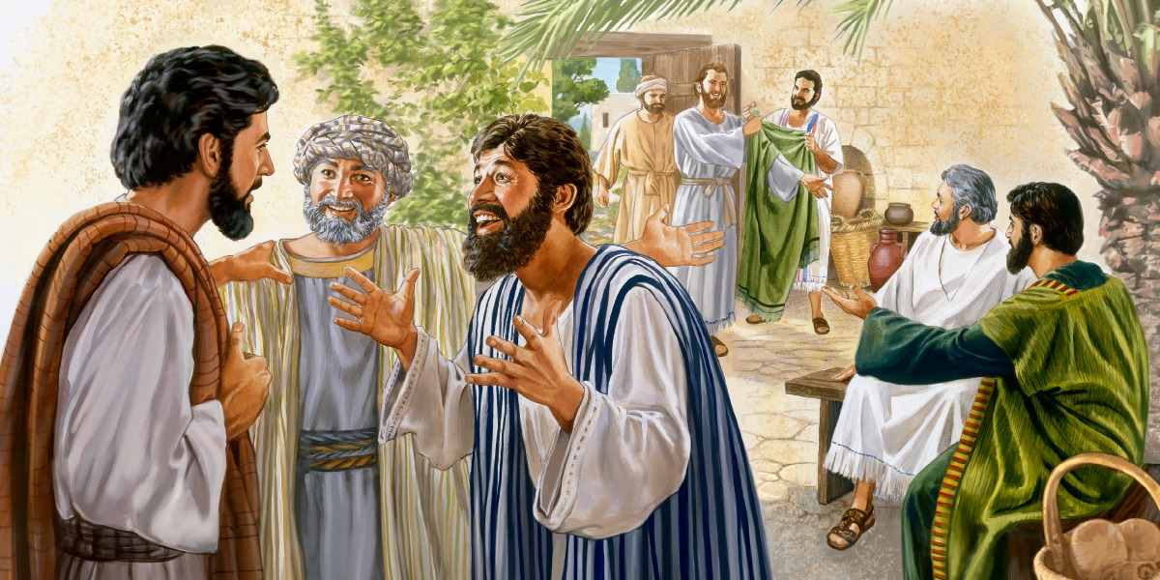
Did you do miracles?
When I started to doubt myself !!!

Slide 11
Acts 9
²⁰ At once he began to preach in the synagogues that Jesus is the Son of God. ²¹ All those who heard him were astonished and asked, “Isn’t he the man who raised havoc in Jerusalem among those who call on this name? And hasn’t he come here to take them as prisoners to the chief priests?” ²² Yet Saul grew more and more powerful and baffled the Jews living in Damascus by proving that Jesus is the Messiah.

Slide 12
The Spirit of Revelation
That the God of our Lord Jesus Christ, the Father of glory, may give to you the Spirit of wisdom and revelation in the knowledge of Him, Eph 1:17

Slide 13
To reveal His Son in me
¹⁵ But when it pleased God, who separated me from my mother’s womb and called me through His grace, ¹⁶ to reveal His Son in me, that I might preach Him among the Gentiles, I did not immediately confer with flesh and blood,

Slide 14
Are you going back to Jerusalem?
³³ So they rose up that very hour and returned to Jerusalem, and found the eleven and those who were with them gathered together, ³⁴ saying, “The Lord is risen indeed, and has appeared to Simon!” ³⁵ And they told about the things that had happened on the road, and how He was known to them in the breaking of bread. Lk 24:33.34
yessss!!!

Slide 15
St. Ephram the Syrian
"O Lord, we cannot go to the pool of Siloam to which you sent the blind man. But we have the chalice of Your Precious Blood, filled with life and light.

