Slide 1
What is the Church?
January 27 ,2016

Slide 2
“And I also say to you that you are Peter, and on this rock I will build My church, and the gates of Hades shall not prevail against it. And I will give you the keys of the kingdom of heaven, and whatever you bind on earth will be bound in heaven, and whatever you loose on earth will be loosed in heaven.”
Matthew 16:18-19

Slide 3
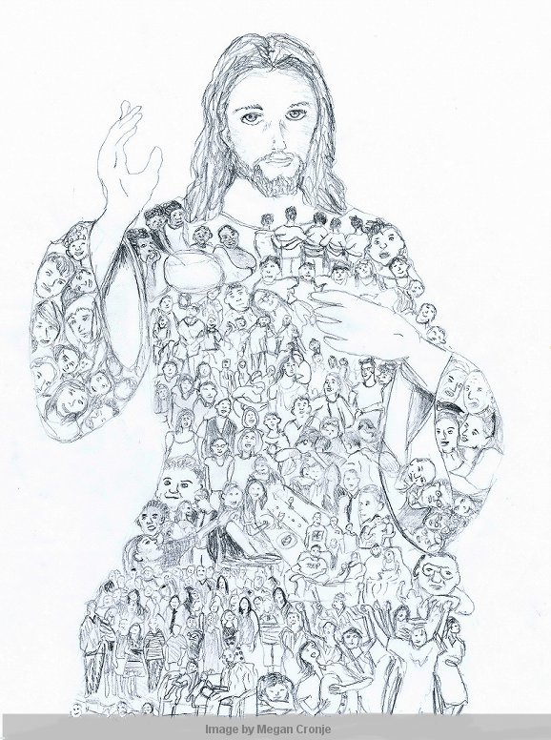
‘theanthropic’ organism

Slide 4
‘theanthropic’ organism
embodying Deity in human form

Slide 5
“And He put all things under His feet,
and gave Him to be head over all things
to the church, which is His body,
the fullness of Him who fills all in all.”
Ephesians 1:22-23

Slide 6
Being a member of the Church is my primary identity

Slide 7
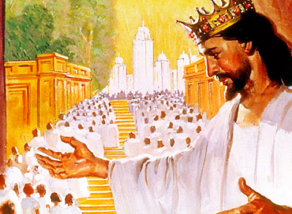
God has a plan for my life at an individual level and also as part of His Body. I can't know one without the other.

Slide 8
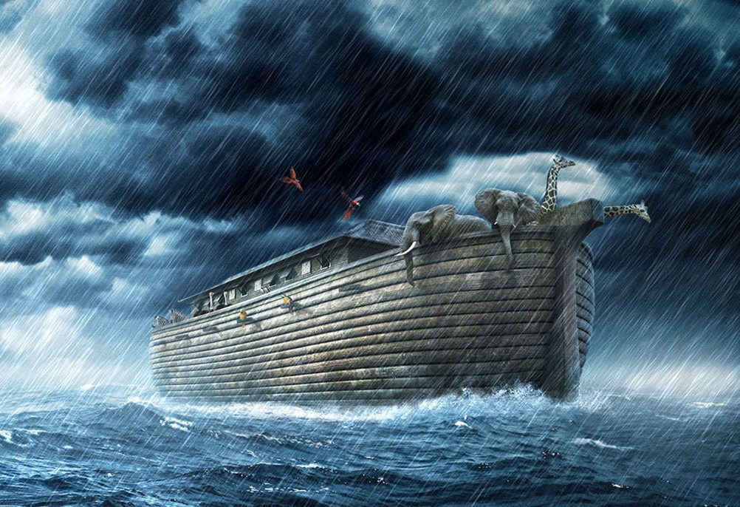
The Church is my salvation

Slide 9
The Church is my salvation
“If someone who was outside of the ark of Noah could escape, so could also someone who is outside the Church.” (St. Cyprian)

Slide 10
“Now, therefore, you are no longer strangers and foreigners, but fellow citizens with the saints and members of the household of God, having been built on the foundation of the apostles and prophets, Jesus Christ Himself being the chief cornerstone, in whom the whole building, being fitted together, grows into a holy temple in the Lord, in whom you also are being built together for a dwelling place of God in the Spirit.”
Ephesians 2:19-22

Slide 11
“Therefore take heed to yourselves
and to all the flock, among which
the Holy Spirit has made you overseers,
to shepherd the church of God
which He purchased with His own blood.”
Acts 20:28

Slide 12
“But you are a chosen generation, a royal priesthood, a holy nation, His own special people, that you may proclaim the praises of Him who called you out of darkness into His marvelous light; who once were not a people but are now the people of God, who had not obtained mercy but now have obtained mercy.”
1 Peter 2:9-10

Slide 13
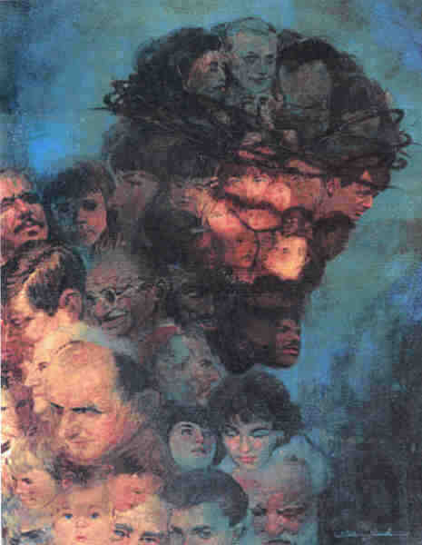
By participating in the life of the Church,
I participate in the life of Christ.

