Slide 1
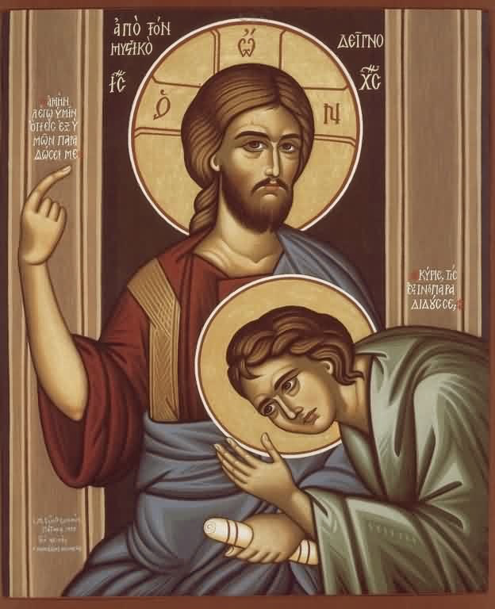
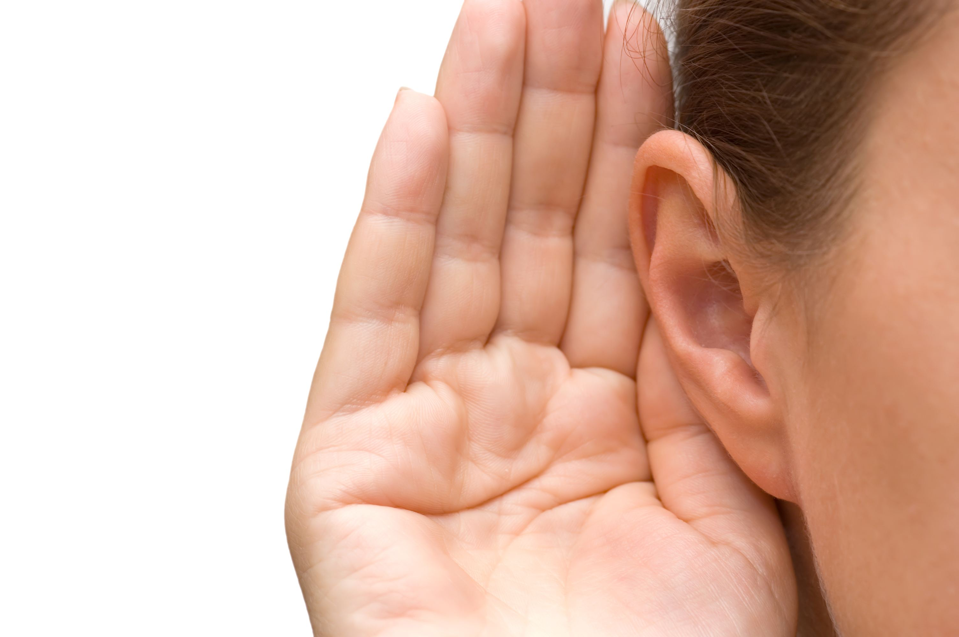
What Kind of Ears?
3rd Sunday of Hatour

Slide 2
The “Dull of Hearing”
11 of whom we have much to say, and hard to explain, since you have become dull of hearing. 12 For though by this time you ought to be teachers, you need someone to teach you again the first principles of the oracles of God; and you have come to need milk and not solid food. Heb 5:11,12

Slide 3
St. John Chrysostom
[There is weakness in listening like the weak stomach which cannot digest all food. Likewise the proud, angry, negligent soul cannot accept the word of the Spirit. Listen to what many of the disciples said, "This is a hard saying, who can understand it?" (John 6:60) However, everything becomes easy, light, and more glorious to the strong person, thus he can be elevated to heavenly matters.]
In Acts hom., 55.

Slide 4
After the parable of the sower
13 Therefore I speak to them in parables, because seeing they do not see, and hearing they do not hear, nor do they understand. 14 And in them the prophecy of Isaiah is fulfilled, which says: ‘Hearing you will hear and shall not understand, And seeing you will see and not perceive; 15 For the hearts of this people have grown dull. Their ears are hard of hearing, And their eyes they have closed.. Matt 13:13-15

Slide 5
The Problem
They can not understand God’s truth
They can not repent
They can not receive healing from God

Slide 6
Itching Ears
For the time will come when they will not endure sound doctrine, but according to their own desires, because they have itching ears, they will heap up for themselves teachers; 2 Ti 4:3

Slide 7
The commandment
Preach the word! Be ready in season and out of season. Convince, rebuke, exhort, with all longsuffering and teaching. 2 Ti 4:2

Slide 8
St Ambrose
[It is inappropriate for a pastor to be cruel, violent, or too lax. If he is cruel or violent, he would be like a tyrant; and if he is too lax, he would be regarded as a negligent and careless worker not worthy of the job entrusted to him.]

Slide 9
The Problem
They do not like sound doctrine, they will find the teachers they want … but then they turn from the Truth to fables

Slide 10
Noble and Good Heart
But the ones that fell on the good ground are those who, having heard the word with a noble and good heart, keep it and bear fruit with patience. Lk 8:15

Slide 11
The Bereans
These were more fair-minded than those in Thessalonica, in that they received the word with all readiness, and searched the Scriptures daily to find out whether these things were so. Acts 17:11

Slide 12
Steps to better listening
Make listening an act of worship
Listen from first to last
Read along in your bible and make your marks
Listen with Faith
Listen with a mind to Act

Slide 13
The Inaudible Prayer Of The Catholic Prayer
Lord God, Who has revealed unto us, through Your holy apostles, the mystery of the gospel of the glory of Your Christ

