Slide 1
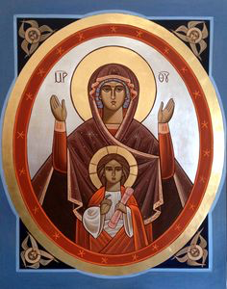
Virgin Mary Teaches us : (3) Synergy
St Maurice and St Verena Church – Virgin Mary’s Revival
18.08.2016

Slide 2
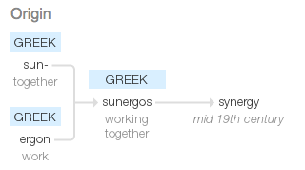
Synergy = Synergia = συνεργός
G4904

Slide 3
26 Now in the sixth month the angel Gabriel was sent by God to a city of Galilee named Nazareth, 27 to a virgin betrothed to a man whose name was Joseph, of the house of David. The virgin’s name was Mary. 28 And having come in, the angel said to her, “Rejoice, highly favored one, the Lord is with you; blessed are you among women!” 29 But when she saw him, she was troubled at his saying, and considered what manner of greeting this was. 30 Then the angel said to her, “Do not be afraid, Mary, for you have found favor with God. 31 And behold, you will conceive in your womb and bring forth a Son, and shall call His name Jesus. 32 He will be great, and will be called the Son of the Highest; and the Lord God will give Him the throne of His father David. 33 And He will reign over the house of Jacob forever, and of His kingdom there will be no end.”

Slide 4
34 Then Mary said to the angel, “How can this be, since I do not know a man?” 35 And the angel answered and said to her, “The Holy Spirit will come upon you, and the power of the Highest will overshadow you; therefore, also, that Holy One who is to be born will be called the Son of God. 36 Now indeed, Elizabeth your relative has also conceived a son in her old age; and this is now the sixth month for her who was called barren. 37 For with God nothing will be impossible.” 38 Then Mary said, “Behold the maidservant of the Lord! Let it be to me according to your word.” And the angel departed from her.

Slide 5
St John Cassian
(Conversations with the Desert Fathers, 18)
"These two, namely, grace and free will, although they seem opposed, in fact are complementary...Were we to deny the one or the other, we would appear to have abandoned the Faith of the Church.”

Slide 6
Grace
7 that in the ages to come He might show the exceeding riches of His grace in His kindness toward us in Christ Jesus. 8 For by grace you have been saved through faith, and that not of yourselves; it is the gift of God, 9 not of works, lest anyone should boast. Eph 2:7-9

Slide 7
Free Will
10 For we are His workmanship, created in Christ Jesus for good works, which God prepared beforehand that we should walk in them. Eph 2:10

Slide 8
Insulting the spirit of Grace
Of how much worse punishment, do you suppose, will he be thought worthy who has trampled the Son of God underfoot, counted the blood of the covenant by which he was sanctified a common thing, and insulted the Spirit of grace? Heb 10:29

Slide 17
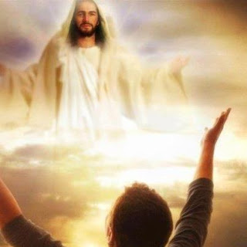
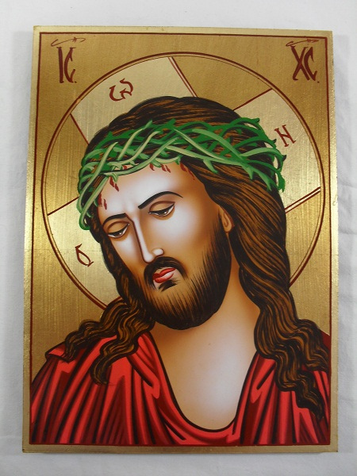
St Augustine
"I (Christ) am the food of full-grown men. Grow and you shall feed on me. But you shall not change me into your own substance, as you do with the food of your body, instead you shall be changed into me“.
Confessions, VII 10 (PL 32, 742) ed & trs. R.S. Pine-Coffin, Penguin 1971, p. 147.

