Slide 1
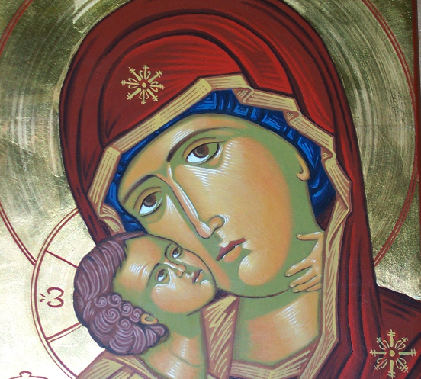
Virgin Mary Teaches us: (1) Holiness
Revival of Virgin Mary – St Maurice and St Verena Church
16th August, 2016

Slide 2
1. Why Holiness

Slide 3
The Will of God
For this is the will of God, your sanctification: that you should abstain from sexual immorality 1 Thes 4:3

Slide 4
St. John Chrysostom In 1 Thess. Hom. 5.
[Virtue is divided into two matters: forsaking evil and doing good. Forsaking evil is not enough to attain virtue, but it is only the beginning. We have a long way to struggle.]

Slide 5
Partaker of His Holiness
For they indeed for a few days chastened us as seemed best to them, but He for our profit, that we may be partakers of His holiness. Heb 12:10

Slide 6
Holiness
Pursue peace with all people, and holiness, without which no one will see the Lord: Heb 12:14

Slide 7
St. Jerome Ep. 116:8.
[Christ is holiness, without which no one can see the face of God. Christ is our salvation, for He is the Savior and the Redeemer at the same time. Christ is everything for us. Whoever forsakes anything for the Lord finds in Him all his satisfaction and compensation for all what he had forsaken. Thus he can freely say: "The Lord is my portion" (Ps. 123:6).]

Slide 8
2. Nazareth

Slide 9
Sebastian Brock, Introduction, Jacob of Serug On the Mother of God , citing St Ephraem, H. Faith 6: 17; 10:8.
There is fire and Spirit in Mary’s womb, there is fire and Spirit in the river in which you were baptized. Fire and Spirit in our own baptism, in the bread and in the cup, fire and the Holy Spirit. In your bread is hidden the Spirit who is not eaten; in your wine dwells the Fire that cannot be drunk. The Spirit in your bread, the Fire in your wine, a remarkable miracle that our lips have received.

Slide 10
The Good News
Now in the sixth month the angel Gabriel was sent by God to a city of Galilee named Nazareth, Luke 1:26

Slide 11
The Childhood of Our Lord
So when they had performed all things according to the law of the Lord, they returned to Galilee, to their own city, Nazareth. Luke 2:39

Slide 12
Back to Nazarene
22 But when he heard that Archelaus was reigning over Judea instead of his father Herod, he was afraid to go there. And being warned by God in a dream, he turned aside into the region of Galilee. 23 And he came and dwelt in a city called Nazareth, that it might be fulfilled which was spoken by the prophets, “He shall be called a Nazarene.” Matt 2:22,23

Slide 13
Nazareth
"Nazareth" is derived from one of the Hebrew words for 'branch', namely netṣer, נֵ֫צֶר,^{[7]} and alludes to the prophetic, messianic
And a Branch (Netzer) shall grow out of his roots. Isa 11:1

Slide 14
Nazareth !!
And Nathanael said to him, “Can anything good come out of Nazareth?”
Philip said to him, “Come and see.” Jn 1:46

Slide 15
Easton Dictionary
From the words of Nathanael in John 1:46 that the city of Nazareth was held in great disrepute, either because, it is said, the people of Galilee were a rude and less cultivated class, and were largely influenced by the Gentiles who mingled with them, or because of their lower type of moral and religious character.

Slide 16
The Fraction of The fast and feast of Virgin Mary
Holy and full of glory is the Theotokos, the pure St. Mary, the Virgin. Amen. Alleluia.
Holy and full of glory is this sacrifice which has been slain for the life of the whole world. Amen. Alleluia.

Slide 17
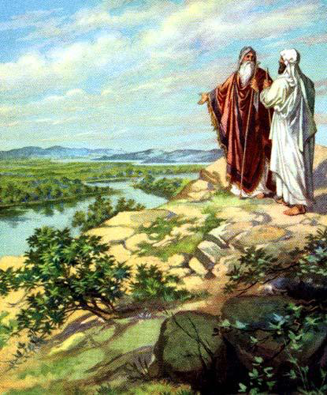
3. Abram and Lot

Slide 18
Going to where the Lord leads
So Abram departed as the Lord had spoken to him, and Lot went with him. And Abram was seventy-five years old when he departed from Haran. Gen 12:4

Slide 19
Lot the follower of Abram
Lot also, who went with Abram, had flocks and herds and tents. Gen 13:5

Slide 20
The separation
8 So Abram said to Lot, “Please let there be no strife between you and me, and between my herdsmen and your herdsmen; for we are brethren. 9 Is not the whole land before you? Please separate from me. If you take the left, then I will go to the right; or, if you go to the right, then I will go to the left.” Gen 13:8,9

Slide 21
He chose for himself
And Lot lifted his eyes and saw all the plain of Jordan, that it was well watered everywhere (before the Lord destroyed Sodom and Gomorrah) like the garden of the Lord, like the land of Egypt as you go toward Zoar. Then Lot chose for himself all the plain of Jordan.. Gen 13:10,11

Slide 22
God chose for Abram
14 And the Lord said to Abram, after Lot had separated from him: “Lift your eyes now and look from the place where you are northward, southward, eastward, and westward; 15 for all the land which you see I give to you and your descendants forever. 16 And I will make your descendants as the dust of the earth; so that if a man could number the dust of the earth, then your descendants also could be numbered. 17 Arise, walk in the land through its length and its width, for I give it to you.” Gen 13:14-17

Slide 23
There is hope even in Sodom and Gomorrah
6 and turning the cities of Sodom and Gomorrah into ashes, condemned them to destruction, making them an example to those who afterward would live ungodly; 7 and delivered righteous Lot, who was oppressed by the filthy conduct of the wicked. 2 Pet 2:6,7

Slide 24
4. The Place of Subjection
Then He went down with them and came to Nazareth, and was subject to them, but His mother kept all these things in her heart. Luke 2:51

Slide 25
Applications:
Examine yourself: did you choose to be in His Will ?
Does the fact that we are called to be partakers of His Holiness encourage you?
Am I in the Wrong Place that is why holiness is too far from me?
Did I lose hope for any reason?
You can not make it alone, its contact your spiritual father and discuss it with him.

Slide 26
St Gregory of Nyssa the great catechetical oration 32
He so far within the grasp of death as to touch a state of deadness and then in His Own Body to bestow in our nature the principal of resurrection, raising as He did by His power along with Himself the whole man.

