Slide 1
Upside Down “These who have turned the world upside down.” Acts 17:6
Light & Life
July 30 2017

Slide 2
The biggest attack against our walk that we experience is to be normal and like everyone else

Slide 3
In order to survive as a Christian in this world, be upside down!

Slide 4
1. How to live upside down
Being reviled, we bless; being persecuted, we endure; being defamed, we entreat.
1 Cor. 4:12-13

Slide 5
Who is my King?
But the Jews who were not persuaded, becoming envious, took some of the evil men from the marketplace, and gathering a mob, set all the city in an uproar and attacked the house of Jason, and sought to bring them out to the people. But when they did not find them, they dragged Jason and some brethren to the rulers of the city, crying out, "These who have turned the world upside down have come here too. Jason has harbored them, and these are all acting contrary to the decrees of Caesar, saying there is another king Jesus."
Acts 17:5-7

Slide 6
“I will no longer talk much with you, for the ruler of this world is coming, and he has nothing in Me.” John 14:30

Slide 7
Joseph and Potiphar’s Wife

Slide 8
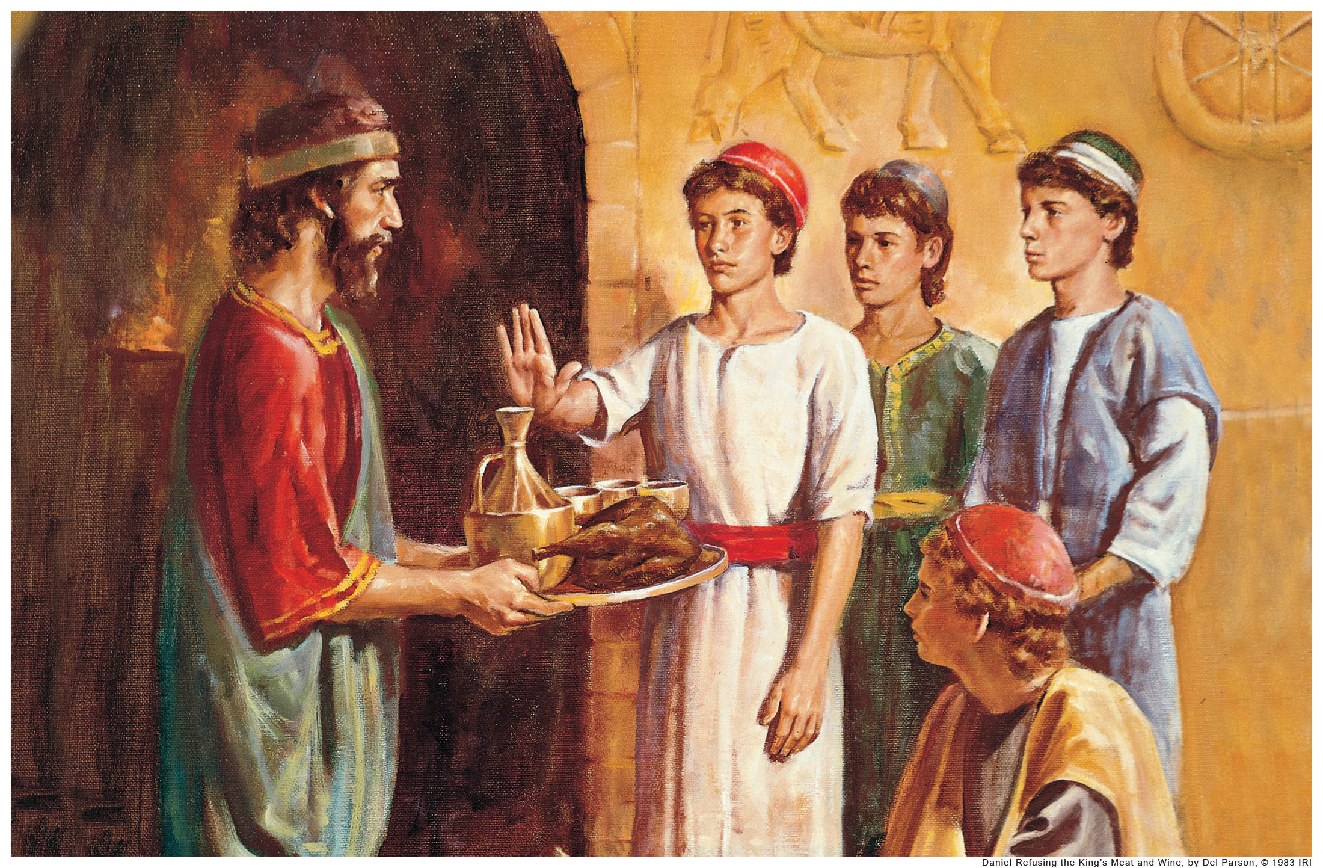
Daniel and the Three Youth Refuse the King’s Food

Slide 9
Daniel Praying in His Window, Despite the King’s Decree

Slide 10
Three Youth Refuse to Bow Down to Idols and are Thrown into Fiery Furnace

Slide 11
2. Love your enemies
“But I say to you who hear: Love your enemies, do good to those who hate you, bless those who curse you, and pray for those who spitefully use you. To him who strikes you on the one cheek, offer the other also.”
Luke 6:27-29

Slide 12
Pray for those who spitefully use you

Slide 13
Do good to those who hate you

Slide 14
“If your enemy is hungry feed him; If he is thirsty, give him a drink. For in doing so you will heap coals of fire on his head.” Romans 12:20

Slide 15
To him who strikes you on the one cheek, offer the other also

Slide 16
3. Get comfortable being uncomfortable

Slide 17
If we learn to live upside down and be comfortable being uncomfortable then we will turn the world upside down.

