Slide 1
Trust Like a Child
Second Sunday of Abib
Matthew 18:1-9
July 18, 2010

Slide 2
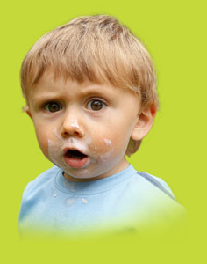
“Assuredly, I say to you, unless you are converted and become as little children, you will by no means enter the kingdom of heaven.” Matthew 18:3

Slide 3
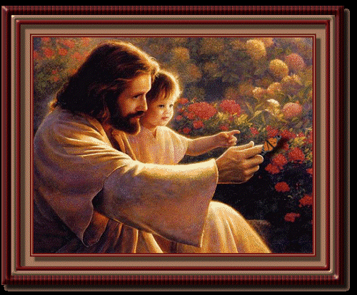
TRUST

Slide 4
TRUST
Trusting God makes me invincible
“Those who trust in the LORD are like Mount Zion, which cannot be shaken but endures forever.” Psalm 125:1

Slide 5
Why is Trust So Important?

Slide 6
Why is Trust So Important?
Trust is the only path to the kingdom

Slide 7
Why is Trust So Important?
Trust is the only path to the kingdom
“The believer does not enter into an argument with God about His doing, but accepts all things and confidence in God's wisdom and love.” Life of Faith, by H.H. Pope Shenouda III

Slide 8
Are you ready to trust Him
up the mountain?
“Jesus said to him, “If you can believe, all things are possible to him who believes.” Mark 9:23

