Slide 1
Trading Places- Kenosis series

Slide 2
Ephesians 5:22-33
“Wives, submit to your own husbands, as to the Lord. ²³ For the husband is head of the wife, as also Christ is head of the church; and He is the Savior of the body. ²⁴ Therefore, just as the church is subject to Christ, so let the wives be to their own husbands in everything.
²⁵ Husbands, love your wives, just as Christ also loved the church and gave Himself for her, ²⁶ that He might ^{[a]}sanctify and cleanse her with the washing of water by the word, ²⁷ that He might present her to Himself a glorious church, not having spot or wrinkle or any such thing, but that she should be holy and without blemish. ²⁸ So husbands ought to love their own wives as their own bodies; he who loves his wife loves himself. ²⁹ For no one ever hated his own flesh, but nourishes and cherishes it, just as the Lord does the church. ³⁰ For we are members of His body, ^{[b]}of His flesh and of His bones.

Slide 3
Trading Places
When a couple neglects trading places with their spouse- they become ignorant of each other

Slide 4

Empathy
the identification with and understanding of another’s situation, feelings, and motives

Slide 5
1 Peter 3:7
“Husbands, likewise, dwell with them with understanding, giving honor to the wife, as to the weaker vessel, and as being heirs together of the grace of life, that your prayers may not be hindered.”

Slide 6
Empathy
Having empathy for one another means becoming more skilled at reading one another

Slide 7
4 Social Styles
Sympathizers- More feeling than thinking
      These are people who jump to conclusions
      These are people who look at the world through the lens of their own personal experiences

Slide 8

Personalizer
  This personal is usually imprisoned by fear in the relationship
  This style causes them to withdraw and retreat in order to avoid potential pain

Slide 9
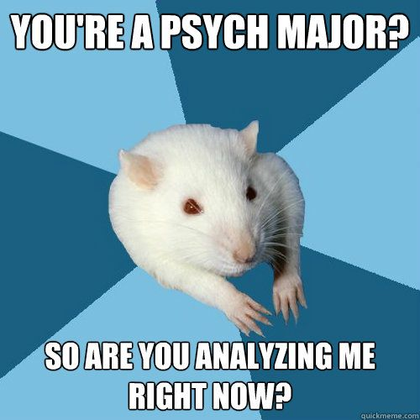
Analyzer
These are not people that empathize but pyscholigize
doesn’t attempt to “really” know what’s going on, but to accurately see the situation from another’s view

Slide 10
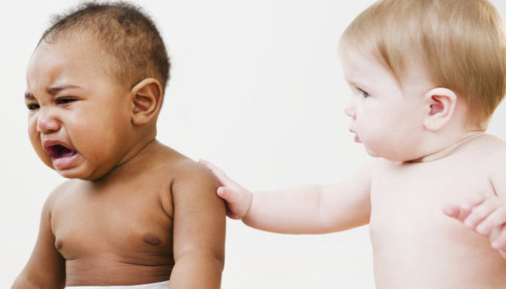
Empathizer
This is where analyzing and sympathizing meet
Putting yourself into each other’s shoes with your head and your heart
A deep emotional attunement that is tempered by an objective

Slide 11


Complaining vs. Criticism

Slide 12

Trading places eliminates nagging

Slide 13

Infuse your marriage with GRace

Slide 14
set aside your own agenda
Know your agenda- you’re trying to change your spouse to do something
Priming – know what condition your spouse is in

Slide 15
Offer an “agendaless presence”-
When you empty yourself of your need to change another person, the things that irritate you about them have the opportunity to become the things that endear you to them

