Slide 1
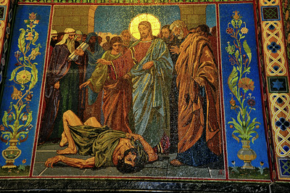
The Upright
3rnd Sunday of Babah

Slide 2
The upright in Heart
Light is sown like seed for the righteous And gladness for the upright in heart. Ps 97:11

Slide 3
(St. Augustine)
What kind of light, you fear to lose through practicing a holy life?! Do not you fear to lose the true light and become in darkness?
On Ps. 97 (96).

Slide 4
The acts of the upright
13 Watch, stand fast in the faith, be brave, be strong. 14 Let all that you do be done with love . 1 Cor 16:13,14

Slide 5
Fr Ambrosiaster
They are committed to watch and hold fast, lest they would be attacked in their faith; and to strongly confess what they have learned; as that would be a sound and mature bond between the word and the work.
CSEL 81: 191.

Slide 6
The warfare of the upright
7 Therefore submit to God. Resist the devil and he will flee from you. 8 Draw near to God and He will draw near to you. Cleanse your hands, you sinners; and purify your hearts, you double-minded. Jas 4:7,8

Slide 7
The reward of the upright
8 So God, who knows the heart, acknowledged them by giving them the Holy Spirit, just as He did to us, 9 and made no distinction between us and them, purifying their hearts by faith. Acts 15:8,9

Slide 8
The blessing of the upright
By the blessing of the upright the city is exalted, But it is overthrown by the mouth of the wicked. Prov. 11:11

Slide 9
The joy of the upright
I have become as a wonder to many, But You are my strong refuge. Let my mouth be filled with Your praise, And with Your glory all the day. Ps 71:7,8

Slide 10
The unrighteous saying
Now when the Pharisees heard it they said, “This fellow does not cast out demons except by Beelzebub, the ruler of the demons.” Matt 12:24

Slide 11
The Enrichment of Humanity St Cyril of Alexandria
“He said well ‘the kingdom of God has come upon you’; this means that since I have become man as you are, and cast out demons by God’s Spirit, by this humanity had become enriched in me from the kingdom of heaven. It has attained glory by casting out demons, and rebuking the evil spirits.”

Slide 12
Test your words
All the words of my mouth are with righteousness; Nothing crooked or perverse is in them. Prov. 8:8

Slide 13
St Augustine
"You ought to know what you have received, what you are going to receive, and what you ought to receive daily. That Bread which you see on the altar, having been sanctified by the word of God, is the Body of Christ. The chalice, or rather, what is in that chalice, having been sanctified by the word of God, is the Blood of Christ."
-"Sermons", [227, 21]

