Slide 1
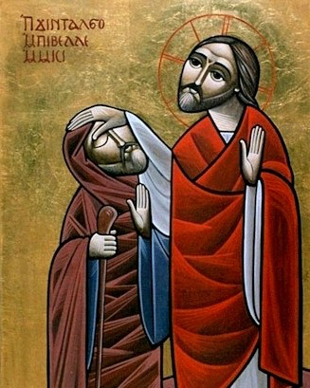
The Move (6) Out of disabled knowledge
Great Lent 2016

Slide 2
Moving mountains
So Jesus said to them, “Because of your unbelief; for assuredly, I say to you, if you have faith as a mustard seed, you will say to this mountain, ‘Move from here to there,’ and it will move; and nothing will be impossible for you. Matt 17:20

Slide 3
The Move
From a superficial to an intimate relationship
From earthly to heavenly treasures
From defeated Adam to Victorious Adam
From hiding within yourself
Out of the Box
Out of disabled knowledge

Slide 4
I Know !!!
Εἴδω = eidō = G1492
625 time in the New Testament
104 times in the Gospel of John
It is translated : see or know …

Slide 5
St. John Cassian
Man falling in pride, even though he may be physically pure, God would forsake him, so that when he falls into carnal lusts, that are visible before his own eyes, he would then realize the hidden pride that he cannot see.

Slide 6
Chapter (9) ( times)
Now as Jesus passed by, He saw a man who was blind from birth. Jn 9:1 (ACTING)
So they again called the man who was blind, and said to him, “Give God the glory! We know that this Man is a sinner.” Jn 9:24 (ACCUSING)
His parents answered them and said, “We know that this is our son, and that he was born blind; Jn 1:20 (PASSIVE)

Slide 7
Acting Knowledge
Therefore put to death your members which are on the earth: fornication, uncleanness, passion, evil desire, and covetousness, which is idolatry. Col 3:5
Put off all these.. Do not lie.. put on.. bearing with one another, and forgiving one another.. Let the word of Christ dwell in you…

Slide 8
St Jerome
Idolatry is not confined to offering incense on the altar of the idols, or pouring doses of wine in a certain container, but it is the ‘covetousness’, or rather selling the Lord for thirty pieces of silver; and counting oneself as doing righteousness.
Covetousness includes uncleanness, defiling the members of Christ, which should be “a living sacrifice acceptable before God”.

Slide 9
Acting Knowledge
And we know that the Son of God has come and has given us an understanding, that we may know Him who is true; and we are in Him who is true, in His Son Jesus Christ. This is the true God and eternal life. 1Jn 5:20

Slide 10
St. Didymus The Blind
The understanding which God gave, by which it is known that the true Son of God is coming, is the same as the mind of Christ.

Slide 11
Acting Knowledge
“Therefore I urge you to take nourishment, for this is for your survival, since not a hair will fall from the head of any of you.” Act 27:34

Slide 12
St Augustine On the Gospel of St John, tractate, 44:15
With his face washed and his conscience purified, the man finally recognized the Lord. He knew Him not only as the Son of Man, according to his earlier knowledge, but as the Son of God who had taken on our body. So he said, “Lord, I believe”

Slide 13
This week's spiritual exercise
Spend some time in prayer discovering your accusing and passive knowledge
Arrange to meet with your spiritual father to help you to get out of them and to come to the marvellous Acting light of Christ.

