Slide 1
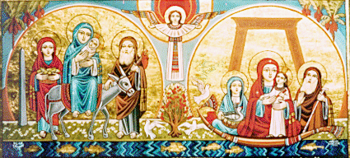
The Holy Tradition and the Church: The Full Experience of God
Discipleship Group
SMSV
28.08.2016

Slide 2
Main Points
Introduction.
Definition.
Church Fathers on the importance of Tradition
Church or Scriptures, where is the dilemma ?
Development of the Revelation on St Gregory the Theologian teachings !!!
Tradition and my Spiritual life today

Slide 3
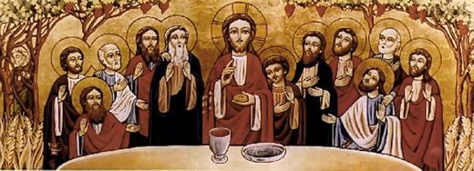
Introduction

Slide 4
Orthodoxy and Tradition
Fr Tadros Malaty
For a long time some western writers looked to “tradition” as a blind obedience to the past and a mechanical transmission of a passive deposit. In their point of view, tradition is a precise catalogue of a set of ancient doctrines, canons and rites, or it is a museum for antiquity. Therefore, the traditional church, in their view, seems to be a solid one and attached to what is old simply for its antiquity.

Slide 5
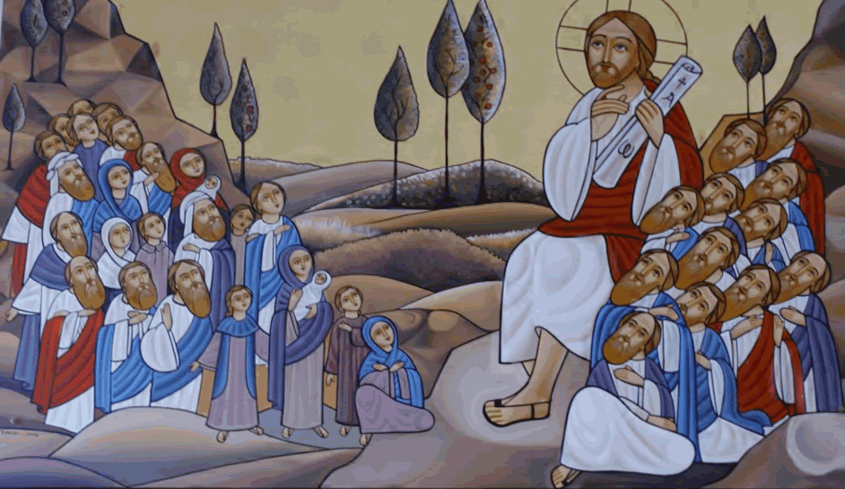
Definition

Slide 6
Difinition
The New International Dictionary of the Christian Church defines “tradition”, or the Greek word paradosis, as handing something over, or a teaching which has been handed down. “Paradosis” occurs thirteen times in the New Testament, including eight times in the Gospel of Matthew Chapter 15 and Mark Chapter 7 where we find the Lord rebuking the Jews for forsaking the Commandments and keeping their fathers’ traditions. St. Paul also uses “paradosis” to describe the old traditions and customs of the Jews and the Gentiles, and again to describe what he taught the Churches by words or by letters. At one point St. Paul instructs the Thessalonians Church to: “Stand firm, then, brothers, and keep the traditions that we taught you, whether by word of mouth or by letter”.
Notes:
Matthew 15:2, 15:3 and 15:6; Mark 7:3,7:5,7:8,7:9 and 7:13.
Gal. 1:14 and Col. 2:8.
I Cr. 11:2, II Th. 2:15 and II Th. 3:3.
II Thess. 2:15.

Slide 7
Origen
By Tradition, I knew the four gospels, and that they are the true ones.

Slide 8
St. Cyril of Jerusalem
Learn also diligently, and from the Church what are the books of the Old Testament, and what are those of the New.

Slide 9
St. Augustine
Contra Epist. Manichae quam V Cant Fundamentals
I would not have believed in the gospel, unless the voice of the Universal Church convinced me.

Slide 10
St. Basil The Great
If we try to dismiss the unwritten traditions as if they are unworthy, we disregard that thus we disdain the important element of preaching, and make the evangelic preaching merely a name.

Slide 11
Text and Event
Event can produce a text
Text can produce many events and none of them is true !
Event Can explain text but text can not explain an event clearly.

Slide 12
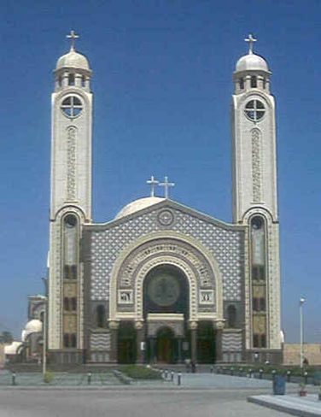
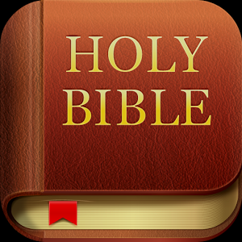

Church or Scriptures, where is the dilemma ?

Slide 13
The Revelation before 1054

Slide 14
Timothy Ware,
The Orthodox Church, (England: Penguin Books, 1983), 204
Christian Tradition, in this case, is the faith which Jesus Christ imparted to the Apostles, and which since the Apostles’ time has been handed down from generation to generation in the Church. But to Orthodox Christians, Tradition means something more concrete and specific than this. It means the books of the Bible; it means the creed; it means the decrees of the ecumenical councils and the Writings of the Fathers; it means the Canons, the Service books, the Holy Icons- in fact the whole system of the Doctrine.

Slide 15
The Revelation in The Catholic church after 1054
Two parallel sources of Revelation

Slide 16
Tradition and traditions
Bishop Aghiorgoussis of Pittsburgh
A favourite distinction among theologians is the one between Tradition and traditions. Tradition, with a capital T, is the life of the Spirit of the Church. It is this life that makes the continuity of Truth and Life in the Church, and gives to it its stability, continuity, and unchangeability. While traditions (with small t) are the concrete and historic manifestation of that Tradition, they may change. As in the Bible one distinguishes between the letter and the spirit, so in the tradition of the church in general one distinguishes between the context and its expression.

Slide 17
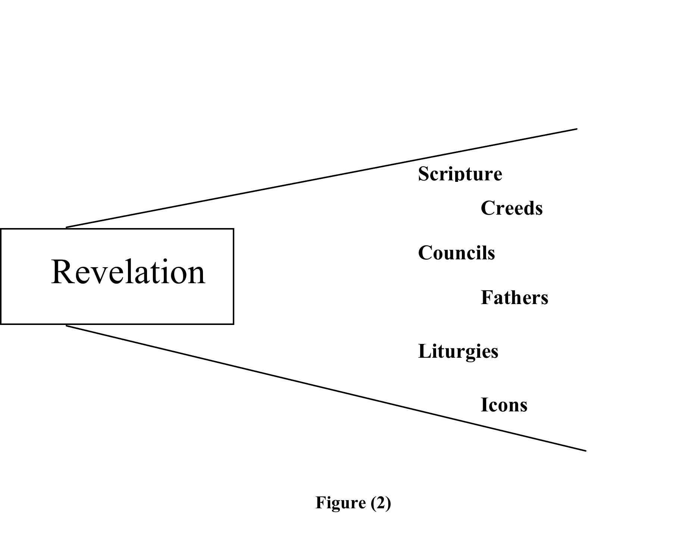
An Orthodox View
( Also the Early medieval according to Tavard)

Slide 18
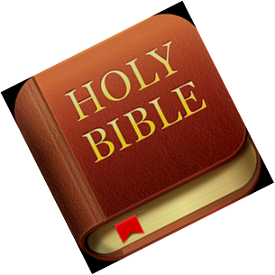

Slide 19
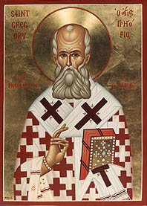
Development of the Revelation on St Gregory the Theologain teachings!!!

Slide 20
St Gregory The Theologian
On the Holy Spirit
Paul is a proof of this; for having at one time administered circumcision, and submitted to legal purification, he advanced till he could say, and I brethren, if I yet preach circumcision, why do I yet suffer persecution? (Gal. 5:11) His former conduct belonged to the temporary dispensation, his later to maturity

Slide 21
John Meyendorff
Living Tradition, (Crestwood, NY :St. Vladimir’s Seminary Press, 1978), 17
The Divine Truth which abides in her (Church) must, therefore, always face new challenges and be expressed in new ways. The Christian message is not only to be kept unchangeable, but it must also be understood by those to whom it is sent by God; it must answer new questions posed by new generations. Thus enters another function of Holy Tradition: to make scripture available and understandable to a changing and imperfect world. In this world, treating problems in isolation from Tradition by simplistic references to Scripture may lead to error and heresy.

Slide 22
John Meyendorff
Living Tradition, (Crestwood, NY :St. Vladimir’s Seminary Press, 1978),
Meyendorff explains the necessity of “doctrinal development” but not as an addition or continuation of revelation. He gives the example of St. Athanasius who succeeded in adding the word homoousios during the Council of Nicea (325) which was not scriptural but contained the scriptural truth and in a language comprehensible in his contemporary time. He adds the example of calling Virgin Mary “Mother of God” “Theotokos” in refuting the Nestorians in council of Ephesus (431)

Slide 23
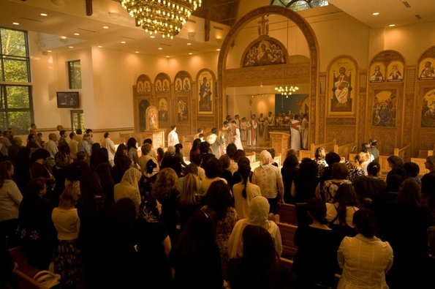
Tradition and my Spiritual life today

Slide 24
Orthodoxy and Tradition
Fr Tadros Malaty
The church tradition, is the continuous stream of the church life in Jesus Christ, by the work of the Holy Spirit. This life is not limited into our “faith” but also embraces the church spiritual and ethical scheme, bedside the church order of worship. Thus the tradition represents the “one” life of the church, which cannot be separated into faith, spiritual teaching and worship.

Slide 25
J.N.D. Kelly
“Hence by tradition the Fathers usually mean doctrine which the Lord or His apostles committed to the Church, irrespective of whether it was handed down orally or in documents... The ancient meaning of the term is well illustrated by Athanasius’ reference to the actual original tradition teaching and faith of the catholic Church, which the Lord bestowed, the apostles proclaimed and the Fathers safeguarded.

Slide 26
ST. IRENAEUS
“I remember the events of those days more clearly than those of recent date, for the things that have been learned from childhood grow up with the soul and become one with it. So I can describe even the place where the blessed Polycarp sat and held discourse, how he came in and went out, his manner of life and personal appearance, the discourses which he delivered to the people, and how he reported his communications with John and with the others who had seen the Lord.”

Slide 27
T.Ware,
The Orthodox Church, 215
All True Orthodox theology is mystical; just as mysticism divorced from theology becomes subjective and heretical, so, theology when it is not mystical, degenerates into an arid scholasticism, ‘academic’ in the bad sense of the word. Theology, mysticism, spirituality, moral rules, worship, art; these things must not be kept in a separate compartment. Doctrine cannot be understood unless it is prayed; a theologian, said Evagrius, is one who knows how to pray, and he who prays in spirit and in truth is by that very act a theologian. And doctrine, if it is to be prayed, must also be lived; theology without action, as Saint Maximus put it, is the theology of demons.

