Slide 1
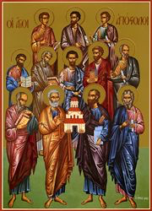
The Holy Tradition and Schisms
SMSV
Discipleship group

Slide 2
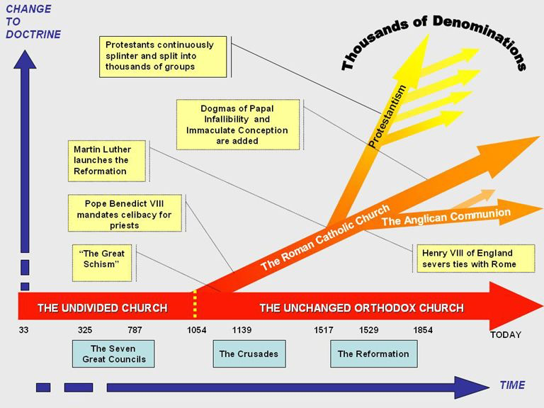
Summary of the Church Schisms
Chalcedon 451
We believe in 3 only
Oriental Orthodox

Slide 3
Adoptionism
. Adoptionism held that Jesus was not really God but merely a man to whom special graces had been given and who achieved a kind of divine status at his baptism. This idea that Christ as a man was only the "adopted" son of God proved to be a persistent heresy. It was condemned by Pope St. Victor 1 (D 199), who excommunicated Theodotus of Byzantium for Adoptionism. The same heresy was condemned in 785 and again in 794 by Pope Adrian 1. Revived by Peter Abelard in the twelfth century, Adoptionism was again condemned by Pope Alexander III in 1177.

Slide 4
Apollinarianism.
This heretical doctrine of Apollinaris (310-390), bishop of Laodicea in Asia Minor, held that Christ had a human body but only a sensitive soul-and no rational human mind or human free will, these having been replaced in Christ by the divine Logos, or Word of God. This theory was condemned by Roman synods in 377 and 381 and by the ecumenical Council of Constantinople in the latter year.

Slide 5
Arianism.
A major heresy that arose in the fourth century and denied the divinity of Jesus Christ. First effectively advanced by Arius (256-336), a priest of Alexandria, who denied that there were three distinct divine Persons in God. For Arius, there was only one Person, the Father. According to Arian theory, the Son was created ("There was a time when he was not"). Christ was thus a son of God, not by nature, but only by grace and adoption. This theory logically evacuates the doctrine of the Incarnation of God in Christ of all meaning: if God did not become man, then the world has not been redeemed and the faith itself eventually dissolves.

Slide 6
Arianism.
Arianism was formally condemned in 325 by the first ecumenical Council of Nicaea, which formulated and promulgated the original version of the Nicene Creed; but Arianism and Semi-Arianism (see below) nevertheless continued to prevail in its original form in many areas for more than a century. Arianism was combatted by the great St. Athanasius of Alexandria (296-373) among others; but the heresy nevertheless persisted, especially among the barbarians, for several centuries.

Slide 7
Macedonianism
Macedonius and his followers were semi-Arian, and taught that though the Son was eternal, He was not of one essence (Latin: consubstanciales, Greek: homoousios) with the Father but of like essence (Greek: homoiousios) with the Father. They also taught that the Holy Spirit was not eternal and consubstantial with the Father and the Son but a creation of the Father and an action of the Son. Thus, the Macedonians denied that the Holy Spirit was a hypostasis, or person, of the Holy Trinity.

Slide 8
Donatism.
A fourth- and fifth-century African heresy holding that the validity of the sacraments depends upon the moral character of the minister of the sacraments and that sinners cannot be true members of the Church or even tolerated by the Church if their sins are publicly known. Donatism began as a schism when rigorists claimed that a bishop of Carthage, Caecilian (fl. ca. 313), was not a true bishop because he had been ordained by a bishop who had been an apostate under the Diocletian persecution. The Donatists ordained their own bishops, one of whom was Donatus, for whom the heresy is named. Donatism was condemned by Pope Miltiades (311-3 14) and by the (local) Council of Arles in 314, but it nevertheless persisted in North Africa until the Muslim conquest in the seventh century. The great St. Augustine (354-430) wrote extensively against Donatism.

Slide 9
The roots of the Reformation
Pelagianism , Augustianism , Semi-Pegliansim and the Root of Reformation

Slide 10
Filioque
Filioque is a Latin word meaning "and the Son" which was added to the Nicene-Constantinopolitan Creed by the Church of Rome in the 11th century, one of the major factors leading to the Great Schism between East and West. This inclusion in the Creedal article regarding the Holy Spirit thus states that the Spirit "proceeds from the Father and the Son."

