Slide 1
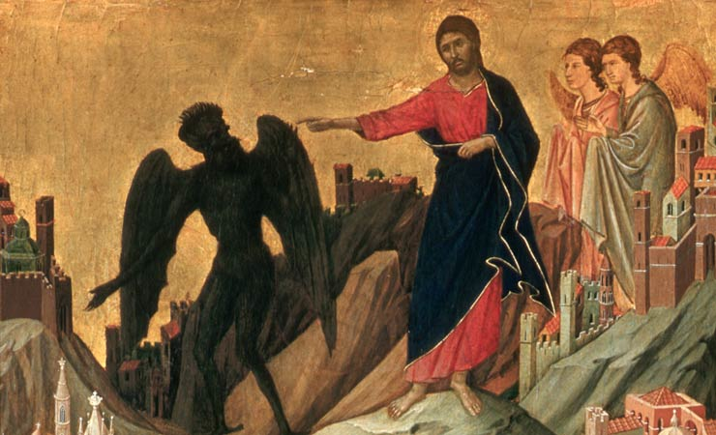
The Change (3): From Temptation to Victory
Temptation Sunday – Great Lent 2014

Slide 2
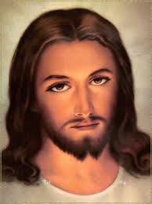
The Image

Slide 3
Those Who are Christ’s
And those who are Christ’s have crucified the flesh with its passions and desires. Gal 5:24

Slide 4
Passions are aliens to our nature
They (passions) were not included in the image of God. St Basil the Great
It is not right to say that they (passions) belong to the soul, even though the soul might be led by the passions. It is clear , then, that the soul is directed by what is exterior to it and not by what belongs to it. St Isaac the Syrian

Slide 5
Passions are man’s inventions
Through the first man’s disobedience , we have received in ourselves an element alien to our nature: the malice of the passions, which having passed into habit and inveterate disposition has become our nature . St Macarius the Great

Slide 6
Basics
passions are the results of man’s misuse of his free will
Logicos , according to the Fathers means in conformity with the Logos, in whose image and likeness man was made
It is we ourselves who have changed the constitutive qualities of our nature into passions. St John Climacus

Slide 7
St Maximus the confessor classification to passions
The quest of pleasure : gluttony, pride, vanity, presumption, greed, ….and every other vice of this kind
The avoidance of suffering: angry, envy, hatred, hostility, negligence, faintheartedness, bitterness, jealousy, false accusation of Divine Providence and all vices of this kind
The mix of pleasure and suffering: hypocrisy, guile, dissimulation, flattery and all vices of this kind

Slide 8
St Evagrius Classification
The core of all of them : self love
Major three: Gluttony, greed and vainglory
( the Lord’s Temptation)
Lust, love of money, sorrow, anger, and Pride

Slide 9
How to conqueror Passions
The aim : Restoring the image
The Goal : reaching the likeness
The Means : all means of Grace

Slide 10
The Lord’s Advice
However, this kind does not go out except by prayer and fasting.” Matt 17:21

Slide 11
Fasting
“For, as I have often told you before and now say again even with tears, many live as enemies of the cross of Christ. Their destiny is destruction, their god is their stomach, and the glory is their shame. Their mind is on earthly things.” (Phil. 3:18-19 NIV)
"A stuffed belly produces fornication, while a mortified stomach leads to purity.” St John Climacus

Slide 12
Repetitious, Meaningful Prayer
St. John Climacus writes:
One phrase on the lips of the tax collector was enough to win God's mercy; one humble request made with faith was enough to save the good thief."

Slide 13
The Refusal to Despair
“Repentance is the daughter of hope and the refusal to despair.”
(The penitent stands guilty-but not disgraced.)
St John Climacus

Slide 14
Using the sign of the cross
St. Athanasius tells of how St. Anthony fought temptation with the sign of the cross.
“Sign yourselves therefore with the cross, and depart boldly, and let these make sport for themselves.' So they departed fortified with the sign of the Cross.

Slide 15
The Liturgical Power
Agypia Prayer
Midnight praise
St Cyril Fraction
The Prayer of Reconciliation

