Slide 1
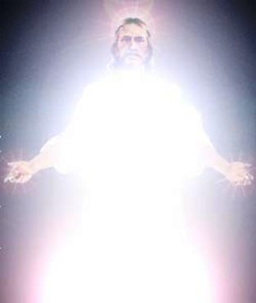
The light of the world
4th Sunday of the fifty joyous days
2009

Slide 2
St. Ambrose of Milan
The Lord was Baptized, not to be cleansed Himself, but to cleanse the waters, so that those waters, cleansed by the flesh of Christ which knew no sin, might have the power of Baptism (illumination)

Slide 3
Light in the bible
אור= H216 = 'owr appeared 123 time in the Old testament , 32 times in the book of Job
Φῶς = G5457 = phōs appeared in the new testament 70 times , 16 times in the gospel of St. John

Slide 4
For How long do we have the light?
Then Jesus told them, “¹You are going to have the light just a little while longer. ²Walk while you have the light, ³before darkness overtakes you. ⁴The man who walks in the dark does not know where he is going. ⁵Put your trust in the light while you have it, ⁶so that you may become sons of light." When he had finished speaking, ⁷Jesus left and hid himself from them.
Jn 12:35,36

Slide 5
1. Fact : You are going to have the light just a little while
That was the true Light which gives light to every man coming into the world.
Jn 1:9
Then Jesus spoke to them again, saying, “I am the light of the world. He who follows Me shall not walk in darkness, but have the light of life.” Jn 8:12

Slide 6
2.command: Walk while you have the light
"You are the light of the world. A city that is set on a hill cannot be hidden.
Matt 5:14
He who loves his brother abides in the light, and there is no cause for stumbling in him. 1 Jn 2:10

Slide 7
3. warning: before darkness overtakes you
For everyone practicing evil hates the light and does not come to the light, lest his deeds should be exposed. Jn 3:20
This is the message which we have heard from Him and declare to you, that God is light and in Him is no darkness at all. But if we walk in the light as He is in the light, we have fellowship with one another, and the blood of Jesus Christ His Son cleanses us from all sin.
1Jn 1:5,7

Slide 8
4. Explanation: The man who walks in the dark does not know where he is going
He reveals deep and secret things; He knows what is in the darkness, And light dwells with Him. Dan 2:22
I will bring the blind by a way they did not know; I will lead them in paths they have not known. I will make darkness light before them, And crooked places straight. These things I will do for them, And not forsake them. Isa 42:16

Slide 9
5. wisdom: Put your trust in the light while you have it
Oh, send out Your light and Your truth! Let them lead me; Let them bring me to Your holy hill And to Your tabernacle. Ps 43:3
And the light shines in the darkness, and the darkness did not comprehend it. Jn 1:5

Slide 10
6. Result: so that you may become sons of light."
For it is the God who commanded light to shine out of darkness, who has shone in our hearts to give the light of the knowledge of the glory of God in the face of Jesus Christ. 2 Cor. 4:6
For you were once darkness, but now you are light in the Lord. Walk as children of light Eph 5:8

Slide 11
7. Don’t miss him: Jesus left and hid himself from them
And this is the condemnation, that the light has come into the world, and men loved darkness rather than light, because their deeds were evil. Jn 3:19
Then the king said to the servants, ‘Bind him hand and foot, take him away, and cast him into outer darkness; there will be weeping and gnashing of teeth.’ Matt 22:13

Slide 12
St. John Chrysostom
You can call happy those who saw Him. But, come to the altar and you will see Him, you will touch Him, you will give to Him holy kisses, you will wash Him with your tears, you will carry Him within you like Mary Most Holy.

