Slide 1
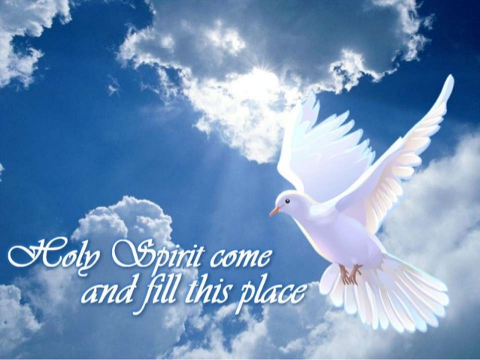
The Gift of the Father
1st Sunday of Baonah 2015

Slide 2
Didymus of Alexandria (313 – 398 AD)
Finding us in a state of deformity, the Spirit restores our original beauty and fills us with his grace, leaving no room for anything unworthy of our love.

Slide 3
Pauline Epistle
13 Now may the God of hope fill you with all joy and peace in believing, that you may abound in hope by the power of the Holy Spirit. 14 Now I myself am confident concerning you, my brethren, that you also are full of goodness, filled with all knowledge, able also to admonish one another. Rom 15:13,14

Slide 4
Catholic Epistle
elect according to the foreknowledge of God the Father, in sanctification of the Spirit, for obedience and sprinkling of the blood of Jesus Christ: 1 Pet 1:2

Slide 5
Didymus of Alexandria (313 – 398 AD)
The Spirit frees us from sin and death, and changes us from the earthly humans we were, men of dust and ashes, into spiritual humans, sharers in the divine glory, sons and heirs of God the Father who bear a likeness to the Son and are his co-heirs and brothers and sisters, destined to reign with him and to share his glory.

Slide 6
Acts
As they ministered to the Lord and fasted, the Holy Spirit said, “Now separate to Me Barnabas and Saul for the work to which I have called them.” 3 Then, having fasted and prayed, and laid hands on them, they sent them away. Acts 13:2

Slide 7
The Gift
If you then, being evil, know how to give good gifts to your children, how much more will your heavenly Father give the Holy Spirit to those who ask Him!” Lk 11:13

Slide 8
St Basil the Great
The Spirit raises our hearts to heaven, guides the steps of the weak, and brings to perfection those who are making progress. He enlightens those who have been cleansed from every stain of sin and makes them spiritual by communion with Himself.

