Slide 1
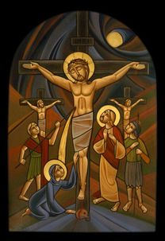
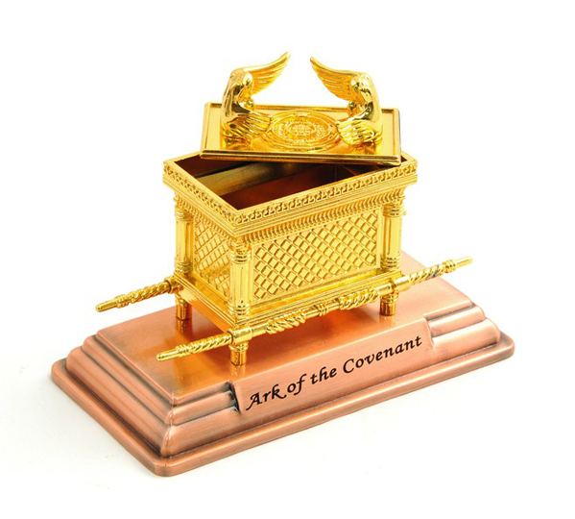
The feast of the cross
17th Tout 1735

Slide 2
The Ascetical Homilies of St. Isaac of Syria
"The Cross is the door to mysteries. Through this door the intellect makes entrance in to the knowledge of heavenly mysteries. The knowledge of the Cross is concealed in the sufferings of the Cross. And the more our participation in its sufferings, the greater the perception we gain through the Cross.

Slide 4
The mercy seat

Slide 5
The Ark of covenant from inside
The two tablets of Stone
Aaron’s staff
The Jar of Manna

Slide 6
The Mercy Seat (ἱλαστήριον)
¹⁷ “You shall make a mercy seat of pure gold;… ²⁰ And the cherubim shall stretch out their wings above, covering the mercy seat with their wings, and they shall face one another; the faces of the cherubim shall be toward the mercy seat. ²¹ You shall put the mercy seat on top of the ark, and in the ark you shall put the Testimony that I will give you. ²² And there I will meet with you, and I will speak with you from above the mercy seat, from between the two cherubim which are on the ark of the Testimony, about everything which I will give you in commandment to the children of Israel. Ex 25:17-22

Slide 7
The Day of Atonement (Yom Kippur)
¹⁵ “Then he shall kill the goat of the sin offering, which is for the people, bring its blood inside the veil, do with that blood as he did with the blood of the bull, and sprinkle it on the mercy seat and before the mercy seat. ¹⁶ So he shall make atonement for the Holy Place, because of the uncleanness of the children of Israel, and because of their transgressions, for all their sins; and so he shall do for the tabernacle of meeting which remains among them in the midst of their uncleanness. Lev 16:15,16

Slide 8
Blessed !
Blessed is he whose transgression is forgiven, Whose sin is covered. Blessed is the man to whom the Lord does not impute iniquity, And in whose spirit there is no deceit. Ps 32:1,2

Slide 9
His Own Blooed
¹² Not with the blood of goats and calves, but with His own blood He entered the Most Holy Place once for all, having obtained eternal redemption. ¹³ For if the blood of bulls and goats and the ashes of a heifer, sprinkling the unclean, sanctifies for the purifying of the flesh, ¹⁴ how much more shall the blood of Christ, who through the eternal Spirit offered Himself without spot to God, cleanse your conscience from dead works to serve the living God? Heb 9:12-14

Slide 10
St. Athanasius of Alexandria On the Gospel of Luke 19
Just as a man is enlightened by the Holy Spirit when he is baptized by a priest, so he who confesses his sins with a repentant heart obtains their remission from the priest.

Slide 11
We were able to eat the true manna
To enjoy the fulfilment of the law in our behalf
Through the incarnation

Slide 12
St John Chrysostom
The Cross uprooted us from the depths of evil and elevated us to the summit of virtue

