Slide 1
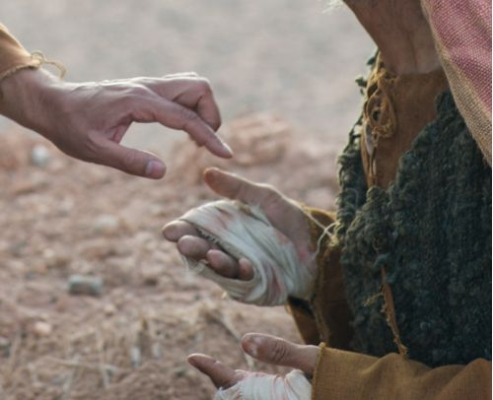
“Irrational Love Series”
God touches the Untouchable

Slide 2
All of us, at certain stages or in certain settings, feel like untouchables— unacceptable, unworthy outsiders.

Slide 3
Mark 1:40-45
“Now a leper came to Him, imploring Him, kneeling down to Him and saying to Him, “If You are willing, You can make me clean.”
⁴¹ Then Jesus, moved with compassion, stretched out His hand and touched him, and said to him, “I am willing; be cleansed.” ⁴² As soon as He had spoken, immediately the leprosy left him, and he was cleansed. ⁴³ And He strictly warned him and sent him away at once, ⁴⁴ and said to him, “See that you say nothing to anyone; but go your way, show yourself to the priest, and offer for your cleansing those things which Moses commanded, as a testimony to them.”
⁴⁵ However, he went out and began to proclaim it freely, and to spread the matter, so that Jesus could no longer openly enter the city, but was outside in deserted places; and they came to Him from every direction.

Slide 4
Strategy of isolation is that sin and suffering are contagious
strategy of

Slide 5
The problem of isolating others is when I do this I come to view the world as “us” versus “them.”

Slide 6
In isolation love dies; humility and compassion and generosity all suffocate

Slide 7
Jesus had the kind “differentness” that drew sinners to Him.
The Pharisees had the kind of superficial differentness that pushed people away.

Slide 8
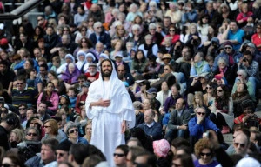
true spirituality always makes a person more approachable, not less

Slide 9
Jesus touched the leper before he healed him.

Slide 10
The word healed his body, but the touch healed his soul.

Slide 11
The miracle of the touch is that Jesus was willing to share another person’s suffering in order to bring about healing

Slide 12
Jesus didn’t call His followers to live in quarantine. He called them to be a kind of hospital.

Slide 13
The leper did not infect Jesus with his sickness. Jesus infected the leper with his life!

Slide 14
2 Corinthians 4:11-12
¹ For we who live are always delivered to death for Jesus’ sake, that the life of Jesus also may be manifested in our mortal flesh. ¹² So then death is working in us, but life in you.

