Slide 1
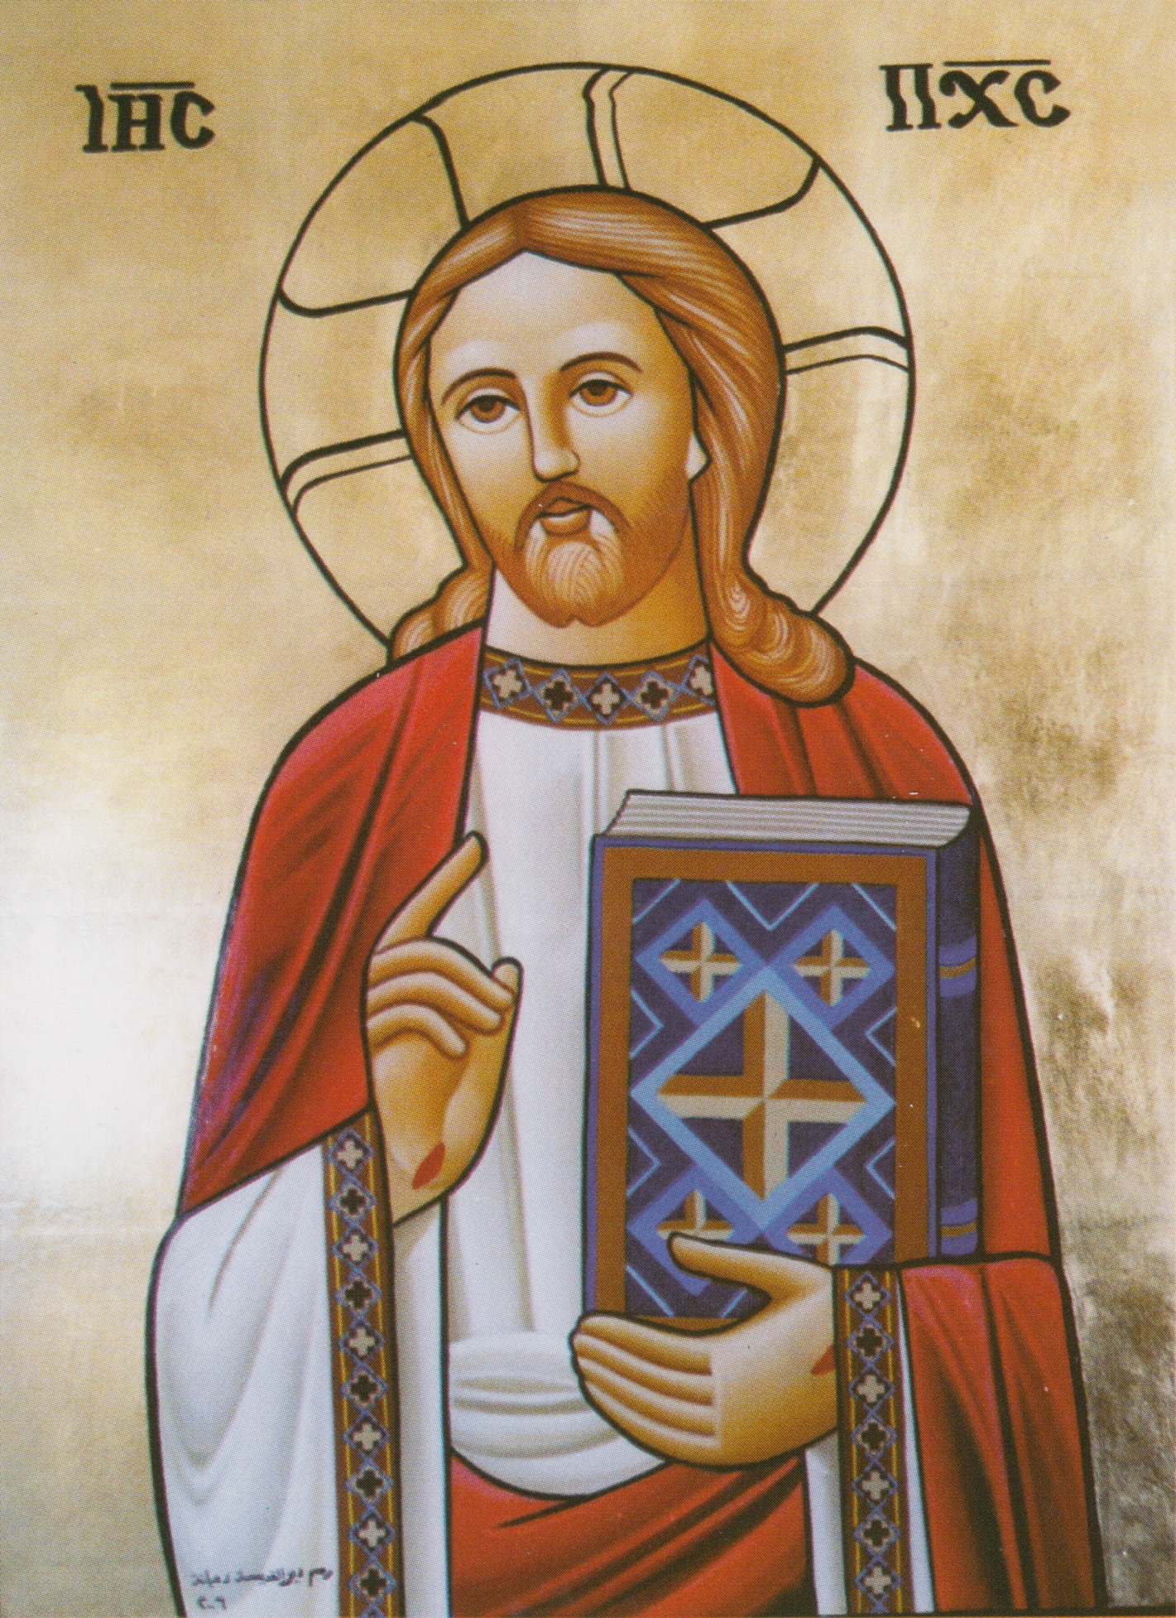
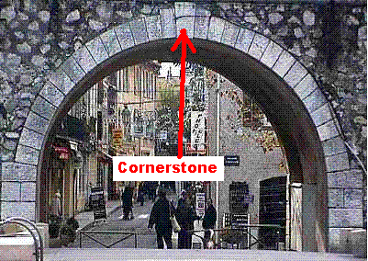
The Cornerstone
1st Sunday Messeri /August 2018

Slide 2
The Chief Cornerstone
20 having been built on the foundation of the apostles and prophets, Jesus Christ Himself being the chief cornerstone, 21 in whom the whole building, being fitted together, grows into a holy temple in the Lord, 22 in whom you also are being built together for a dwelling place of God in the Spirit. Eph 2:20-22

Slide 3
Having been built on the foundation of the apostles and prophets, Jesus Christ Himself being the chief cornerstone,
Eph 2:20
prophets
apostles

Slide 4
Pauline
Therefore I run thus: not with uncertainty. Thus I fight: not as one who beats the air. But I discipline my body and bring it into subjection, lest, when I have preached to others, I myself should become disqualified. 1 Cor 9:26,27

Slide 5
Obedience as the sign !!!
Therefore, to you who believe, He is precious; but to those who are disobedient, “The stone which the builders rejected Has become the chief cornerstone,” and “A stone of stumbling And a rock of offense.” They stumble, being disobedient to the word, to which they also were appointed. 1 Pet 2:7,8

Slide 6
Acts
Moreover you see and hear that not only at Ephesus, but throughout almost all Asia, this Paul has persuaded and turned away many people, saying that they are not gods which are made with hands. Acts 19:26

Slide 7
(St. Gregory, Bishop of Nyssa)
Yet, let us change for the better; let us have a kind of wings to fly up to better things; from glory to glory, to be greater through the daily growth, and the continuous seeking of perfection. The true perfection is not to stop at growing to what is better, and not to set limits for perfection.
On Perfection.

Slide 8
Psalm
Return, we beseech You, O God of hosts;
Look down from heaven and see,
And visit this vine
And the vineyard which Your right hand has planted,
And the branch that You made strong for Yourself. Ps 80:14,15

Slide 9
The Gospel
Then He looked at them and said, “What then is this that is written: ‘The stone which the builders rejected Has become the chief cornerstone’? Luke 20:17 (Ps 118:22)

Slide 10
This week's spiritual exercise
Search your heart , knowing that rejecting the cornerstone = disobedience
Obedience is neither partial nor postponed
Dedicate this week to fast and pray for a real clear choice of obedience
sit with your father of confession or your spiritual mentor to take serious steps towards obedience.

