Slide 1
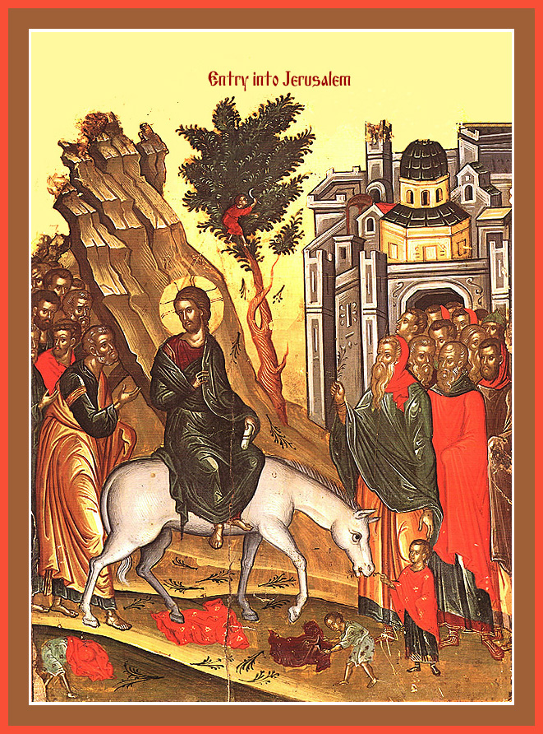
The Change (7): From Silence to Cry
Palm Sunday 2014

Slide 2
The Change
Is a need
From double minded to single minded
From temptation to Victory
From Guilty past to shameless life
From my way to His way
From my vision to His Vision
From silence to Cry out

Slide 3
They Cried Out
Then the multitudes who went before and those who followed cried out, saying:
“Hosanna to the Son of David! ‘Blessed is He who comes in the name of the Lord!’ Hosanna in the highest!” Matt 21:9

Slide 4
1 – Death
And He said, “What have you done? The voice of your brother’s blood cries out to Me from the ground. Gen 4:10

Slide 5
2 - Lost birthrights
When Esau heard the words of his father, he cried with an exceedingly great and bitter cry, and said to his father, “Bless me—me also, O my father!” Gen 27:34

Slide 6
3- famine and Joseph
So when all the land of Egypt was famished, the people cried to Pharaoh for bread. Then Pharaoh said to all the Egyptians, “Go to Joseph; whatever he says to you, do. Gen 41:55

Slide 7
4. Bondage and slavery
Now it happened in the process of time that the king of Egypt died. Then the children of Israel groaned because of the bondage, and they cried out; and their cry came up to God because of the bondage. Ex 2:23

Slide 8
Our cry is heard
The righteous cry out, and the Lord hears, And delivers them out of all their troubles. Ps 34:17

Slide 9
They Cried Out
Then the multitudes who went before and those who followed cried out, saying:
“Hosanna to the Son of David! ‘Blessed is He who comes in the name of the Lord!’ Hosanna in the highest!” Matt 21:9

Slide 10
St Andrew of Crete
Let us run to accompany him as he hastens toward his passion, and imitate those who met him then, not by covering his path with garments, olive branches or palms, but by doing all we can to prostrate ourselves before him by being humble and by trying to live as he would wish. Then we shall be able to receive the Word at his coming, and God, whom no limits can contain, will be within us.

