Slide 1
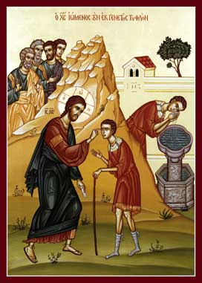
The Change (6): From My vision To His Vision
6th Sunday of the Great Lent 2014

Slide 2
St. John of Kronstadt
Watch your heart during all your life — examine it, listen to it, and see what prevents its union with the most blessed Lord. Let this be for you the science of all sciences,

Slide 3
1. He saw him : they did not see him
Now as Jesus passed by, He saw a man who was blind from birth. 2 And His disciples asked Him, saying, “Rabbi, who sinned, this man or his parents, that he was born blind?” Jn 9:1,2

Slide 4
2. He saw Glory in It : they saw someone to condemn
2 And His disciples asked Him, saying, “Rabbi, who sinned, this man or his parents, that he was born blind?”3 Jesus answered, “Neither this man nor his parents sinned, but that the works of God should be revealed in him. Jn 9:3,4

Slide 5
3. He saw him illuminated : they saw him just a son
His parents answered them and said, “We know that this is our son, and that he was born blind; 21 but by what means he now sees we do not know, or who opened his eyes we do not know. He is of age; ask him. He will speak for himself.” Jn 9:20,21

Slide 6
4. He saw the joy of his mission: they saw the broken human tradition
As long as I am in the world, I am the light of the world.” …..16 Therefore some of the Pharisees said, “This Man is not from God, because He does not keep the Sabbath.” Jn 9:5,16

Slide 7
5. He saw that he came to unify : they saw him a cause of division
Therefore some of the Pharisees said, “This Man is not from God, because He does not keep the Sabbath.” Others said, “How can a man who is a sinner do such signs?” And there was a division among them. Jn 9:16

Slide 8
St Paul and Discernment
This girl followed Paul and us, and cried out, saying, “These men are the servants of the Most High God, who proclaim to us the way of salvation.” And this she did for many days... Acts 16:17,18

Slide 9
6. He saw him a believer : they saw him a sinner
So they again called the man who was blind, and said to him, “Give God the glory! We know that this Man is a sinner.”…Then he said, “Lord, I believe!” And he worshiped Him. Jn 9:24,38

Slide 10
7. He saw them blind : they saw him a sinner
So they again called the man who was blind, and said to him, “Give God the glory! We know that this Man is a sinner.” …Then some of the Pharisees who were with Him heard these words, and said to Him, “Are we blind also?” Jn 9:24,40

Slide 11
St. Justin Martyr
This baptism is called “illumination” because of the mental enlightenment that is experienced by those who learn these things.

