Slide 1
Spiritual Warfare - the War of Thoughts
2018 Holy Lent Servants meeting

Slide 2
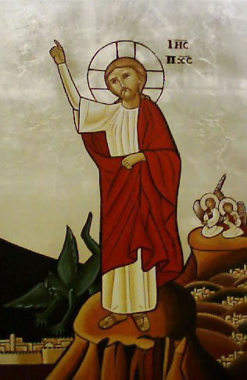
“Turn these stones into bread”
The first temptation Satan tried to tempt Jesus with was to avoid and ascetic struggle

Slide 3
2 Timothy 2:1-4
“You therefore, my son, be strong in the grace that is in Christ Jesus. ² And the things that you have heard from me among many witnesses, commit these to faithful men who will be able to teach others also. ³ You therefore must endure hardship as a good soldier of Jesus Christ. ⁴ No one engaged in warfare entangles himself with the affairs of this life, that he may please him who enlisted him as a soldier.”

Slide 4
2 present Dangers
To be unaware of the spiritual war
To not know who your enemy is

Slide 5
2 Corinthians 10:3-5
“ For we do not wrestle against flesh and blood, but against principalities, against powers, against the rulers of the darkness of this age,^{[c]} against spiritual hosts of wickedness in the heavenly places.”

Slide 6
We need to have a mind to battle, and to battle in the mind

Slide 7
Delusion

Slide 8
“Watchful”

Slide 9
Watchfulness
Watch, therefore, and pray at all times (Luke 21:36).
Watch and pray that you enter not into temptation; the spirit indeed is willing. but the flesh is weak (Matt. 26:41)

Slide 10
Discernment

