Slide 2
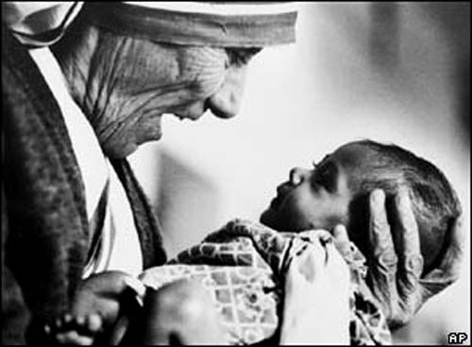
Church Built on Sacrificial Love

Slide 3
Romans 12:1-2
I beseech you therefore, brethren, by the mercies of God, that you present your bodies a living sacrifice, holy, acceptable to God, which is your reasonable service. 2 And do not be conformed to this world, but be transformed by the renewing of your mind, that you may prove what is that good and acceptable and perfect will of God.

Slide 4
Believers were not afraid of personal sacrifice, especially for a brother

Slide 5
They learned sacrifice from the one they followed

Slide 6
2 Corinthians 4:8-12
8 We are hard-pressed on every side, yet not crushed; we are perplexed, but not in despair; 9 persecuted, but not forsaken; struck down, but not destroyed— 10 always carrying about in the body the dying of the Lord Jesus, that the life of Jesus also may be manifested in our body. 11 For we who live are always delivered to death for Jesus’ sake, that the life of Jesus also may be manifested in our mortal flesh. 12 So then death is working in us, but life in you.

Slide 7
The motto of life was to die daily

Slide 8
How did they treat suffering?

Slide 9
Acts 5:40-41
40 And they agreed with him, and when they had called for the apostles and beaten them, they commanded that they should not speak in the name of Jesus, and let them go. 41 So they departed from the presence of the council, rejoicing that they were counted worthy to suffer shame for His name.

Slide 10
Philippians 1:29
²⁹ For to you it has been granted on behalf of Christ, not only to believe in Him, but also to suffer for His sake,

Slide 11
What do you call love that sacrifices?
LABOR OF LOVE

Slide 12
Luke 12:22-34
²² Then He said to His disciples, “Therefore I say to you, do not worry about your life, what you will eat; nor about the body, what you will put on. ²³ Life is more than food, and the body is more than clothing. ²⁴ Consider the ravens, for they neither sow nor reap, which have neither storehouse nor barn; and God feeds them. Of how much more value are you than the birds? ²⁵ And which of you by worrying can add one cubit to his stature? ²⁶ If you then are not able to do the least, why are you anxious for the rest? ²⁷ Consider the lilies, how they grow: they neither toil nor spin; and yet I say to you, even Solomon in all his glory was not arrayed like one of these.

Slide 13
²⁸ If then God so clothes the grass, which today is in the field and tomorrow is thrown into the oven, how much more will He clothe you, O you of little faith? ²⁹ “And do not seek what you should eat or what you should drink, nor have an anxious mind. ³⁰ For all these things the nations of the world seek after, and your Father knows that you need these things. ³¹ But seek the kingdom of God, and all these things shall be added to you. ³² “Do not fear, little flock, for it is your Father’s good pleasure to give you the kingdom. ³³ Sell what you have and give alms; provide yourselves money bags which do not grow old, a treasure in the heavens that does not fail, where no thief approaches nor moth destroys. ³⁴ For where your treasure is, there your heart will be also.

Slide 14
The early church Christians preferred richness toward God over earthly riches
#Heavenlyperspective

Slide 15
2 Corinthians 4:16-18
16 Therefore we do not lose heart. Even though our outward man is perishing, yet the inward man is being renewed day by day. 17 For our light affliction, which is but for a moment, is working for us a far more exceeding and eternal weight of glory, 18 while we do not look at the things which are seen, but at the things which are not seen. For the things which are seen are temporary, but the things which are not seen are eternal.

Slide 16
Christian Love
Sacrificial love.
Labor of Love.

