Slide 1
Last Week Summary
St. John: who he is…….
When & Where the Book of Revelation was Written
The Tree of Life & The Tree of Knowledge
Why Adam & Eve were casted out of Eden
Connecting Genesis to Revelation
Starting the 7 Churches……

Slide 3
The 1st Vision
It describes Jesus Christ in his glory. (REV 1:12-16)
Who Jesus is: The Alpha and Omega (REV 1:8),
The First and Last (REV 1: 17),
He that Liveth and was Dead (REV 1: 18),
Alive forever more (REV 1: 18),
Has the Keys of Hell and of Death (REV 1:19),
The one that can explain the mystery of the seven stars (angels/bishops of seven churches) (REV 1:20), and
the seven candlesticks (churches) (REV 1:20)

Slide 4
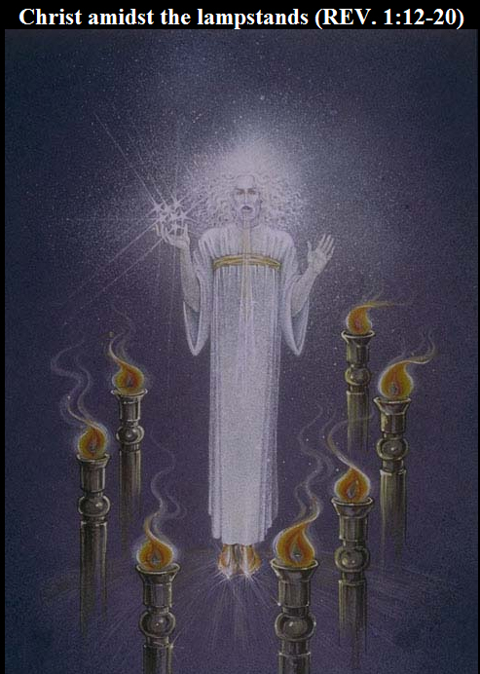
His eyes like a flame of fire
Golden Band about the chest..
His head and hair were white as snow…
Out of his mouth went a sharp two edged sword…
His countenance was like the sun shining in the strength.
Mystery of the Seven stars
The Golden Lamp stand
Clothed with a white garment down to the foot
His feet were like fine brass as if refined in a furnace

Slide 5
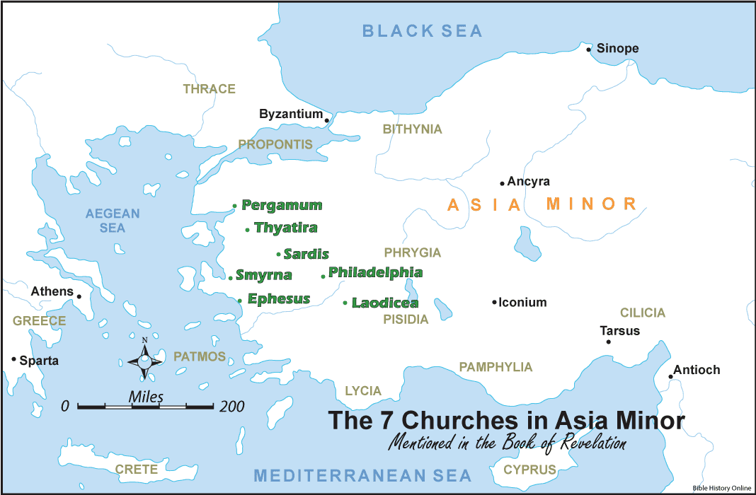

Slide 7
The Church of Ephesus (means “Beloved”) (Rev 2:1-7)
Who is Jesus In the Text | The Love of God: Starts with The Strengths 1st | Weaknesses | Remedy | Promises
He who holds the seven stars in His right hand. Who walks in the midst of the seven golden lampstands | I Know your labor Patience You can not bear those who are evil And you have tested those who say they are apostles and are not, and have found them liars | You have left your first love | Remember from where you have fallen; repent and do the first works | I will give to eat from the tree of life, which is in the midst of the Paradise of God

Slide 8
The Church of Smyrna means (“Bitter”) – (the persecuted) (Rev 2:8-11)
Who is Jesus In the Text | The Love of God: Starts with The Strengths 1st | Weaknesses | Remedy | Promises
The First and the Last Who was dead, and came to life | I know your works Your Tribulation And your poverty (but you are rich) | None | Do not fear any of those things which you are about to suffer | I will give you the crown of life He who overcomes shall not be hurt by the second death

Slide 9
the church of Pergamos Means : compromising (Rev 2:12-17)
Who is Jesus in the text | The Love of God: Starts with the Strengths 1st | Weaknesses | Remedy | Promises
He who has the sharp two-edged sword | You dwell where Satan’s throne is. And you hold fast to My name, You did not deny My faith even in the days in which Antipas, My faithful martyr, who was killed among you, where Satan dwells | Some accepted the doctrine of Balaam to eat things sacrificed to idols, and to commit sexual immorality | Repent, or else I will come to you quickly and will fight against them with the sword of My mouth | I will give some of the hidden manna to eat I will give him a white stone, and on the stone a new name written which no one knows except him who receives it.

Slide 10
the church of Thyatira means “Theatrical” (A outwardly relationship with no depth) (Rev 2: 18-29)
Who is Jesus in the text | The Love of God: Starts with the Strengths 1st | Weaknesses | Remedy | Promises
Son of God, who has eyes like a flame of fire, and His feet like fine brass | love, service, faith, and your patience; and as for your works, the last are more than the first | You allow that woman Jezebel (She was spreading the spirit of physical and spiritual fornication) who calls herself a prophetess, to teach and seduce My servants to commit sexual immorality and eat things sacrificed to idols | Hold fast what you have till I come | I will give power over the nations shall rule them with a rod of iron shall be dashed to pieces like the potter’s vessels I will give him the morning star

Slide 11
The church of Sardis: means “remnant” (Rev 3: 1-6)
Who is Jesus In the Text | The Love of God: Starts with The Strength 1st | Weaknesses | Remedy | Promises
He who has the seven Spirits of God And the seven stars | You have a few names even in Sardis who have not defiled their garments; and they shall walk with Me in white, for they are worthy | You have a name that you are alive, but you are dead | Be watchful, and strengthen the things which remain, that are ready to die, for I have not found your works perfect before God. Hold fast and repent | You shall be clothed in white garments, and I will not blot out your name from the Book of Life; but I will confess your name before My Father and before His angels.

Slide 12
The church of Philadelphia means “brotherly love”
Phil: means lover, and Adelfos: means brotherly love.
(Rev 3: 7-13)
Who is Jesus In the Text | The Love of God: Starts with The Strength 1st | Weaknesses | Remedy | Promises
He who is holy He who is true He who has the key of David He who opens and no one shuts and shuts and no one opens | Have kept My word, and have not denied My name | Laxity | Hold Fast | I will make you a pillar in the temple of My God. I will write on you the name of My God and the name of the city of My God, the New Jerusalem. And I will write on him My new name.

Slide 13
The church of Laodicea: means “Rule of the People” The lukewarm (Rev 3: 14-22)
Who is Jesus in the text | The Love of God: Starts with the Strengths 1st | Weaknesses | Remedy | Promises
The Amen The Faithful and True Witness The Beginning of the creation of God | None--------------- | Lukewarm Wretched Miserable, Poor, Blind, Naked. | Buy from Me gold refined in the fire, that you may be rich White garments, that you may be clothed, that the shame of your nakedness may not be revealed; Anoint your eyes with eye salve, that you may see | If anyone hears My voice and opens the door, I will come in to him and dine with him, and he with Me. I will grant you to sit with Me on My throne, as I also overcame and sat down with My Father on His throne

Slide 14
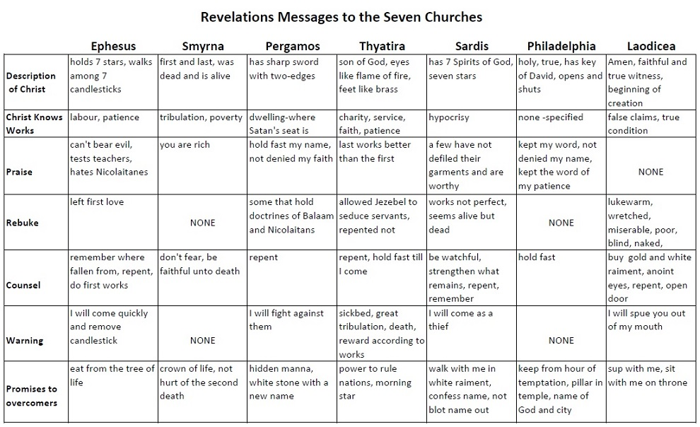

Slide 15
The Seven Seals (Chapter 4- 7)
It emphasizes the war and struggle of the church against the evil powers that ends by the Victory of the church.
St. John moved with his sight from earth to heaven to see the marvelous seen of the throne of God, the 24 elders, the sea of glass and the four living creatures with praising voices.
He saw a sealed scroll and knew that only the lion of the tribe of Judah has prevailed to loose the scroll and open its seven seals.
A Lamb stood as though it had been slain and all creatures praised Him and gave Him glory because he redeemed us to God by His Blood.
The Lamb opened the seven seals
1-White Horse (Apostolic Era – Jesus abolished death & opened the Paradise)
2-Red Horse (Martyrdom Era)
3-Black Horse (Era of Heresies)
4-Green Horse (serious heresy looks green as symbol of life while it carries death)
5-Spirits of the Martyrs under the Alter - will wait for their brothers
6-The Great Earthquake; no more time for repentance
7- When opened (8:1), there was silence in heaven. Everyone
was astonished at the Lord's coming to glorify His suffering
Church!

