Slide 1
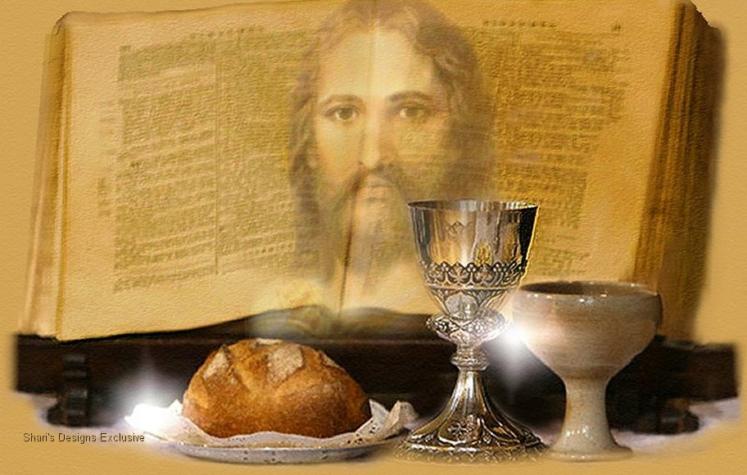
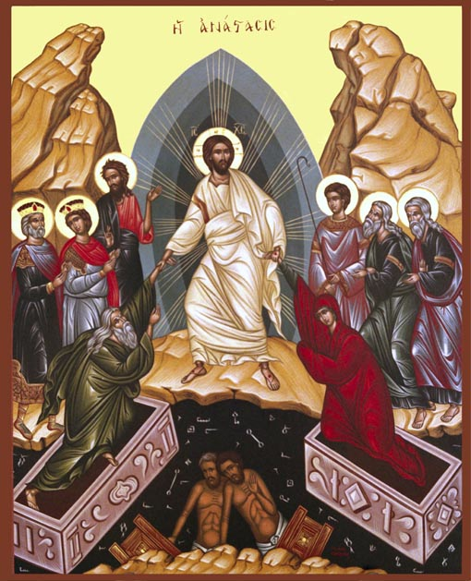
Resurrection And The Sheaf (2) : Full satisfaction
2nd Sunday of the Fifty Joyous days 2014

Slide 2
Our Resurrection and Ascension with Christ As One Sheaf Presented to the Father Glaphyra on Numbers
“And he shall wave the sheaf before the Lord, that you may find acceptance; on the morrow after the First Day the Priest shall wave it” (Lev 23:11 LXX).

Slide 3
Jesus Christ is one. But like a sheaf he is considered to contain many within himself. He is so because he possesses within himself all believers in a spiritual union.

Slide 4
… So when our Lord Jesus Christ arose and waved himself as the first fruits of mankind before God the Father, it was then that our very depths were changed into a new life.

Slide 5
The Heavenly Sanctuary
11 But Christ came as High Priest of the good things to come,[a] with the greater and more perfect tabernacle not made with hands, that is, not of this creation. 12 Not with the blood of goats and calves, but with His own blood He entered the Most Holy Place once for all, having obtained eternal redemption. 13 For if the blood of bulls and goats and the ashes of a heifer, sprinkling the unclean, sanctifies for the purifying of the flesh, 14 how much more shall the blood of Christ, who through the eternal Spirit offered Himself without spot to God, cleanse your conscience from dead works to serve the living God? 15 And for this reason He is the Mediator of the new covenant, by means of death, for the redemption of the transgressions under the first covenant, that those who are called may receive the promise of the eternal inheritance.

Slide 6
Everlasting Now
For Christ has not entered the holy places made with hands, which are copies of the true, but into heaven itself, now to appear in the presence of God for us; Heb 9:24

Slide 7
Full satisfaction
And Jesus said to them, “I am the bread of life. He who comes to Me shall never hunger, and he who believes in Me shall never thirst. Jn 6:35

Slide 8
Full acceptance
All that the Father gives Me will come to Me, and the one who comes to Me I will by no means cast out. Jn 6:37

Slide 9
Full Protection
This is the will of the Father who sent Me, that of all He has given Me I should lose nothing, but should raise it up at the last day. Jn 6:

Slide 10
My participation !!!
It is written in the prophets, ‘And they shall all be taught by God.’ Therefore everyone who has heard and learned from the Father comes to Me. Jn 6:45

