Slide 1
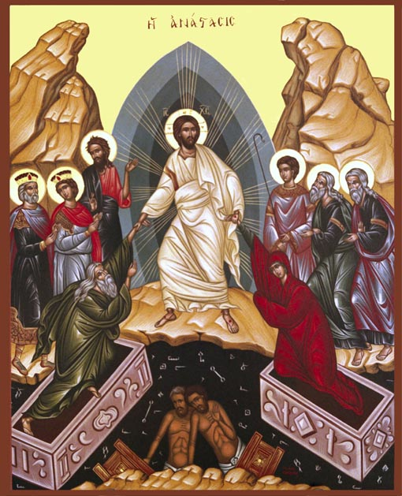
Resurrection One Sheaf Presented to the Father
Easter 2014

Slide 2
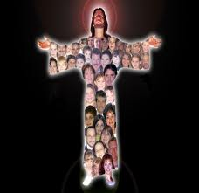
Ἀνακεφαλαιόω anakephalaioō G346 To sum up Again
That in the dispensation of the fullness of the times He might gather together in one all things in Christ, both which are in heaven and which are on earth—in Him. Eph 1:10

Slide 3
Recapitulation
The Logos become a man, recapit ulating all things in Himself. .. He takes the primacy to Himself and by making Himself the Head of the Church, He will draw all things to himself at the appointed time.
St Irenaeus A H book III, 16:6

Slide 4
Jewish Spring Holidays

Slide 5
Our Resurrection and Ascension with Christ As One Sheaf Presented to the Father Glaphyra on Numbers
“And he shall wave the sheaf before the Lord, that you may find acceptance; on the morrow after the First Day the Priest shall wave it” (Lev 23:11 LXX).

Slide 6
Jesus Christ is one. But like a sheaf he is considered to contain many within himself. He is so because he possesses within himself all believers in a spiritual union.

Slide 7
For this reason Blessed Paul writes that we have been raised up with him, and made to sit with him in the heavenly places (Eph 2:6).

Slide 8
Because when he became like us we became with him “members of the same body” (Eph 3:6). We have become rich by union with him through his body. Thus we say that we are all in him.

Slide 9
He says that the sheaf should be waved in the morrow of the first day [of unleavened bread], that is, on the third day [after the Passover]. For Christ arose from the dead on the third day, on which he also entered into heaven….

Slide 10
… So when our Lord Jesus Christ arose and waved himself as the first fruits of mankind before God the Father, it was then that our very depths were changed into a new life.

Slide 11
Everlasting Now
For Christ has not entered the holy places made with hands, which are copies of the true, but into heaven itself, now to appear in the presence of God for us; Heb 9:24

Slide 12
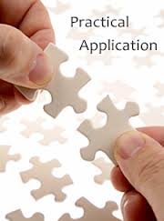
Applications
Do not allow this Easter to be just a day
Seek to be always in the sheaf
See yourself always in the Presence of the Father
As a Father : lead your family to be in the sheaf
As A mother ; observe the ways of your household
As a son/ Daughter : seek all means encourage each other to be in the sheaf
Present others to the sheaf

