Slide 1
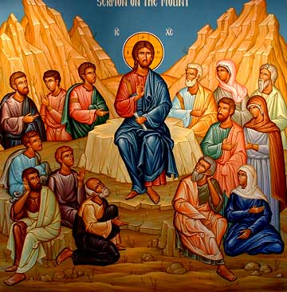
Restore me (1)
Set my Mind on Things Above
Treasures’ Sunday – Great Lent 2015

Slide 2
Points to be coverd
Treasures in Heaven
Full of Light
One True master
Do not worry

Slide 3
Restore me
“I have surely heard Ephraim bemoaning himself: ‘You have chastised me, and I was chastised, Like an untrained bull; Restore me, and I will return, For You are the Lord my God. Jer 31:18

Slide 4
1. Treasures in Heaven
19 “Do not lay up for yourselves treasures on earth, where moth and rust destroy and where thieves break in and steal; 20 but lay up for yourselves treasures in heaven, where neither moth nor rust destroys and where thieves do not break in and steal. 21 For where your treasure is, there your heart will be also. Matt 6:19-21

Slide 5
Father Afrahat
Let us “seek first the kingdom of God and His righteousness” (Matthew 6: 33). …. Let us meditate in the heavenly places, where Christ ascended. …. But let us first forsake the world which is not ours; to reach the place to which we are invited. …. Let us lift up our eyes high, to behold the splendor proclaimed. …. Let us spread our wings like angels, to behold the holy body laid there.
Demonstrations 6 on Monks, 1.

Slide 6
2. Full of Light
22 “The lamp of the body is the eye. If therefore your eye is good, your whole body will be full of light. 23 But if your eye is bad, your whole body will be full of darkness. If therefore the light that is in you is darkness, how great is that darkness! Matt 6:22,23

Slide 7
3. One True master
24 “No one can serve two masters; for either he will hate the one and love the other, or else he will be loyal to the one and despise the other. You cannot serve God and mammon. Matt 6:24

Slide 8
(St. Ambrose)
We have been risen with Christ, Let us then live in Him, and ascend with Him, so that the serpent would not find our heal to sting on earth.
Escape from the World 7: 44.

Slide 9
4. Do not worry
“Therefore I say to you, do not worry about your life ….. “Therefore do not worry, saying, ‘What shall we eat?’ or ‘What shall we drink?’ or ‘What shall we wear?’ …Therefore do not worry about tomorrow, for tomorrow will worry about its own things. Sufficient for the day is its own trouble. Matt 6: 25,28,34

Slide 10
(St. Basil the Great)
Being called for more exalted and honorable interests: “things which are above, where Christ is sitting …” , Raise yourselves above the level of the earthly things; Holdfast to your citizenship in heaven, for your true home is the heavenly Jerusalem (Philippians 3: 20), and your fellow citizens are “the firstborn who are registered in heaven” (Hebrew 12: 23) .
Hexmarion, Hom. 9: 2.

Slide 11
Exercise :
Find out who is master , pray and fast for having the one true master
Catch you worry: reject it in your prayers and sanctify this week to conquer it.
Find out the whole direction of life is it towards things above or still on earthly things?

