Slide 1
Bonding with Others

Slide 2
Bonding
the ability to establish an emotional attachment to another person. It’s the ability to relate to another on the deepest level

Slide 3
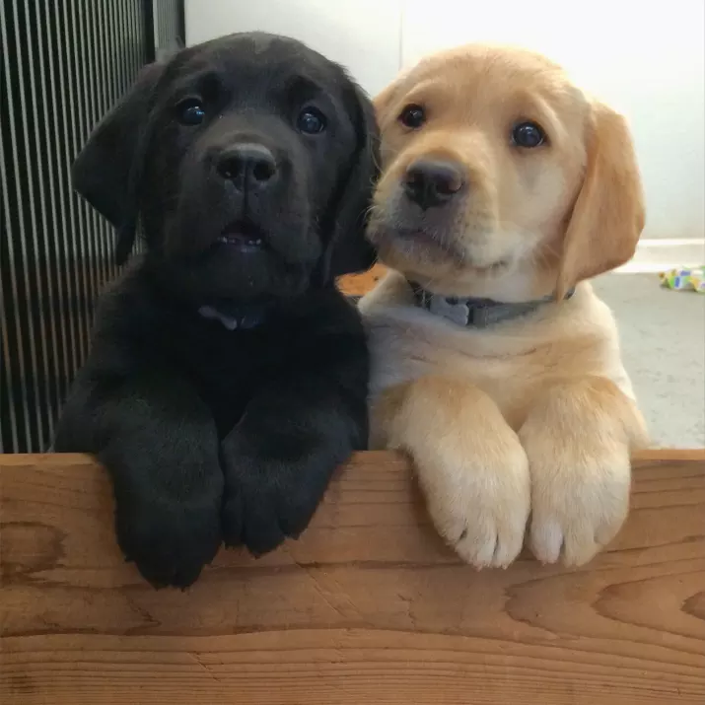
God created us with a need for relationship

Slide 4
We grow through things outside of ourselves

Slide 5
Why is our need to bond so strong? Why is our failure to bond so disastrous for our well-being?

Slide 6
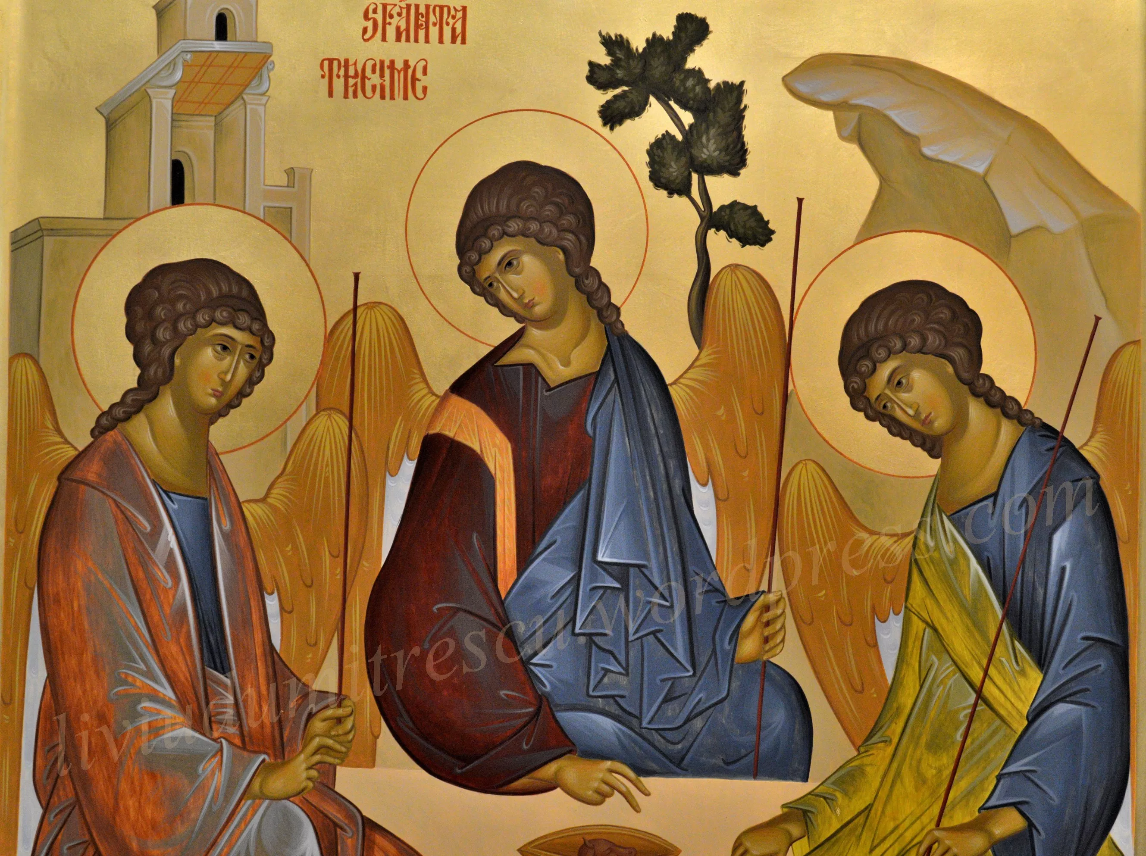
God the Holy Trinity is a relational being
At the center of all reality there exists an eternal divine community of perfect love.

Slide 7
Proverbs 9:27-31
“When He prepared the heavens, I was there, When He drew a circle on the face of the deep, ²⁸ When He established the clouds above, When He strengthened the fountains of the deep, ²⁹ When He assigned to the sea its limit, so that the waters would not transgress His command, When He marked out the foundations of the earth, ³⁰ Then I was beside Him as a master craftsman; And I was daily His delight, rejoicing always before Him, ³¹ Rejoicing in His inhabited world, And my delight was with the sons of men.”

Slide 8
Without relationship, without attachment to God and others, we can’t be our true selves.
We can’t be truly human.

Slide 9
Ephesians 3:16-19
“¹⁶ that He would grant you, according to the riches of His glory, to be strengthened with might through His Spirit in the inner man, ¹⁷ that Christ may dwell in your hearts through faith; that you, being rooted and grounded in love, ¹⁸ may be able to comprehend with all the saints what is the width and length and depth and height— ¹⁹ to know the love of Christ which passes knowledge; that you may be filled with all the fullness of God.”

Slide 10
Relationship was broken at the creation
Where perfect love had been, isolation and hatred came

Slide 11
Emotional Object Constancy

Slide 12
1 John 4:20
“For anyone who does not love his brother, whom he has seen, cannot love God, whom he has not seen.”

Slide 13
When we fail to bond

Slide 14
Stages of Isolation
Protest
Depressions and despair
Detachment

Slide 15
Distorted Thinking

Slide 16
Emptiness

Slide 17
2 Corinthians 7:5-7
“ For indeed, when we came to Macedonia, our bodies had no rest, but we were troubled on every side. Outside were conflicts, inside were fears. 6 Nevertheless God, who comforts the downcast, comforted us by the coming of Titus, 7 and not only by his coming, but also by the consolation with which he was comforted in you, when he told us of your earnest desire, your mourning, your zeal for me, so that I rejoiced even more.”

Slide 18
Emptiness
Only when a person owns his or her need and responds to another’s love will this bond begin to fill the emptiness inside

Slide 19
Barriers to Bonding

Slide 20
Past Injury

Slide 21
Addiction
Addictions are not real desires. They are substitutes for some other need of the real self.

Slide 22
Building the “Trust Muscle”

Slide 23
Our ability to bond is based on our ability to be vulnerable and needy

Slide 24
Learning to Bond

Slide 25
Skills to Bond
Realize the need
Move Towards Others
Be Vulnerable
Challenge the distortions that keep you in bondage.
Take Risks
Allow Dependent Feelings
Pray and search your heart
Rely on the Holy Spirit

