Slide 1
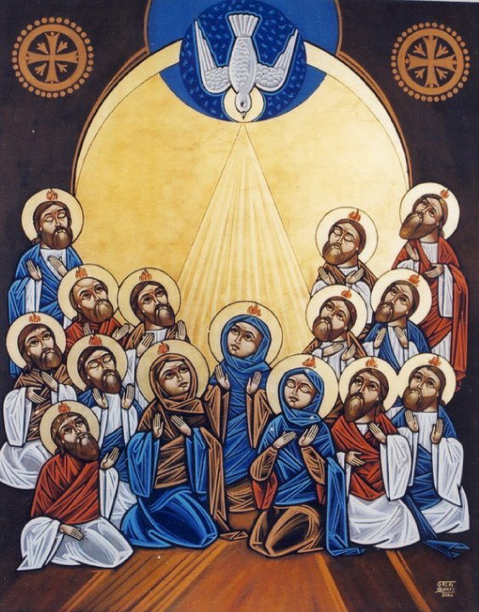
Having the Mind of Christ
Feast of Pentecost
June 4, 2017

Slide 2
The Mind of Christ
And remember the words of the Lord Jesus, that He said, ‘It is more blessed to give than to receive.’” Acts 20:35

Slide 3
The Mind of Christ
And remember the words of the Lord Jesus, that He said, ‘It is more blessed to give than to receive.’” (Acts 20:35)
“for He will take of what is Mine and declare it to you.” (John 16:14)

Slide 4
“Do not quench the Spirit.”

Slide 5
“Do not quench the Spirit.”
1) Be thankful
¹⁸ in everything give thanks; for this is the will of God in Christ Jesus for you. ¹⁹ Do not quench the Spirit. (1 Thessalonians 5:18-19)

Slide 6
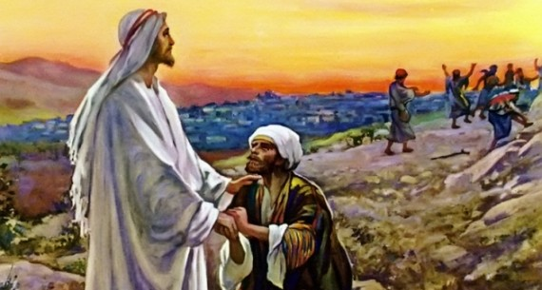
The Ten Lepers
¹⁵ And one of them, when he saw that he was healed, returned, and with a loud voice glorified God, ¹⁶ and fell down on his face at His feet, giving Him thanks. And he was a Samaritan.¹⁷ So Jesus answered and said, “Were there not ten cleansed? But where are the nine? ¹⁸ Were there not any found who returned to give glory to God except this foreigner?” (Luke 17:15-17)

Slide 7
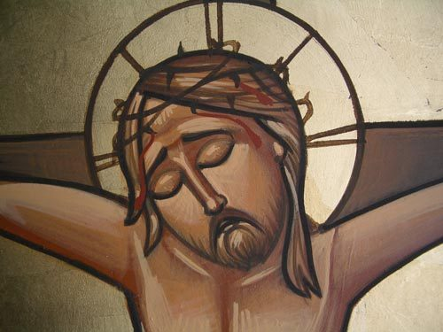
“Do not quench the Spirit.”
2) Learn to give

Slide 8
“Do not quench the Spirit.”
2) Learn to give
⁷ But the manifestation of the Spirit is given to each one for the profit of all (1 Cor. 12:7)

Slide 9
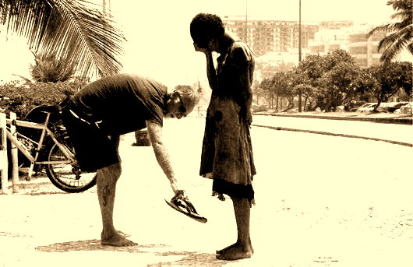
“Do not quench the Spirit.”
You are filled and you are empty. Fill your empty neighbor from your fullness, so that your emptiness may be filled from God’s fullness.
(St. Augustine)

Slide 10
“Do not quench the Spirit.”
“that they all may be one, as You, Father, are in Me, and I in You; that they also may be one in Us” John 17:21
Now the multitude of those who believed were of one heart and one soul; neither did anyone say that any of the things he possessed was his own, but they had all things in common. Acts 4:32

Slide 11
“Do not quench the Spirit.”
3) Learn to Struggle
“If anyone desires to come after Me, let him deny himself, and take up his cross daily, and follow Me. (Luke 9:23)

Slide 12
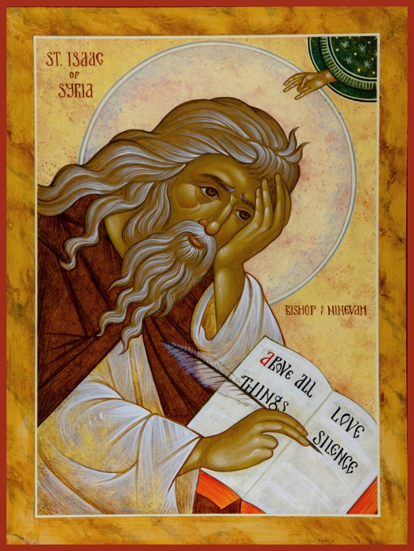
“Do not quench the Spirit.”
3) Learn to Struggle
The path of God is a daily cross. No one has ascended into heaven by means of ease. (St. Isaac the Syrian)

Slide 13
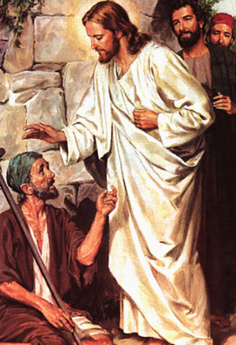
Conclusion
“…He went about doing good…” (Acts 10:38)

