Slide 1
Patience Pays Off
Second Sunday of Hatour
November 21, 2010
Matthew 13:1-9

Slide 2
Liturgy Psalm – Psalm 104:10, 16
“The trees of the Lord are full of sap, the cedars of Lebanon which He planted. He sends the springs into the valleys, they flow among the hills.”
Matins Psalm: Psalm 67:6-7
“Then the earth shall yield her increase; God, our own God, shall bless us. God shall bless us, and all the ends of the earth shall fear Him.”
Vespers Psalm – Psalm 104:13
“He waters the hills from His upper chambers; the earth is satisfied with the fruit of Your works.”

Slide 3
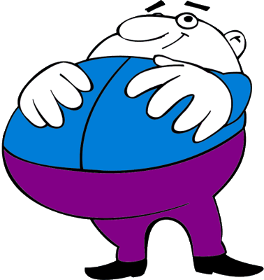
God wants FATNESS

Slide 4
Faith

Slide 5
Faith + repentance

Slide 6
Faith + repentance x PATIENCE

Slide 7
Faith + repentance x PATIENCE
“Therefore, leaving the discussion of the elementary principles of Christ, let us go on to perfection, not laying again the foundation of repentance from dead works and of faith toward God” Hebrews 6:1

Slide 8
Faith + repentance x PATIENCE
“And we desire that each one of you show the same diligence to the full assurance of hope until the end, that you do not become sluggish, but imitate those who through faith and patience inherit the promises.” Hebrews 6:10-12

Slide 9
Faith + repentance x PATIENCE
“For when God made a promise to Abraham, because He could swear by no one greater, He swore by Himself, saying, “Surely blessing I will bless you, and multiplying I will multiply you.” And so, after he had patiently endured, he obtained the promise.” Hebrews 6:13-15

Slide 10
Faith + repentance x PATIENCE
“But let patience have its perfect work, that you may be perfect and complete, lacking nothing.” James 1:4

Slide 11
“And so, after he had patiently endured, he obtained the promise.”
Hebrews 6:15

