Slide 1
Week 4: Service

Slide 3
Week 4: Service

Slide 4
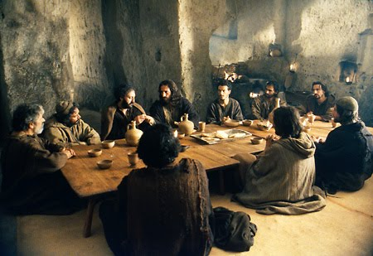

Slide 5
[Jesus] “rose from supper and laid aside His garments, took a towel and girded Himself. After that, He poured water into a basin and began to wash the disciples’ feet, and to wipe them with the towel with which He was girded.” John 13:4-5

Slide 6
“If I then, your Lord and Teacher, have washed your feet, you also ought to wash one another’s feet. For I have given you an example, that you should do as I have done to you.” John 13:14-15

Slide 7
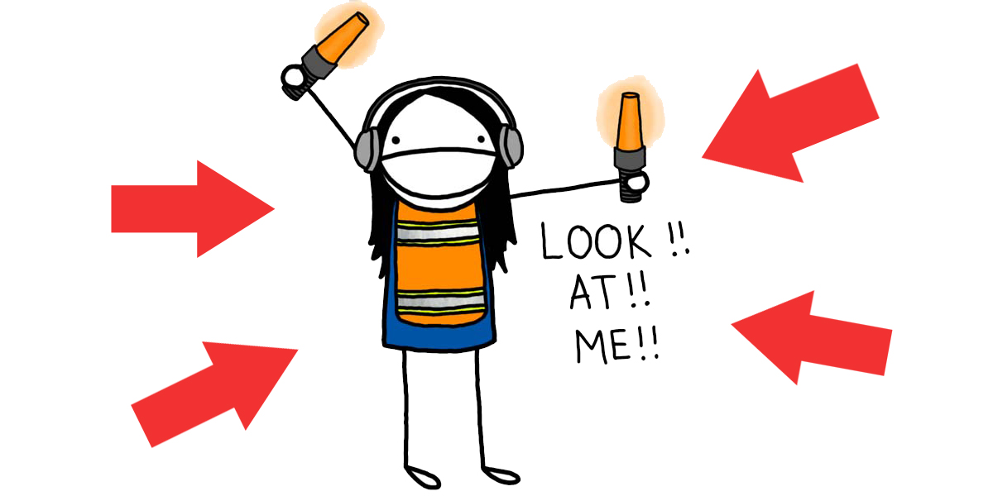
I’m a SERVANT!

Slide 8
I’m a SERVANT!

Slide 9
Service is something I DO because a slave is something I AM

Slide 10
“You know that those who are considered rulers over the Gentiles lord it over them, and their great ones exercise authority over them. Yet it shall not be so among you; but whoever desires to become great among you shall be your servant. And whoever of you desires to be first shall be slave of all. For even the Son of Man did not come to be served, but to serve, and to give His life a ransom for many.” Mark 10:42-45

Slide 11
Forced slavery vs “love slave”

Slide 12
“But if the servant plainly says, ‘I love my master, my wife, and my children; I will not go out free,’ then his master shall bring him to the judges. He shall also bring him to the door, or to the doorpost, and his master shall pierce his ear with an awl; and he shall serve him forever.” Exodus 21:5-6

Slide 13
“Let this mind be in you which was also in Christ Jesus, who, being in the form of God, did not consider it robbery to be equal with God, but made Himself of no reputation, taking the form of a bondservant, and coming in the likeness of men.” Philippians 2:5-7

Slide 14
Looking at others VS looking at God

Slide 15
Looking at others VS looking at God
Service in terms of size VS no small/big

Slide 16
Looking at others VS looking at God
Service in terms of size VS no small/big
Requires external rewards VS doesn’t see any need for reward

Slide 17
Looking at others VS looking at God
Service in terms of size VS no small/big
Requires external rewards VS doesn’t see any need for reward
Chooses who to serve VS slave of all

Slide 18
Chooses when to serve VS slave for life

Slide 19
Chooses when to serve VS slave for life
Job I do VS life I live

Slide 20
Chooses when to serve VS slave for life
Job I do VS life I live
Leads to division VS builds authentic community

Slide 21
KEY: knowing who I am & who He is
“Jesus, knowing that the Father had given all things into His hands, and that He had come from God and was going to God, rose from supper and laid aside His garments, took a towel and girded Himself.” John 13:3-4

Slide 22
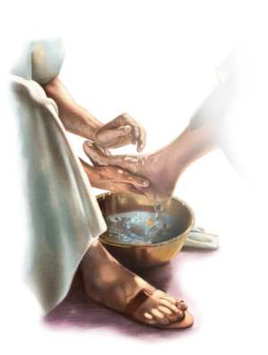
Your Homework
Prayer of a slave
One thing that no one sees except God

