Slide 1
Week 7: CELEBRATION

Slide 2
“Do not be afraid, for behold, I bring you good tidings of great joy which will be to all people.” Luke 2:10

Slide 3
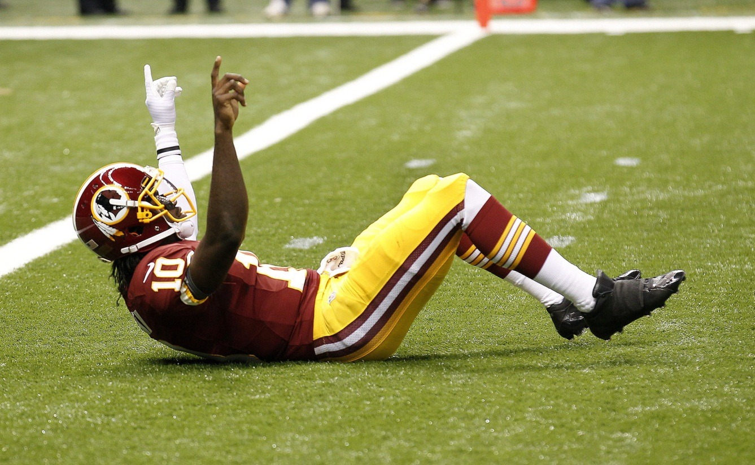
Celebration is the practice of bringing JOY into our lives

Slide 4
“For this is the love of God, that we keep His commandments. And His commandments are not burdensome.” 1 John 5:3

Slide 6
1. Practice seeing the good
through the bad

Slide 7
“And we know that all things work together for good to those who love God, to those who are called according to His purpose.” Romans 8:28

Slide 8
Shimei: "Come out! Come out! You bloodthirsty man, you rogue! The LORD has brought upon you all the blood of the house of Saul, in whose place you have reigned; and the LORD has delivered the kingdom into the hand of Absalom your son. So now you are caught in your own evil, because you are a bloodthirsty man!" 2 Samuel 16:7-8

Slide 9
Abishai: "Why should this dead dog curse my lord the king? Please, let me go over and take off his head!" 2 Samuel 16:9

Slide 10
David: "What have I to do with you, you sons of Zeruiah? So let him curse, because the LORD has said to him, "Curse David.' Who then shall say, "Why have you done so?...Let him alone, and let him curse; for so the LORD has ordered him. It may be that the LORD will look on my affliction, and that the LORD will repay me with good for his cursing this day.” 2 Samuel 16:10-12

Slide 11
“Weeping may remain for a night, but rejoicing comes in the morning.” Psalm 30:5

Slide 12
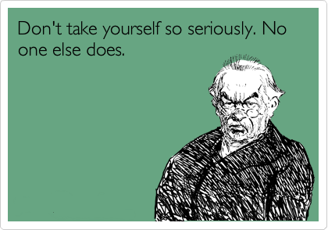
2. Practice taking yourself
less seriously

Slide 13
“It is true that some preach Christ out of envy and rivalry, but others out of goodwill. The latter do so in love, knowing that I am put here for the defense of the gospel. The former preach Christ out of selfish ambition, not sincerely, supposing that they can stir up trouble for me while I am in chains…

Slide 14
…But what does it matter? The important thing is that in every way, whether from false motives or true, Christ is preached. And because of this I rejoice.” Philippians 1:15-18

Slide 15
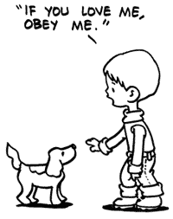
3. Practice a life of obedience

Slide 16
“Blessed is the womb that bore You, and the breasts which nursed You!” But He said, “More than that, blessed are those who hear the word of God and keep it!” Luke 11:27-28

Slide 17
“If you keep My commandments, you will abide in My love, just as I have kept My Father’s commandments and abide in His love. “These things I have spoken to you, that My joy may remain in you, and that your joy may be full.” John 15:10-11

Slide 18
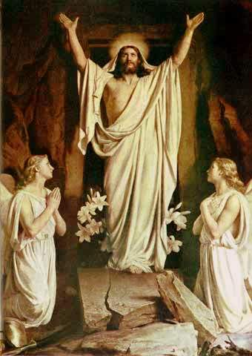
“The Christian should be an
alleluia from head to foot!”
St. Augustine of Hippo

