Slide 1
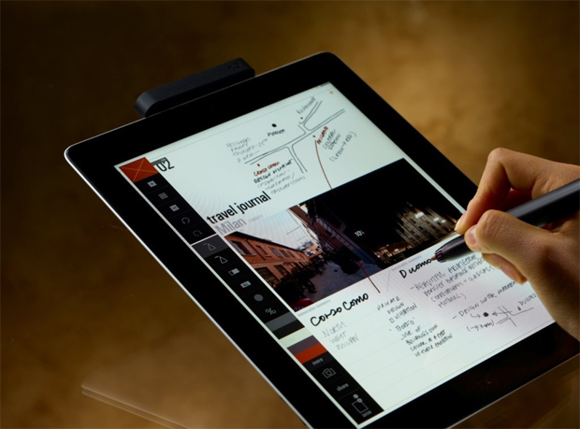
Get today’s handout on your iPad
Find wireless network: STSA Church
Go to STSAchurch.org/sermons

Slide 2
Harvesting Holiness
August 26, 2012
Part 5

Slide 3
GOD’S STANDARD
“But among you there must not be even a hint of sexual immorality, or of any kind of impurity, or of greed, because these are improper for God’s holy people.” Ephesians 5:3

Slide 4
The goal is not a quick fix, but rather long lasting transformation

Slide 5
Galatians 6:7-9
“Do not be deceived, God is not mocked; for whatever a man sows, that he will also reap. For he who sows to his flesh will of the flesh reap corruption, but he who sows to the Spirit will of the Spirit reap everlasting life. And let us not grow weary while doing good, for in due season we shall reap if we do not lose heart.”

Slide 6
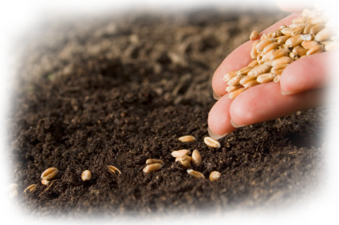
Your spiritual life today is a direct result of the seeds you planted before today

Slide 7
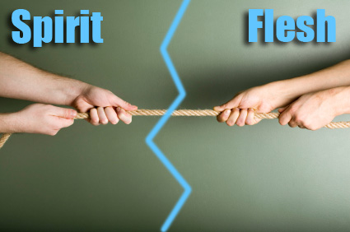
Are you sowing to the Spirit? Or sowing to the flesh?

Slide 8
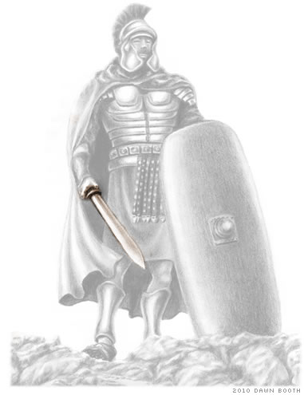
Ephesians 6:17
“And take…the sword of the Spirit, which is the word of God.”

Slide 9
The Word of God is the ONLY weapon that can fight off lust

Slide 10
Hebrews 4:12
“For the word of God is living and powerful, and sharper than any two-edged sword, piercing even to the division of soul and spirit, and of joints and marrow, and is a discerner of the thoughts and intents of the heart.”

Slide 11
2 Timothy 3:16-17
“All Scripture is given by inspiration of God, and is profitable for doctrine, for reproof, for correction, for instruction in righteousness, that the man of God may be complete, thoroughly equipped for every good work.”

Slide 12
LIE: “Lust is no big deal”

Slide 13
LIE: “Lust is no big deal”
TRUTH: “For that [LUST] would be wickedness; yes, it would be iniquity deserving of judgment. For that would be a fire that consumes to destruction, and would root out all my increase.” Job 31:11-12

Slide 14
LIE: “A little fantasizing won’t hurt”

Slide 15
LIE: “A little fantasizing won’t hurt”
TRUTH: “For to be carnally minded is death, but to be spiritually minded is life and peace.” Romans 8:6

Slide 16
LIE: “Relax, don’t make such a big deal out of sin”

Slide 17
LIE: “Relax, don’t make such a big deal out of sin”
TRUTH: “If your right eye causes you to sin, pluck it out and cast it from you; for it is more profitable for you that one of your members perish, than for your whole body to be cast into hell.” Matthew 5:29

Slide 18
LIE: “God is understanding and easy-going”

Slide 19
LIE: “God is understanding and easy-going”
TRUTH: “Therefore put to death your members which are on the earth: fornication, uncleanness, passion, evil desire, and covetousness, which is idolatry. Because of these things the wrath of God is coming upon the sons of disobedience” Colossians 3:5-6

Slide 20
LIE: “What I do with my own body is my business”

Slide 21
LIE: “What I do with my own body is my business”
TRUTH: “Flee sexual immorality… Or do you not know that your body is the temple of the Holy Spirit who is in you, whom you have from God, and you are not your own? For you were bought at a price; therefore glorify God in your body and in your spirit, which are God’s” 1 Corinthians 6:18-20

Slide 22
LIE: “I can’t control my lusts”

Slide 23
LIE: “I can’t control my lusts”
TRUTH: “For this is the will of God, your sanctification: that you should abstain from sexual immorality; that each of you should know how to possess his own vessel in sanctification and honor, not in passion of lust, like the Gentiles who do not know God” 1 Thessalonians 4:3-5

Slide 24
LIE: “A little look won’t kill”

Slide 25
LIE: “A little look won’t kill”
TRUTH: “Do not lust in your heart after her beauty or let her captivate you with her eyes… Can a man scoop fire into his lap without his clothes being burned?” Proverbs 6:25-27

Slide 26
LIE: “My lust is harmless; it has no consequences”

Slide 27
LIE: “My lust is harmless; it has no consequences”
TRUTH: “So then each of us shall give account of himself to God.” Romans 14:12

Slide 28
Psalm 119:9-11
“How can a young man keep his way pure? By living according to Your word… I have hidden your word in my heart that I might not sin against you.”

Slide 29
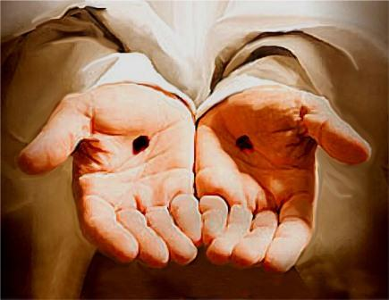
Whose promises will you believe?

Slide 30
Whose promises will you believe?
“In your presence is fullness of joy; at your right hand are pleasures forevermore.”
Psalm 16:11

