Slide 1
Week 5: Confession

Slide 2
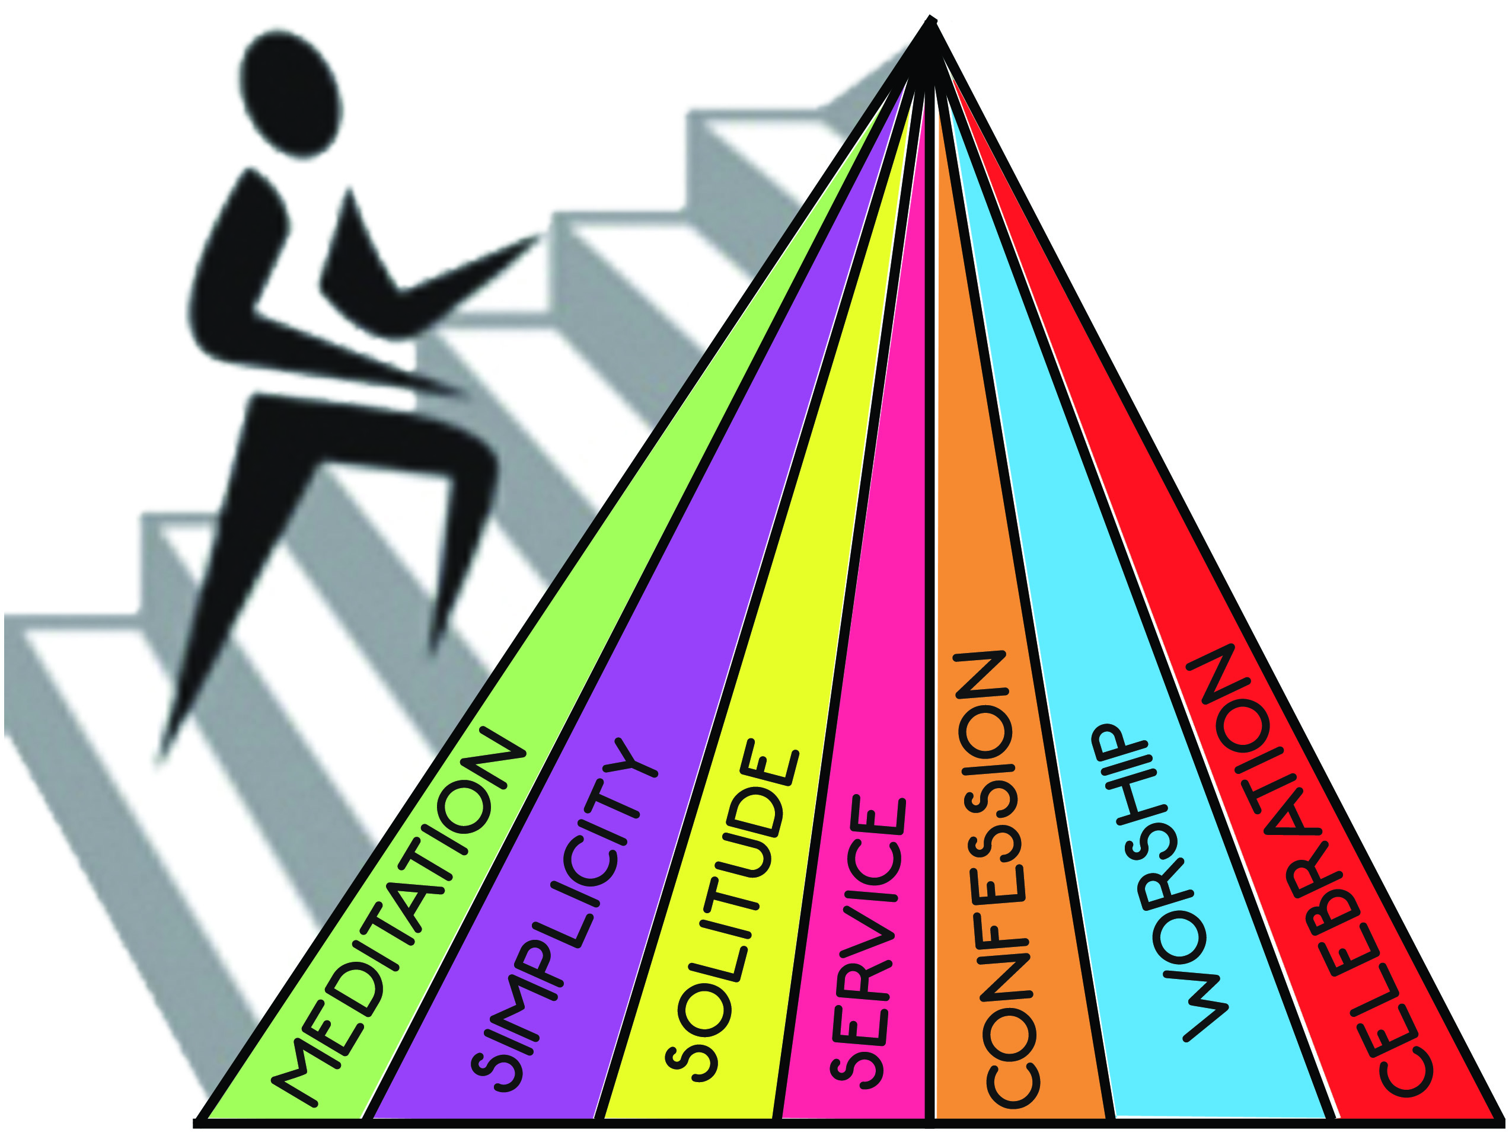

Slide 3
“For You, Lord, are good, and ready to forgive, and abundant in mercy to all those who call upon You.” Psalm 86:5

Slide 4
“Who is a God like You, pardoning iniquity and passing over the transgression of the remnant of His heritage? He does not retain His anger forever, because He delights in mercy. He will again have compassion on us, and will subdue our iniquities. You will cast all our sins into the depths of the sea.” Micah 7:18-19

Slide 5
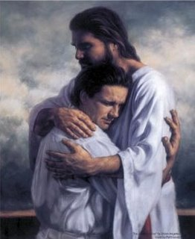
God’s greatest desire is to offer forgiveness

Slide 6
“For He made Him who knew no sin to be sin for us, that we might become the righteousness of God in Him.” 2 Corinthians 5:21

Slide 7
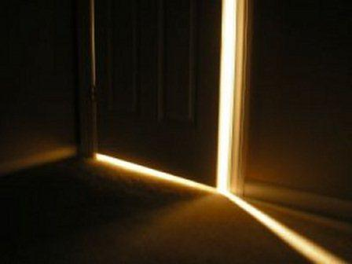
CONFESSION:
the doorway to forgiveness

Slide 8
Confession is the means by which we receive God’s forgiveness.

Slide 9
“work out your own salvation with fear and trembling” Philippians 2:12

Slide 10
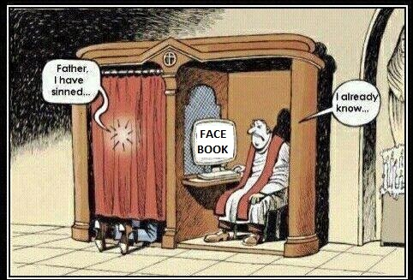
Why confess to a priest?

Slide 11
“Then, the same day at evening, being the first day of the week, when the doors were shut where the disciples were assembled… Jesus came and stood in the midst, and said to them… “Peace to you! As the Father has sent Me, I also send you.” And when He had said this, He breathed on them, and said to them, “Receive the Holy Spirit. If you forgive the sins of any, they are forgiven them; if you retain the sins of any, they are retained.” John 20:19-23

Slide 12
“And it shall be, when he is guilty in any of these matters, that he shall confess that he has sinned in that thing; and he shall bring his trespass offering to the Lord for his sin which he has committed… So the priest shall make atonement for him concerning his sin.” Leviticus 5:5-6

Slide 13
Church as fellowship of saints?
Or fellowship of sinners?

Slide 14
“Confess your trespasses to one another, and pray for one another, that you may be healed.” James 5:16

Slide 15
Tips for Getting Started

Slide 16
Tips for Getting Started
EXAMINE myself prayerfully

Slide 17
Tips for Getting Started
EXAMINE myself prayerfully
REPENT sincerely

Slide 18
Tips for Getting Started
EXAMINE myself prayerfully
REPENT sincerely
CHANGE practically

Slide 19
Tips for Getting Started
EXAMINE myself prayerfully
REPENT sincerely
CHANGE practically
CONFESS immediately

Slide 20
Tips for Getting Started
EXAMINE myself prayerfully
REPENT sincerely
CHANGE practically
CONFESS immediately
CELEBRATE God’s forgiveness joyfully

Slide 21
“I say to you that likewise there will be more joy in heaven over one sinner who repents than over ninety-nine just persons who need no repentance.” Luke 15:7

Slide 22
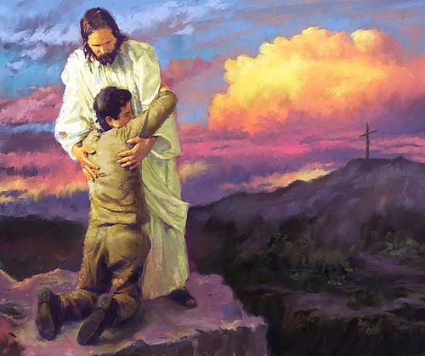
“For I will forgive their iniquity, and their sin I will remember no more.” Jeremiah 31:34

