Slide 1
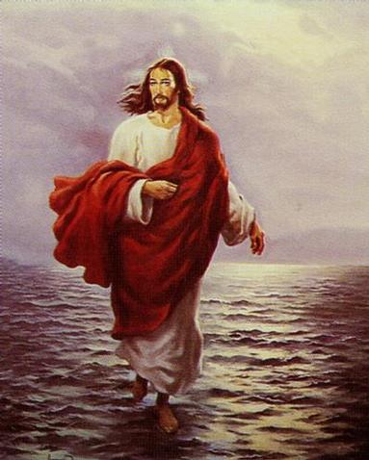
God? Or Man? Or All of the Above?
Back to Basics – Part 4
September 5, 2010

Slide 2
$500,000

Slide 3
God? Or Man? Or All of the Above?
Back to Basics – Part 4
September 5, 2010

Slide 4
$500,000

Slide 5
God? Or Man? Or All of the Above?
Back to Basics – Part 4
September 5, 2010

Slide 6
$500,000

Slide 7
God? Or Man? Or All of the Above?
Back to Basics – Part 4
September 5, 2010

Slide 8
“His Divinity parted not from His humanity for a single moment nor a twinkling of an eye…”

Slide 9
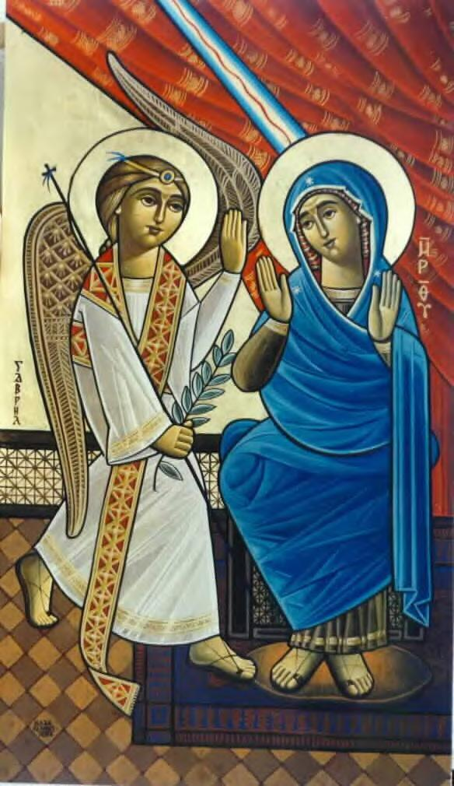
“His Divinity parted not from His humanity for a single moment nor a twinkling of an eye…”
HYPOSTATIC UNION

Slide 10
“…without controversy great is the mystery of godliness: God was manifested in the flesh,” 1 Timothy 3:16

Slide 11
The One Nature of the Incarnate Logos
St. Cyril of Alexandria

Slide 12
The One Nature of the Incarnate Logos
St. Cyril of Alexandria
“without mingling, confusion or alteration…”

Slide 13
The One Nature of the Incarnate Logos
St. Cyril of Alexandria
“without mingling, confusion or alteration…”
100% God
100% Man
100% of the time

Slide 14
Implications of this Nature

Slide 15
Implications of this Nature
He experienced a human LIFE
“And Jesus increased in wisdom and stature, and in favor with God and men.” Luke 2:52

Slide 16
Implications of this Nature
He experienced human EMOTIONS

Slide 17
Implications of this Nature
He experienced human EMOTIONS
“Jesus wept” John 11:35
“In that hour Jesus rejoiced in the Spirit…” Luke 10:21
“When Jesus heard it, He marveled…” Matt. 8:10

Slide 18
Implications of this Nature
He experienced human EMOTIONS
“And when He had looked around at them with anger, being grieved by the hardness of their hearts…” Mark 3:5

Slide 19
Implications of this Nature
He experienced human NEEDS
“Jesus therefore, being wearied from His journey, sat thus by the well.” John 4:6

Slide 20
Did He have two wills or one?

Slide 21
Did He have two wills or one?

Slide 22
Did He have two wills or one?
One Nature = One Will
“For I have come down from heaven, not to do My own will, but the will of Him who sent Me.” John 6:38

Slide 23
Did He have two wills or one?
One Nature = One Will
“But we have the mind of Christ.” 1 Corinthians 2:16

Slide 24
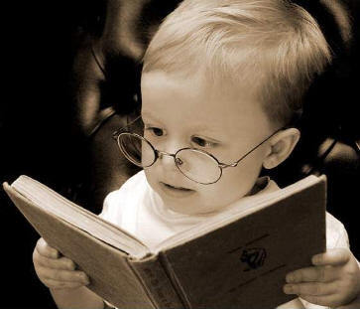
Not monophysites, but miaphysites

Slide 25
Why is this Important?

Slide 26
Why is this Important?
My SALVATION depends on it.

Slide 27
Why is this Important?
It revealed GOD to man.
“No one has seen God at any time. The only begotten Son, who is in the bosom of the Father, He has declared Him.” John 1:18
“He is the image of the invisible God” Colossians 1:15

Slide 28
Why is this Important?
It revealed MAN to man.
“I have come that they may have life, and that they may have it more abundantly.” John 10:10

Slide 29
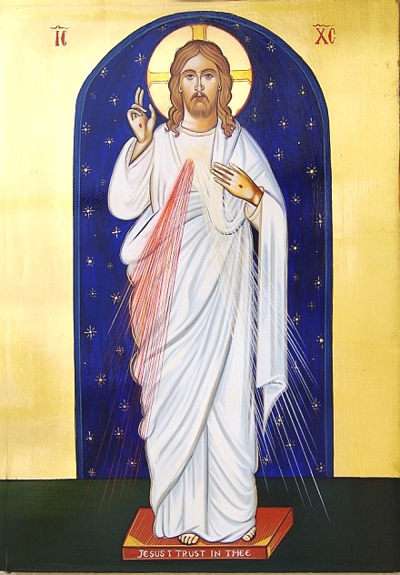
The Solution to the Divine Dilemma
“God became man so man could become God.”
St. Athanasius

