Slide 1
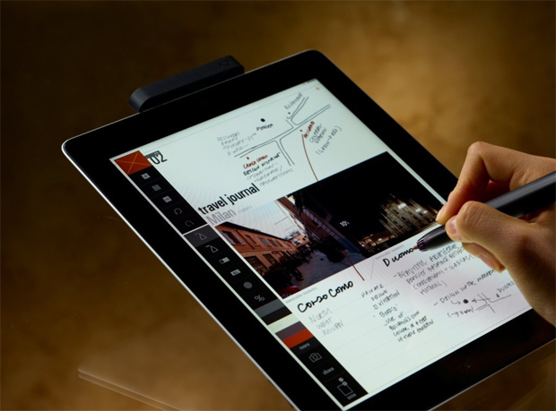
Get today’s handout on your iPad
Find wireless network: STSA Church
Go to TheWellAtSTSA.com

Slide 2
Lone Rangers are Dead Rangers
August 19, 2012
Part 4

Slide 3
GOD’S STANDARD
“But among you there must not be even a hint of sexual immorality, or of any kind of impurity, or of greed, because these are improper for God’s holy people.” Ephesians 5:3

Slide 4
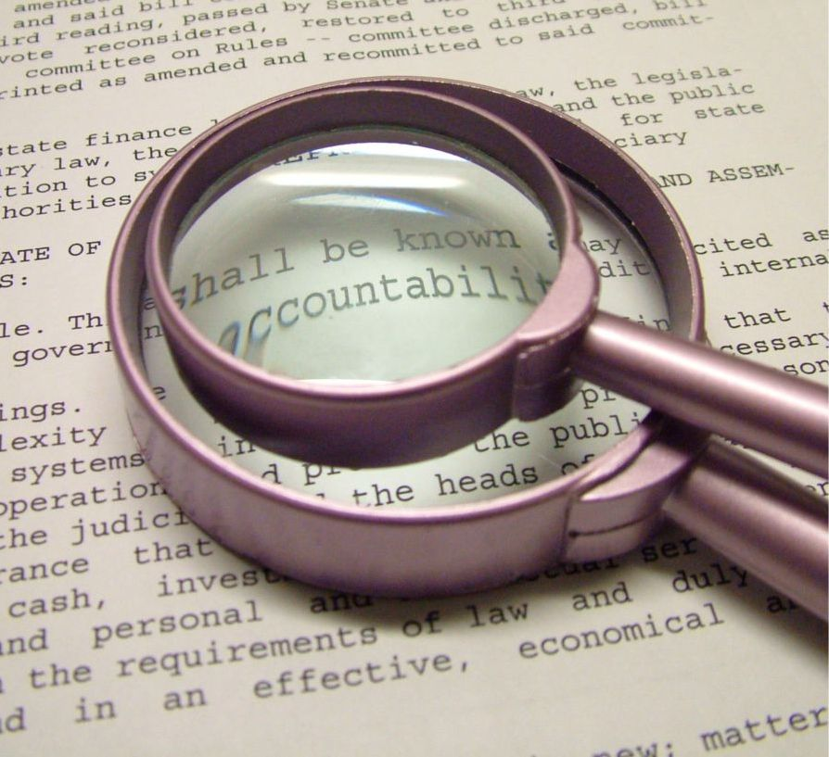

Slide 5
Ecclesiastes 4:9-10
“Two are better than one, because they have a good reward for their labor. For if they fall, one will lift up his companion. But woe to him who is alone when he falls, for he has no one to help him up.”

Slide 6
Matthew 7:14
“Because narrow is the gate and difficult is the way which leads to life, and there are few who find it.”

Slide 7
Do I really need to have an accountability partner?

Slide 8
Genesis 3:8-10
“And they heard the sound of the Lord God walking in the garden in the cool of the day, and Adam and his wife hid themselves from the presence of the Lord God among the trees of the garden. Then the Lord God called to Adam and said to him, “Where are you?” So he said, “I heard Your voice in the garden, and I was afraid because I was naked; and I hid myself.”

Slide 9
Repentance leads to forgiveness, but confession leads to healing
“Confess your trespasses to one another, and pray for one another, that you may be healed.” James 5:16

Slide 10
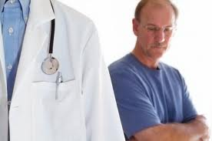
Revealing is the beginning of healing

Slide 11
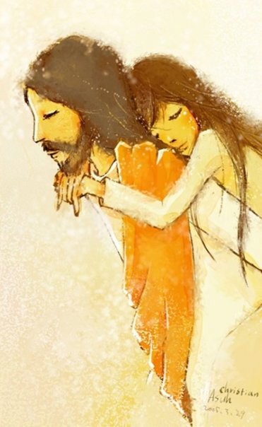
James 4:6
“God resists the proud, but gives grace to the humble.”

Slide 12
Defining Accountability

Slide 13
Defining Accountability
…offers challenge, not just sympathy

Slide 14
John 8:10-11
“When Jesus had raised Himself up and saw no one but the woman, He said to her, “Woman, where are those accusers of yours? Has no one condemned you?” She said, “No one, Lord.” And Jesus said to her, “Neither do I condemn you; go and sin no more.”

Slide 15
Defining Accountability
…requires specific confession, not general confession

Slide 16
Proverbs 28:13
“He who covers his sins will not prosper”

Slide 17
Defining Accountability
…needs consistent/scheduled follow up

Slide 18
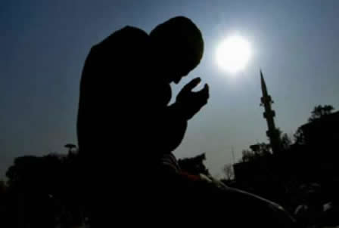
Defining Accountability
Don’t confuse confession with repentance

Slide 19
Psalm 51:4
“Against you, you only, have I sinned and done what is evil in your sight”

Slide 20
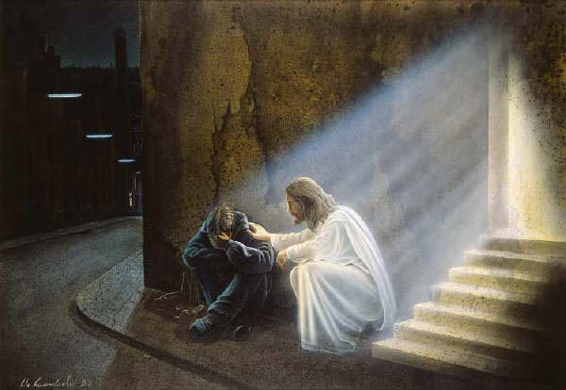
Watch out for FEAR!

Slide 21
Allow yourself to be held accountable, because accountability before man is a stepping stone to integrity before God.

