Slide 1
The Mystery of Unanswered Prayer
Part 2

Slide 2
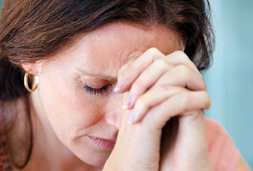

Slide 3
Job 30:20
“I cry out to You, but You do not answer me”
Psalm 22:2
“O My God, I cry in the daytime, but You do not hear”

Slide 4
KEY POINT: God wants to answer your prayers
Memory verse: “Call to Me, and I will answer you, and show you great and mighty things, which you do not know.’ Jeremiah 33:3

Slide 5
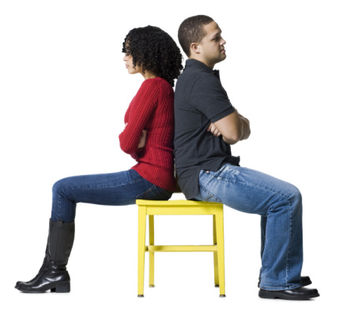
1. Your relationships matter

Slide 6
Mark 11:24-25
“Therefore I say to you, whatever things you ask when you pray, believe that you receive them, and you will have them. And whenever you stand praying, if you have anything against anyone, forgive him, that your Father in heaven may also forgive you your trespasses.”

Slide 7
1 Peter 3:7
“Husbands, likewise, dwell with them with understanding, giving honor to the wife, as to the weaker vessel, and as being heirs together of the grace of life, that your prayers may not be hindered.”

Slide 8
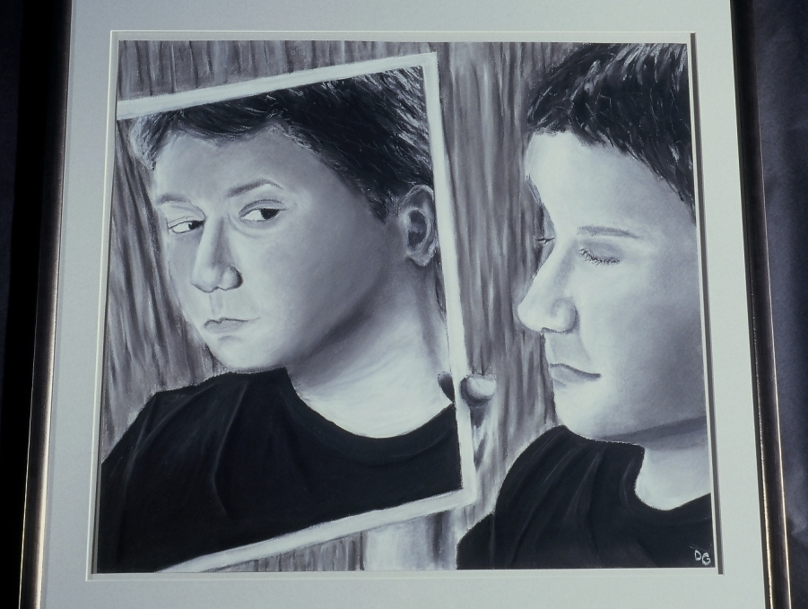
2. Your motives matter

Slide 9
James 4:3
“You ask and do not receive, because you ask amiss, that you may spend it on your pleasures.”

Slide 10
Proverbs 16:2
“All a man's ways seem innocent to him, but motives are weighed by the LORD.”

Slide 11
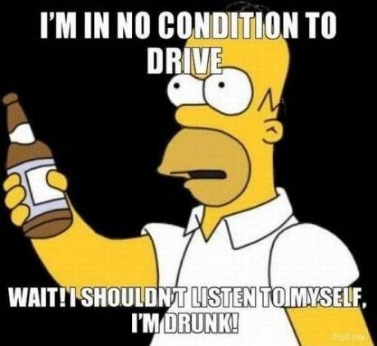
3. The way you live matters

Slide 12
James 5:16
“The effective, fervent prayer of a righteous man avails much.”

Slide 13
Proverbs 15:29
“The LORD is far from the wicked but he hears the prayer of the righteous.”

Slide 14
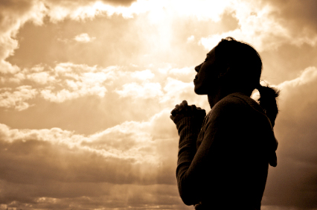
4. Your faith matters

Slide 15
James 1:6-7
“But let him ask in faith, with no doubting, for he who doubts is like a wave of the sea driven and tossed by the wind. For let not that man suppose that he will receive anything from the Lord.”

Slide 16
Matthew 9:28-30
“And when He had come into the house, the blind men came to Him. And Jesus said to them, “Do you believe that I am able to do this?” They said to Him, “Yes, Lord.” Then He touched their eyes, saying, “According to your faith let it be to you.” And their eyes were opened.”

Slide 17
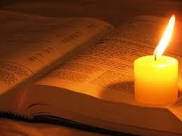
5. God’s will matters

Slide 18
1 John 5:14-15
“Now this is the confidence that we have in Him, that if we ask anything according to His will, He hears us. And if we know that He hears us, whatever we ask, we know that we have the petitions that we have asked of Him.”

Slide 19
2 Corinthians 12:8-9
“Concerning this thing I pleaded with the Lord three times that it might depart from me. And He said to me, “My grace is sufficient for you, for My strength is made perfect in weakness.”

Slide 20
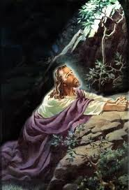
“Father, if it is Your will, take this cup away from Me; nevertheless not My will, but Yours, be done.”
Luke 22:42

Slide 21
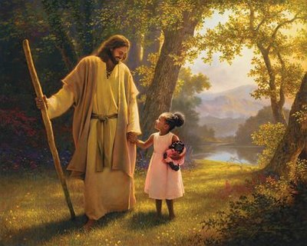
The ultimate conversation isn’t about answers; it’s about intimacy.

