Slide 1
Week 1: Meditation

Slide 3
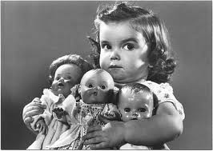
The opposite of simplicity? COVETOUSNESS

Slide 4
“Take heed and beware of covetousness, for one’s life does not consist in the abundance of the things he possesses.” Luke 12:15
“Let your conduct be without covetousness; be content with such things as you have.” Hebrews 13:5

Slide 5
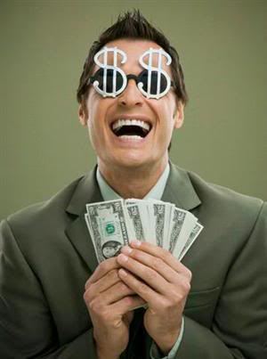

Slide 6
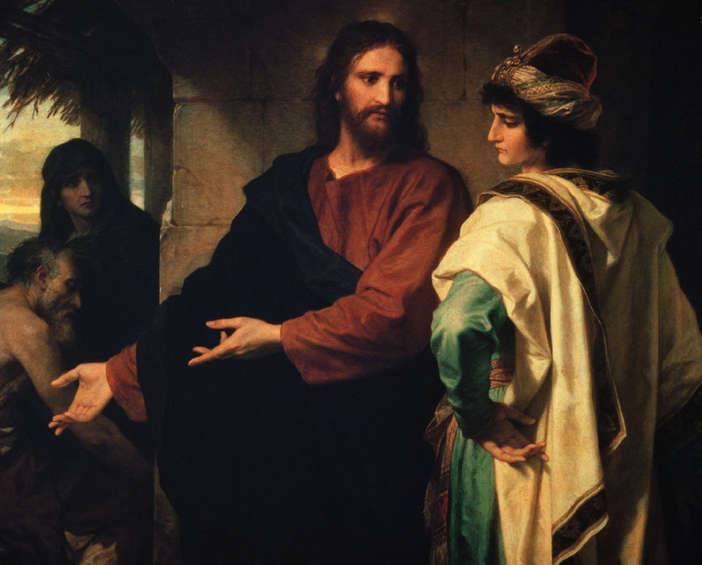

Slide 7
“And you shall count seven sabbaths of years for yourself, seven times seven years; and the time of the seven sabbaths of years shall be to you forty-nine years. Then you shall cause the trumpet of the Jubilee to sound on the tenth day of the seventh month; on the Day of Atonement you shall make the trumpet to sound throughout all your land…

Slide 8
… And you shall consecrate the fiftieth year, and proclaim liberty throughout all the land to all its inhabitants. It shall be a Jubilee for you; and each of you shall return to his possession, and each of you shall return to his family… Therefore you shall not oppress one another, but you shall fear your God; for I am the Lord your God.” Leviticus 25:8-10,17

Slide 9
“The land must not be sold permanently, because the land is mine and you reside in my land as foreigners and strangers.” Leviticus 25:23

Slide 10
“So you shall observe My statutes and keep My judgments, and perform them; and you will dwell in the land in safety. Then the land will yield its fruit, and you will eat your fill, and dwell there in safety.” Leviticus 25:18-19

Slide 11
What we have, we receive as a gift

Slide 12
What we have, we receive as a gift
What we have is to be cared for by God

Slide 13
What we have, we receive as a gift
What we have is to be cared for by God
What we have is available to others

Slide 14
“For the Lord your God is bringing you into a good land…a land in which you will eat bread without scarcity, in which you will lack nothing… [Beware lest] you say in your heart, ‘My power and the might of my hand have gained me this wealth.’” Deuteronomy 8:7-9, 17

Slide 15
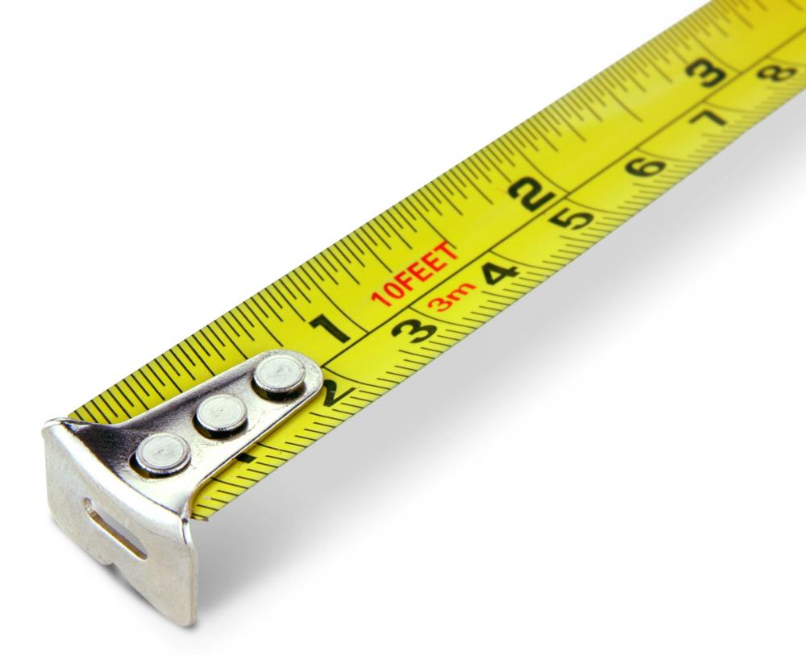
The Measure of Simplicity

Slide 16
“Therefore I say to you, do not worry about your life, what you will eat or what you will drink; nor about your body, what you will put on. Is not life more than food and the body more than clothing? Look at the birds of the air, for they neither sow nor reap nor gather into barns; yet your heavenly Father feeds them. Are you not of more value than they? Which of you by worrying can add one cubit to his stature?

Slide 17
“So why do you worry about clothing? Consider the lilies of the field, how they grow: they neither toil nor spin; and yet I say to you that even Solomon in all his glory was not arrayed like one of these. Now if God so clothes the grass of the field, which today is, and tomorrow is thrown into the oven, will He not much more clothe you, O you of little faith?

Slide 18
“Therefore do not worry, saying, ‘What shall we eat?’ or ‘What shall we drink?’ or ‘What shall we wear?’ For after all these things the Gentiles seek. For your heavenly Father knows that you need all these things. But seek first the kingdom of God and His righteousness, and all these things shall be added to you.” Matthew 6:25-33

Slide 19
Measure of Simplicity: LEVEL OF ANXIETY
“Therefore do not worry about tomorrow, for tomorrow will worry about its own things. Sufficient for the day is its own trouble.”
Matthew 6:34

Slide 20
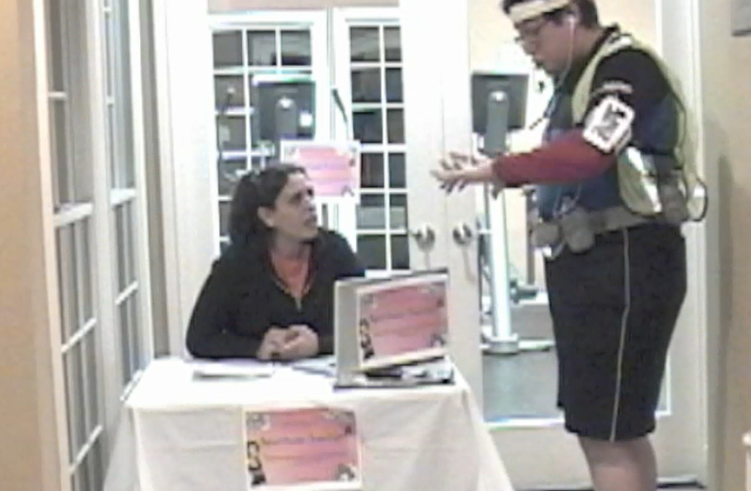
The Practice of Simplicity

Slide 21
Buy things for usefulness rather than status

Slide 22
Buy things for usefulness rather than status
Reject anything that is producing an addiction

Slide 23
Buy things for usefulness rather than status
Reject anything that is producing an addiction
Develop habit of giving stuff away

Slide 24
Beware of the “latest and greatest”

Slide 25
Beware of the “latest and greatest”
Buy only what you can afford

Slide 26
Beware of the “latest and greatest”
Buy only what you can afford
Reject anything that distracts you from seeking the kingdom first

Slide 27
“But those who desire to be rich fall into temptation and a snare, and into many foolish and harmful lusts which drown men in destruction and perdition. For the love of money is a root of all kinds of evil, for which some have strayed from the faith in their greediness, and pierced themselves through with many sorrows.” 1 Timothy 6:9-10

Slide 28
“Take heed and beware of covetousness, for one’s life does not consist in the abundance of the things he possesses.”
Luke 12:15

