Slide 1
Week 1: Meditation

Slide 3
Week 1: Meditation

Slide 4
Our greatest problem today?

Slide 5
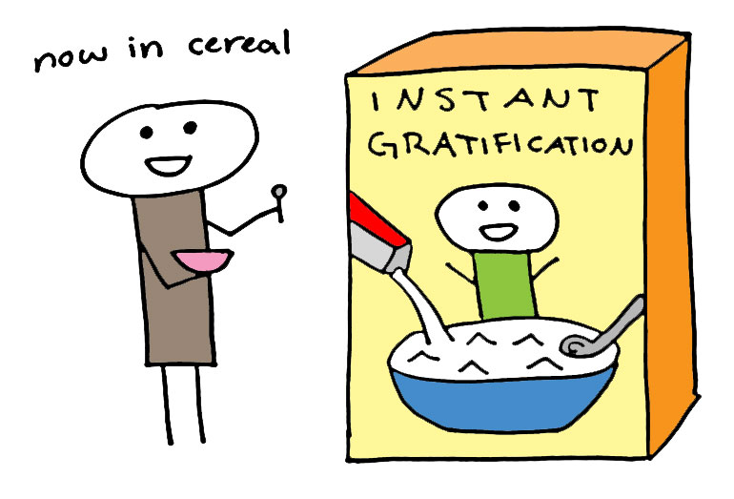
SUPERFICIALITY

Slide 6
The Path of Disciplined Grace
Meditation
Simplicity
Solitude
Worship
Service
Confession
Celebration

Slide 7
Goal is not to escape the world, but to live with the power of God in the world

Slide 8
“For what I am doing, I do not understand. For what I will to do, that I do not practice; but what I hate, that I do… But now, it is no longer I who do it, but sin that dwells in me. For I know that in me (that is, in my flesh) nothing good dwells; for to will is present with me, but how to perform what is good I do not find.”

Slide 9
…For the good that I will to do, I do not do; but the evil I will not to do, that I practice. Now if I do what I will not to do, it is no longer I who do it, but sin that dwells in me… O wretched man that I am! Who will deliver me from this body of death?” Romans 7:15-24

Slide 10
“Therefore, if you died with Christ from the basic principles of the world, why, as though living in the world, do you subject yourselves to regulations — “Do not touch, do not taste, do not handle,” which all concern things which perish with the using — according to the commandments and doctrines of men.”

Slide 11
…These things indeed have an appearance of wisdom in self-imposed religion, false humility, and neglect of the body, but are of no value against the indulgence of the flesh.” Colossians 2:20-23

Slide 12
WILLPOWER DOESN’T WORK

Slide 13
Righteousness comes through grace.
Grace is made available through the disciplines.

Slide 14
KEY VERSE: “For he who sows to his flesh will of the flesh reap corruption, but he who sows to the Spirit will of the Spirit reap everlasting life.” Galatians 6:8

Slide 15
MEDITATION The Art of Slowing Down

Slide 16
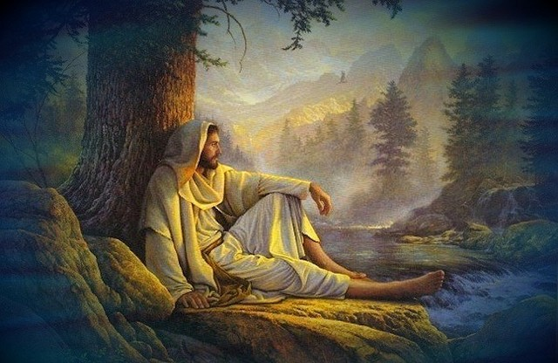
“When Jesus heard what had happened, he withdrew by boat privately to a solitary place.” Matthew 14:13

Slide 17
Meditation is the process of hearing and obeying God’s voice

Slide 18
“So the Lord spoke to Moses face to face, as a man speaks to his friend.” Exodus 33:11

Slide 19
“For the Lord takes pleasure in His people” Psalm 149:4

Slide 20
“For the Lord takes pleasure in His people” Psalm 149:4
GOD LIKES YOU!

Slide 21
Meditation is where we deepen our relationship with God

Slide 22
“Behold, I stand at the door and knock. If anyone hears My voice and opens the door, I will come in to him and dine with him, and he with Me.” Revelation 3:20

Slide 23
Tips for Getting Started

Slide 24
Tips for Getting Started
Set a specific time

Slide 25
Tips for Getting Started
Set a specific time
Choose a proper place

Slide 26
Tips for Getting Started
Set a specific time
Choose a proper place
Have a plan

Slide 27
Tips for Getting Started
Set a specific time
Choose a proper place
Have a plan
Prepare for obstacles

Slide 28
“And let us not grow weary while doing good, for in due season we shall reap if we do not lose heart.” Galatians 6:9

Slide 29
“Now all the people witnessed the thunderings, the lightning flashes, the sound of the trumpet, and the mountain smoking; and when the people saw it, they trembled and stood afar off. Then they said to Moses, “You speak with us, and we will hear; but let not God speak with us, lest we die.” Exodus 20:18-18

Slide 30
“And the Lord said to Samuel, “Heed the voice of the people in all that they say to you; for they have not rejected you, but they have rejected Me, that I should not reign over them.” 1 Samuel 8:7

Slide 31
Start with desire not technique
“My sheep hear My voice, and I know them, and they follow Me. And I give them eternal life, and they shall never perish; neither shall anyone snatch them out of My hand.” John 10:27-28

