Slide 1
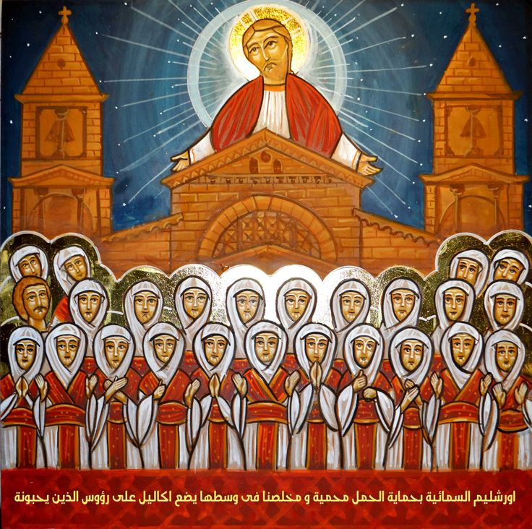
On the Unity of the Church According to St Cyprian of Carthage
Servants meeting 11/29/2017

Slide 2
Novatian
After the martyrdom of Pope Fabian during the Decian persecution, a Roman priest, Novatian, opposed the election of Pope Cornelius in 251, on the grounds that Cornelius was too liberal in accepting lapsed Christians. Novatian held that lapsed Christians, who had not maintained their confession of faith under persecution, may not be received again into communion with the church. He was consecrated bishop by three bishops of Italy and presented himself as Bishop of Rome. He and his followers were excommunicated by a synod held at Rome in October of the same year. Novatian is said to have suffered martyrdom under the Emperor Valerian I (253–60).

Slide 3
The Unity of the spirit
¹ I, therefore, the prisoner of the Lord, beseech you to walk worthy of the calling with which you were called, ² with all lowliness and gentleness, with longsuffering, bearing with one another in love, ³ endeavoring to keep the unity of the Spirit in the bond of peace. ⁴ There is one body and one Spirit, just as you were called in one hope of your calling; ⁵ one Lord, one faith, one baptism; ⁶ one God and Father of all, who is above all, and through all, and in you all. Eph 4:1-4

Slide 4
Who is the Church St Cyprian , ANF V., 305.
The Church is founded upon the bishop and established upon the clergy and all those who stand fast in the faith.

Slide 5
Trinitarian unity A. d' Alès. La Théologie de St. Cyprien (Paris: Gabriel Beauchesne, 1922), 100
“to break the peace and the concord of Christ (in the Church) is to try to break the unity of the divine Trinity itself.”

Slide 6
Sacramental unity St Cyprian , ANF V.,423,6.
The unity of the Church comes from the divine strength and coheres in celestial sacraments, that is why, whoever does not hold this unity, does not hold God's law, does not hold the faith of the Father and of the Son, does not hold life and salvation.”

Slide 7
Repentance St. Cyprian
“When once you have departed this life, there is no longer any place for repentance, no way of making satisfaction. Here, life is either lost or kept. Here, by the worship of God and by the fruit of faith, provision is made for eternal salvation. Let no one be kept back either by his sins or by his years from coming to obtain salvation. To him who still remains in this world, there is no repentance that is too late.

Slide 8
Eucharistic Unity (On the Lord's Prayer, 18)
"Christ is the bread of those who are in union with His body. And we ask that this bread should be given to us daily, that we who are in Christ, and daily receive the Eucharist for the food of salvation, may not, by the interposition of some heinous sin, by being prevented, as withheld and not communicating, from partaking of the heavenly bread, be separated from Christ's body, ….And therefore we ask that our bread— that is, Christ— may be given to us daily, that we who abide and live in Christ may not depart from His sanctification and body"

Slide 9
Harmony, concord and Charity The Theology of St. Cyprian of Carthage: The Unity of the Church and the Role of the Bishop Theodor Damian, p95
Harmony is a fundamental characteristic of the Church. This is harmony, concord, and simplicity between flock and shepherd, and also between the people of God, who dwell in one mind and one heart in the house of God. One of the important means of the unity of the Church is charity. Charity, according to St. Cyprian, is solidarity and recapitulation of the divine mystery of the Holy Trinity.

Slide 10
Christological Unity The Theology of St. Cyprian of Carthage: The Unity of the Church and the Role of the Bishop Theodor Damian, p96
The Church is profoundly Christological: one Christ, one Church, one divine unity under the authority of the One Lord. Nobody and nothing can separate the Church, the people who faithfully believed in what they received from Christ. If the unity of the Church is the unity of Christ, to break the Church's unity is to violate Christ's love for His Church.

Slide 11
Mutual Obedience in Love The Theology of St. Cyprian of Carthage: The Unity of the Church and the Role of the Bishop Theodor Damian, p96
To obey the great commandment of Jesus, the love for God and for neighbor, means to be in the unity of the body of Christ. There is no unity without mutual obedience in love. The love of neighbor commended to us by Jesus is a basis for the unity of the Church. Division in the Church comes when people do not seek the source of truth, the Head, the Christ, the Heavenly Master.

Slide 12
Personal qualities inside the communion The Theology of St. Cyprian of Carthage: The Unity of the Church and the Role of the Bishop Theodor Damian, p96
For Cyprian rank, dignity, or social position do not matter. The word “Christian” cannot be applied to anyone who is not in the Church. He specifies that the prayers and sacrifice, even a martyrdom which is not made in the unity of the Church are of no use. The quality of the Christian is given by the communion with the whole body of Christ, it is not given by the personal qualities outside of this communion.

Slide 13
The bishops are cemented in the same life and teaching The Theology of St. Cyprian of Carthage: The Unity of the Church and the Role of the Bishop Theodor Damian, p96
The whole body of bishops are in communion when they teach and initiate actions in the Church of Christ and this is the way in which they remain firmly in “the unity and charity of the Catholic Church.” The bishops are so strongly cemented together in the same life and teaching that if one of them would be inclined to heretical teaching or to do whatever would divide the flock of Christ, all other bishops would step in to help him to stay in the communion of the Church.

Slide 14
Christ is the primal truth who brings liberation Joseph T. Lienhard. The Bible, the Church, and Authority. (Collegeville, MN: The Liturgical Press, 1995), 75.
Real authority is not an arbitrary exercise of power since it is generated by truth; that is why it is not an end in itself but a means to achieve freedom. The primal truth in the Christian Church is Jesus Christ who brings about liberation and who is the source of all ecclesial authority.

Slide 15
Liturgy OF St Basil
Make us all worthy, O our Master, to partake of Your holies, unto the purification of our souls, our bodies, and our spirits; That we become one body and one spirit, and may have a share and an inheritance with all the saints who have pleased You since the beginning.

Slide 16
St Cyprian A. Roberts and Y. Donaldson, ed., The Ante-Nicene Fathers, vol. V (Grand Rapids, MI: Wm. B. Eerdmans Publishing Company, 1986), 289
“O, blessed Church of ours, which the honor of the divine condescension illuminates, which in our own times the glorious blood of martyrs renders illustrious! She was white before in the work of the brethren, now she has become purple in the blood of the martyrs.”

