Slide 1
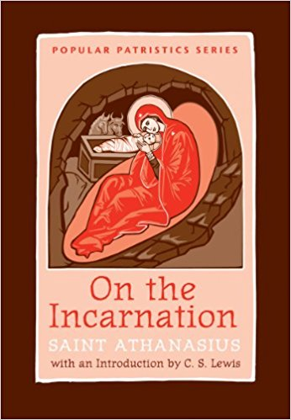
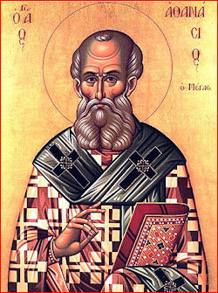
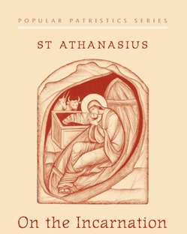
Talk III
The Death and the resurrection of Christ (20-32)
Wednesday 12.20.17

Slide 2
Points covered in Talk 1
Introduction
Ch. 1,2
Ch. 3
Ch. 4-10
How we pray it.
How we live it.

Slide 3
1. Chapters 1 & 2
Introduction and putting the base of his Treatise. Ch. 1
Refuting the wrong theories on the Creation:
Some say that all things have come into being spontaneously and as by chance, such as the Epicureans
Others, amongst whom is Plato, that giant among the Greeks, declare that God made the universe from preexistent and uncreated matter.
Others, again, from the heretics fabricate for themselves another creator of all things besides the Father of our Lord Jesus Christ. (Gnostics) Ch. 2

Slide 4
Summary of CH. 3
General Grace to all creation
Additional Grace to man
A law and a Set Place
All creation was made out of nothing
(ex-nihilio)
The Grace of Creation
Man was created according to the image of God
The Addititional Grace
God Secured the Additional Grace with
a law and a set place

Slide 5
2. The Creation (ch. 3)
He created all things out of nothing (ex-nihilio) by his Grace through the Son
Special (additional ) Grace is given to human beings to be the divine icon (according to the Image of God)
God secured this Grace by a Law and a set place..
The Life in paradise is for those who guarded their additional grace.

Slide 6
3. More related Topics to the Divine Dilemma
CH. 4-10
The connection between the creation and the incarnation. Ch. 4
The power of the Word in us and how we lost it. Ch. 5
God is Good. Ch. 6
He can not lie
He can not leave his creation to corruption and death
Why repentance is not enough? Ch. 7
It does not preserve the consistency of God
It will not restore man to the additional Grace
He took what is our and gave us what is His. Ch 8,9
In His Incarnation is the dissolution of Death and the resurrection of Life. CH. 10

Slide 7
Points covered in Talk II
The two ways of expressing His Love
He bestowed upon us His own image to know the Father
Man’s rejection to the Additional grace and its consequences
He sent the low and the prophets
So he rightly took a mortal body
The image of the Father came to renew us
We needed God the Word
He is not a man Only but a God
His works testify to His divinity

Slide 8
Points to Be covered
He alone can do it
The paradox
The Grace of the Resurrection
He did not die out of human weakness
He accepted death coming from us
He died in public to confirm his death and resurrection
Why the Cross?
Why he is risen on the third day
The irrefutable proof of His Resurrection

Slide 9
HE alone can do it
We have spoken above in part, as far as was possible and as far as we were able to understand, the cause of his bodily manifestation, that it was not for another to turn what was corruptible to incorruptibility except the Savior himself, who in the beginning created the universe from nothing; and that it was not for another to recreate again the “in the image” for human beings, except the Image of the Father; and that it was not for another to raise up the mortal to be immortal, except our Lord Jesus Christ, who is Life itself. 20:1

Slide 10
The paradox
And thus it happened that both things occurred together in a paradoxical manner: the death of all was completed in the lordly body, and also death and corruption were destroyed by the Word in it. For there was need of death, and death on behalf of all had to take place, so that what was required by all might occur. 20:5

Slide 11
The Grace of the Resurrection
Indeed, with the common Savior of all dying for us, we, the faithful in Christ, no longer die by death as before according to the threat of the law, for such condemnation has ceased. But with corruption ceasing and being destroyed by the grace of the resurrection, henceforth according to the mortality of the body we are dissolved only for the time which God has set for each, that we may be able “to attain a better resurrection’ (Heb 11.35) 21:1

Slide 12
He did not die out of human weakness
For this reason also diseases come upon them, and, weakening, they die. But the Lord is not weak, but the Power of God, and the Word of God, and himself Life. If, then, it was in some private place that he laid his body upon a bed in the manner of human beings, it would have been supposed that he also suffered this through the weakness of nature and because he had nothing more than other humans. But since he was Life, and Word of God, and because death on behalf of all had to take place, therefore, on the one hand, as being life and power he strengthened the body in him, and as, on the other hand, death had to occur, he took the occasion, provided not from himself but from others, to complete the sacrifice. 21:5,6

Slide 13
He accepted death coming from us
Such action did not show weakness on the part of the Word, but rather made him known to be Savior and Life, in that he both waited for death to destroy it and hastened to complete the death given to him for the salvation of all. And, besides, it was not his own death that the Savior came to complete, but that of human beings. Therefore he did not lay aside the body by his own death—for he had none, being Life—but he accepted that death coming from human beings, in order to destroy it completely when it came to his own body. 22:2,3

Slide 14
He died in public to confirm his death and resurrection
But if, without any illness and without any pain, he had hidden his body away by itself privately and “in a corner” (Acts 26.26), or in a desert place or a house or anywhere at all, and afterwards suddenly appearing again said he had raised himself from the dead, he would have been supposed by all to be telling tall tales and would have been distrusted even more when speaking about the resurrection, as there would be no one at all to witness to his death. 23: 1

Slide 15
Humiliating death Vs The Trophy of his victory
So something wonderful and marvelous happened: that humiliating death which they thought to inflict, this was the trophy of his victory over death. Therefore he neither endured the death of John by being beheaded, nor as Isaiah was he sawn in part, that in death he might keep his body undivided and whole and that there be no pretext for those wishing to divide the Church. 24:4

Slide 16
Why the Cross? 1. to bear the curse which lay upon us
For if he came himself to bear the curse which lay upon us, how else could he have “become a curse” (Gal 3.13) if he had not accepted the death occasioned by the curse? And that is the cross, for thus it is written, “cursed is he who hangs from the tree” (Deut 21.23). Moreover, if the death of the Lord is a ransom for all and by his death “the wall of partition” (Eph 2.14) is broken down, and the call of the Gentiles effected, how would he have called us if he had not been crucified? For only upon the cross does one die with hands stretched out. 25:2

Slide 17
2. To unite Jews and gentiles
Therefore it was fitting for the Lord to endure this, and to stretch out his hands, that with the one he might draw the ancient people and with the other those from the Gentiles, and join both together in himself. This he himself said when he indicated by what manner of death he was going to redeem all, “ When I am lifted up, I shall draw all to myself (Jn 12.32) 25:3, 4

Slide 18
3. To over through the devil and purify the air
And again, if the enemy of our race, the devil, having fallen from heaven, wanders around these lower airs and, lording it here over the demons with him, similar in disobedience, through them works illusions in those who are deceived and attempts to prevent them rising upwards—about this the Apostle also says, “Following the prince of the power of the airy who is now at work in the sons of disobedience” (Eph 2.2) —yet Christ came that he might overthrow the devil, purify the air, and open up for us the way to heaven, as the Apostle said, “through the veil, that is, his flesh” (Heb 10.20), 25:5

Slide 19
Why he is risen on the third day
He could have raised the body immediately upon death and shown it alive again, but foreseeing well the Savior did not do this. For someone might have said that he had not died at all, or that death had not fully touched him, if he had shown the resurrection immediately. Had the interval between death and resurrection been within the same day, the glory of incorruptibility would have been obscure. 26: 2,3,4

Slide 20
The consequences of His resurrection 1.New concept of Death after His resurrection
And the proof of this is that human beings, before believing in Christ, view death as fearsome and are terrified at it. But when they come to faith in him and to his teaching, they so despise death that they eagerly rush to it and become witnesses to the resurrection over it effected by the Savior. 27:2

Slide 21
2. The snake and the Lion
For one who sees a snake trampled down, especially if he knows its former ferocity, no longer doubts that it is dead and completely weakened, unless he is perverted in mind and does not have even his bodily senses sound. For who, seeing a lion being played with by children, does not know that it is either dead or has lost all its power? Just as it is possible for the eye to see that these things are true, so when death is played with and despised by those believing in Christ, let no one any longer doubt, nor be unbelieving, that death has been destroyed by Christ and its corruption dissolved and brought to an end. 29:5

Slide 22
The irrefutable proof of His Resurrection
For since the Savior works so many things among human beings, and daily in every place invisibly persuades such a great multitude, both from those who dwell in Greece and in the foreign lands, to turn to his faith and all to obey his teaching, would anyone still have doubt in their mind whether the resurrection has been accomplished by the Savior, and whether Christ is alive, or rather is himself the Life? 30:4

Slide 23
The Temple of Life
Or what kind of end should befall the body, once the Word had come to it? It was unable not to die, since it was mortal and offered to death on behalf of all, for which purpose the Savior had prepared it for himself. But it could not remain dead, because it had become the temple of life. So, it died as mortal, but came again to life because of the life which is in it; and the works are a proof of the resurrection. 31:4

Slide 24
Points to Be covered
He alone can do it
The paradox
The Grace of the Resurrection
He did not die out of human weakness
He accepted death coming from us
He died in public to confirm his death and resurrection
Why the Cross?
Why he is risen on the third day
The irrefutable proof of His Resurrection

