Slide 1
Offering Better, not More
Second Sunday of Mesra
August 14, 2011
Luke 5:27-39

Slide 2
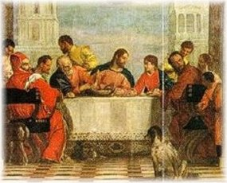

Slide 3
He offered what Jesus wanted

Slide 4
He knew who he was trying to please

Slide 5
He knew who he was trying to please
“And the world is passing away, and the lust of it; but he who does the will of God abides forever.” 1 John 2:17

Slide 6
He knew who he was trying to please
“Why do you trouble the woman? For she has done a good work for Me.” Matthew 26:10

Slide 7
“Bondservants, be obedient to those who are your masters according to the flesh, with fear and trembling, in sincerity of heart, as to Christ; not with eyeservice, as men-pleasers, but as bondservants of Christ, doing the will of God from the heart, with goodwill doing service, as to the Lord, and not to men, knowing that whatever good anyone does, he will receive the same from the Lord, whether he is a slave or free. And you, masters, do the same things to them, giving up threatening, knowing that your own Master also is in heaven, and there is no partiality with Him.” Ephesians 6:5-9

Slide 8
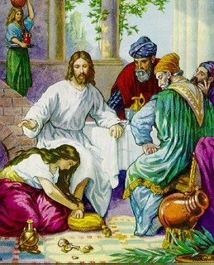
Make offering to Jesus

Slide 9
“Two men went up to the temple to pray, one a Pharisee and the other a tax collector. The Pharisee stood and prayed thus with himself, `God, I thank You that I am not like other men--extortioners, unjust, adulterers, or even as this tax collector. `I fast twice a week; I give tithes of all that I possess.' And the tax collector, standing afar off, would not so much as raise his eyes to heaven, but beat his breast, saying, `God, be merciful to me a sinner!’” Luke 18:10-13

Slide 10
Offer better, not more
“And whatever you do, do it heartily, as to the Lord and not to men”
Colossians 3:23

