Slide 1
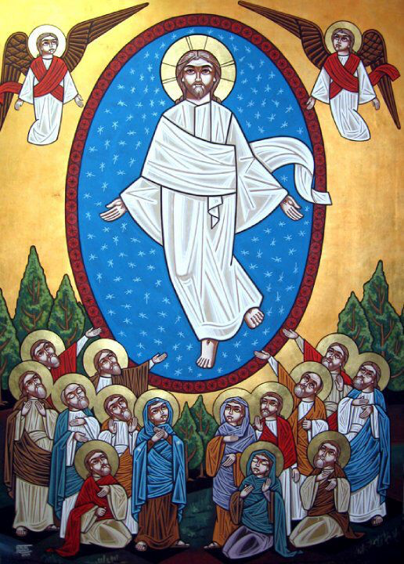
Newness of Life (5)
The Mountains’ way

Slide 2
Newness of Life
Therefore we were buried with Him through baptism into death, that just as Christ was raised from the dead by the glory of the Father, even so we also should walk in newness of life. Rom 6:4

Slide 3
Newness of Life
New Creation
The Bread of Life and obedience
Leave your waterpot
Light and Blindness
The Mountains’ Way

Slide 4
Leaping upon the Mountains Following Him
The voice of my beloved! Behold, he comes Leaping upon the mountains, Skipping upon the hills…My beloved spoke, and said to me: “Rise up, my love, my fair one, And come away. Song 2:8,10

Slide 5
Scholar Origen
The one who wants to meet the Word of God on the mountains and on the hills has at first meet Him on the highly mountains of the New Testament books and on the hills of the Old Testament books, which were hidden for long time.

Slide 6
Mountains of Bether (Fighting the separation)
My beloved is mine, and I am his. He feeds his flock among the lilies. Until the day breaks And the shadows flee away, Turn, my beloved, And be like a gazelle Or a young stag Upon the mountains of Bether. Song 2:16,17

Slide 7
the mountain of myrrh (bearing the Cross)
Until the day breaks, And the shadows flee away, I will go my way to the mountain of myrrh And to the hill of frankincense. Song 4:6

Slide 8
The mountains of the leopards (Fighting Sin)
Come with me from Lebanon, my spouse, With me from Lebanon. Look from the top of Amana, From the top of Senir and Hermon, From the lions’ dens, From the mountains of the leopards. Son 4:8

Slide 9
St Gregory of Nyssa
The Bridegroom calling her to cross with Him from the lions’ dens and from the mountains of the leopards means that sin is a wild beast like a lion or a leopard. Man has been transformed from this sinful nature, but the Bridegroom fears lest His bride goes back to sin. Therefore, He calls her to put off the old man. This is a call for continuous struggle in the life of faith

Slide 10
The mountains of spices (Full Death and Full Life)
Make haste, my beloved, And be like a gazelle Or a young stag On the mountains of spices. Son 8:14

Slide 11
Fr Tadros Malaty
His haste coming on the mountains of spices reminds us of the spices with which the Lord Jesus was buried. He meets with her when she is buried with Him, for every day she dies with Him so she may live forever with Him.

Slide 12
Application
Following Him
Fighting separation
Bearing the cross
Fighting sin
Full death and Full life

Slide 13
St. Cyril of Alexandria
[He desires for us a unity with each other, like the unity of the Holy Trinity. This should be reflected on the unity of the believers.]
On St. John. Book 2, ch.2

