Slide 1
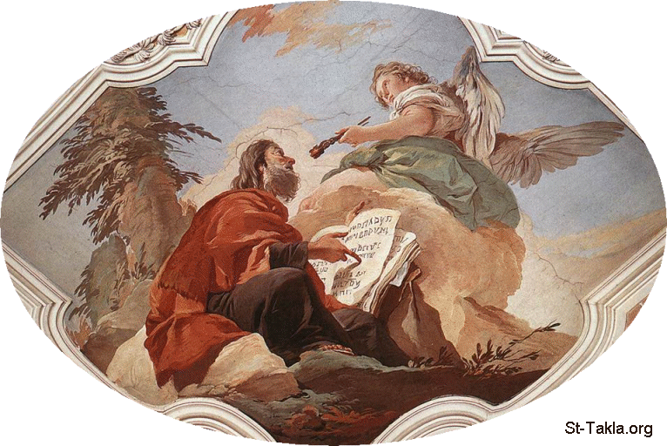
Newness of Life (4)
Light and Blindness

Slide 2
Newness of Life
Therefore we were buried with Him through baptism into death, that just as Christ was raised from the dead by the glory of the Father, even so we also should walk in newness of life. Rom 6:4

Slide 3
Newness of Life
New Creation
The Bread of Life and obedience
Leave your waterpot
Light and Blindness

Slide 4
Light VS Darkness
Then Jesus said to them, “A little while longer the light is with you. Walk while you have the light, lest darkness overtake you; he who walks in darkness does not know where he is going. While you have the light, believe in the light, that you may become sons of light.” Jn 12:35,36

Slide 5
What a blindness!!!
“He has blinded their eyes and hardened their hearts, Lest they should see with their eyes, Lest they should understand with their hearts and turn, So that I should heal them.” Jn 12:40

Slide 6
He saw His Glory !
These things Isaiah said when he saw His glory and spoke of Him. Jn 12:41

Slide 7
St. John Chrysostom
“What do the word mean ‘to see and yet not see? They are able to see how the demons get out, and say there is a demon in him. They are able also to see those risen from the dead, and yet not worship him, they rather plot how to kill him.’”

Slide 8
The Calling !
But we are bound to give thanks to God always for you, brethren beloved by the Lord, because God from the beginning chose you for salvation through sanctification by the Spirit and belief in the truth, to which He called you by our gospel, for the obtaining of the glory of our Lord Jesus Christ. 2 Thes 2:13,14

Slide 9
The Sign
By this we know that we abide in Him, and He in us, because He has given us of His Spirit. 1 Jn 4:13

Slide 10
He Returned to Lystra
Then Jews from Antioch and Iconium came there; and having persuaded the multitudes, they stoned Paul and dragged him out of the city, supposing him to be dead. However, when the disciples gathered around him, he rose up and went into the city. And the next day he departed with Barnabas to Derbe. And when they had preached the gospel to that city and made many disciples, they returned to Lystra, Iconium, and Antioch, Acts 14:19-21

Slide 11
The Voice of Rejoicing
The LORD is my strength and song, And He has become my salvation. The voice of rejoicing and salvation Is in the tents of the righteous; The right hand of the LORD does valiantly. Ps 118:14,15

Slide 12
Application
Check where do you stand
Check your actions
Check your Love
Check that you are pursuing The Light

