Slide 1
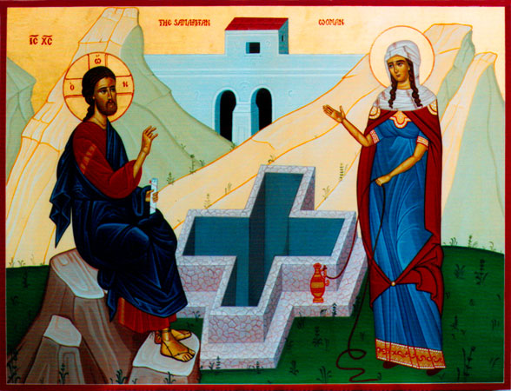
Newness of Life (3)
The Old Has Gone

Slide 2
Newness of Life
Therefore we were buried with Him through baptism into death, that just as Christ was raised from the dead by the glory of the Father, even so we also should walk in newness of life. Rom 6:4

Slide 3
Newness of Life
New Creation
The Bread of Life and obedience
The Old Has Gone

Slide 4
Augustine St. Augustine: On the Gospel of St. John, tractate 15:30
Having received the Lord Jesus Christ into her heart, what else could she do but abandon her waterpot and run to preach the Gospel? She banished lust and hurried to proclaim the truth. May those who wish to preach the Gospel learn to abandon their waterpot at the well.

Slide 5
Her old has gone !!
28 The woman then left her waterpot, went her way into the city, and said to the men, 29 “Come, see a Man who told me all things that I ever did. Could this be the Christ?” Jn 4:28,29

Slide 6
Scholar Origen
This is all what this Samaritan woman had done: she had a relationship with five husbands, then she got involved with a sixth man who was not her legal husband, and finally she renounced that last man, abandoned her waterpot, and rested reverently on a Saturday.

Slide 7
If Then !!!
If then you were raised with Christ, seek those things which are above, where Christ is, sitting at the right hand of God. Set your mind on things above, not on things on the earth. Col 3:1,2

Slide 8
Put off and on !!
Do not lie to one another, since you have put off the old man with his deeds, and have put on the new man who is renewed in knowledge according to the image of Him who created him, Col 3:9,10

Slide 9
Passed from death to life
We know that we have passed from death to life, because we love the brethren. He who does not love his brother abides in death. 1Jn 3:14

Slide 10
A commandment !
42 And He commanded us to preach to the people, and to testify that it is He who was ordained by God to be Judge of the living and the dead. 43 To Him all the prophets witness that, through His name, whoever believes in Him will receive remission of sins.” Acts 10

Slide 11
A real need !
Then they said to the woman, “Now we believe, not because of what you said, for we ourselves have heard Him and we know that this is indeed the Christ, the Savior of the world.” Jn 4:42

Slide 12
Origen Commentary on John, Book 13:352.
In fact it is better to be an eyewitness of the Word and listen to Him without using the physical members or allowing the interference of teachers. He teaches and presents images to the mind to reveal the truth more clearly. It is better for a person to hear Him than to listen to a report about Him through the servants who saw Him, for the person who does not hear Him personally or see Him is not covered by His power.

Slide 13
Application
Check your waterpot
Check your husband
Check your mission
check that you are seeking things from above

